Slide 1
Phonics
&
Early Maths
Workshop
1st October 2025

Slide 2
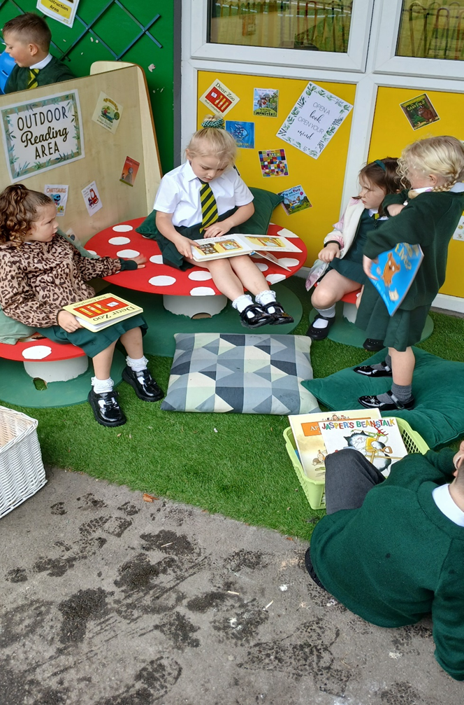
Reading Skills
Reading is not just about words on a page.
It involves a range of skills.
Have a go at this short passage

Slide 3
What skills were needed?
Without realising you will have used a range of reading skills to decipher the meaning of the text and read the unfamiliar words.
-comprehension skills
-ability to decode unfamiliar words
-knowledge of grammar
-structural knowledge of text
- knowledge of traditional tales
-
-prediction skills

Slide 4
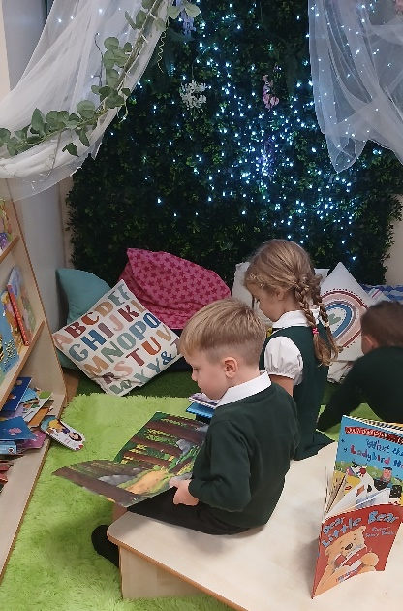
The Importance of Reading
It’s about the entire experience for a child not
just using their phonics.
As a parent you can provide something very special:
-a relaxed, comfortable environment
-1:1 attention and focus
- a real purpose for reading e.g. labels in the shops, bedtime stories to help with the bedtime routine, comics/magazines for fun/leisure.

Slide 5

Reading at Home
Reading together creates a nurturing environment where children can develop language skills, vocabulary, and a love for books.
Research shows that when families read together, it not only enhances children's literacy skills but also strengthens emotional bonds.

Slide 6
The Foundations of Early Reading.
Phonics is used in school to support children to develop a number of skills :
- Decode words
Spell words
Expand vocabulary
Comprehension skills
Independence/confidence when reading.

Slide 7
Phonic Terminology
Phoneme
Grapheme
Digraph
Trigraph
Split digraph
Blending
Segmenting

Slide 8
Phase 1 (Nursery)
There are 7 aspects:
A1 – Environmental
A2 – Instrumental sounds
A3 – Body Percussion
A4 – Rhythm and rhyme
A5 – Alliteration
A6 – Voice sounds
A7 – Oral blending and segmenting.

Slide 9
Phase 2
Set 1: s, a, t, p
Set 2: i, n, m, d
Set 3: g, o, c, k
Set 4: ck, e, u, r
Set 5: h, b, f, ff, l, ll, ss

Slide 10
Phase 3
Set 6: j, v, w, x
Set 7: y, z, zz, qu
Consonant digraphs: ch, sh, th, ng
Vowel digraphs: ai, ee, oa, oo, ar, or, ur, ow, oi, er
Trigraphs: igh, ear, air, ure

Slide 11
Phase 4
This phase consolidates all the children have learnt in the previous phases through practising skills such as blending, segmenting and phoneme-grapheme correspondence.
This phase also encourages children to apply learned letter sounds by blending and segmenting longer words with adjacent consonants and polysyllabic words.

Slide 12
Segmenting
Breaking down words into their individual sounds for spelling.
cat
c a t

Slide 13
Segmenting
queen
qu ee n

Slide 14
Blending
Building words from phonemes to read.
c a t
cat

Slide 15
Blending
qu ee n
queen

Slide 16
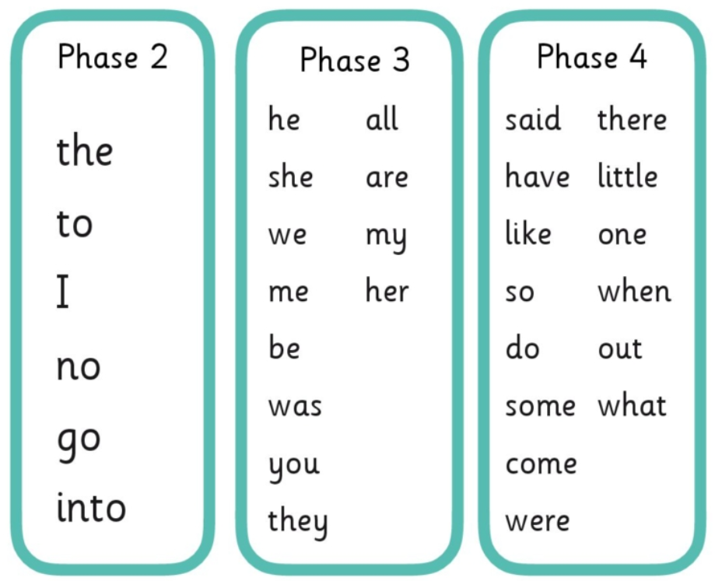
Tricky words

Slide 17
What is the point of phonics?
Phonics is the step up to word recognition, allowing fluency
when reading.
It enables children to automatically read words-both decodable and
tricky.

Slide 18
What does a Phonics lesson look like?
Revisit/review | Practise phonemes taught so far (flashcards)
Teach | Introduce a new sound for example the trigraph air.
Practise | Practise blending and segmenting words with the new sound. This could be done through a game like Buried Treasure for example using the following real and nonsense words: air, zair, fair, hair, lair, pair, vair, sair, thair
Apply | Apply the learning to reading or writing sentences for example: Read the caption: Sit on the chair and feel the air! Or Write the sentence: The pair went to the fair.

Slide 19
Supporting your child at home.
Support your child daily by talking about the new sound that they have learnt that day.
Help them to complete their daily phonics activity.
If you are unsure of how to articulate the sounds correctly, there are many useful resources online
such as:
-Jolly Phonics Songs (youtube)
-Mr Thorne does phonics (youtube)
Or alternatively just ask.

Slide 20
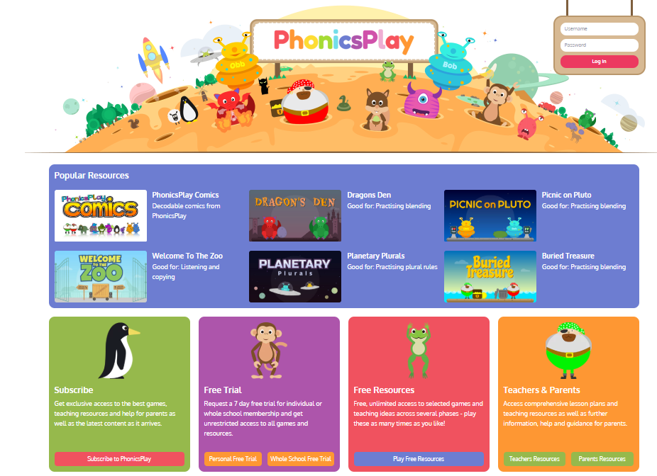
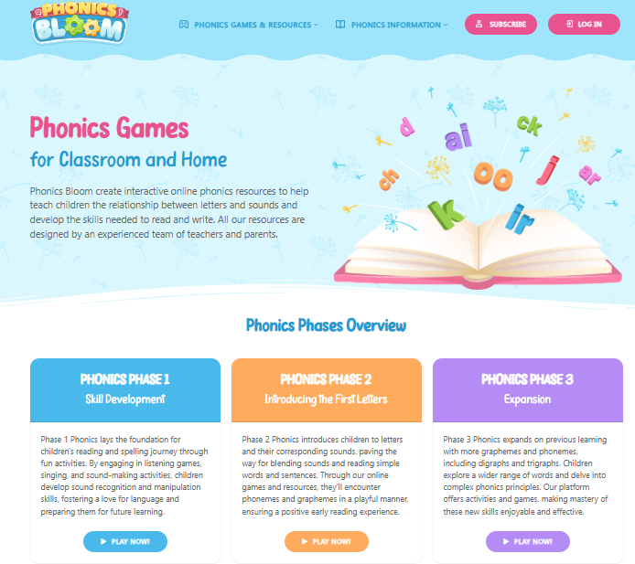
Resources

Slide 21
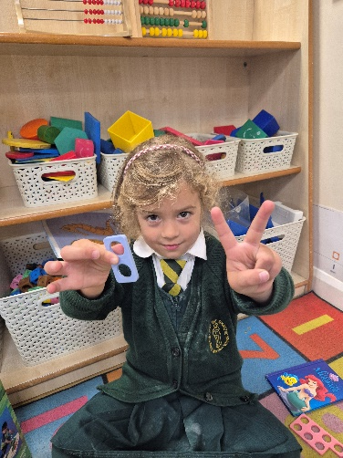
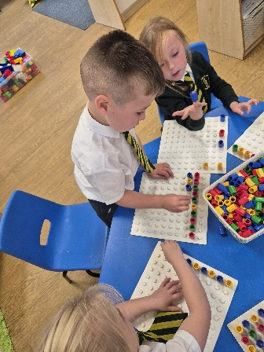
What does Maths look like in EYFS?
Understanding Early Years Maths (Ages 0-5)
Focuses on developing a strong foundation in:
  Number: counting, recognising numbers, understanding quantity.
  Numerical patterns: comparing quantities, understanding more/less
Taught through play-based, hands-on learning

Slide 22
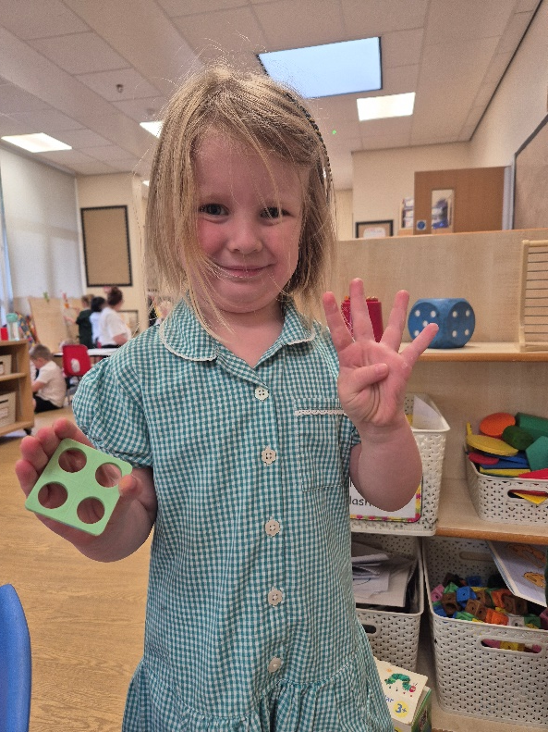
Why Maths in the Early Years Matters
Building blocks for lifelong learning
Supports problem-solving and critical thinking
Encourages curiosity and confidence with numbers
Develops vocabulary (e.g., big/small, more/less, first/last)

Slide 23
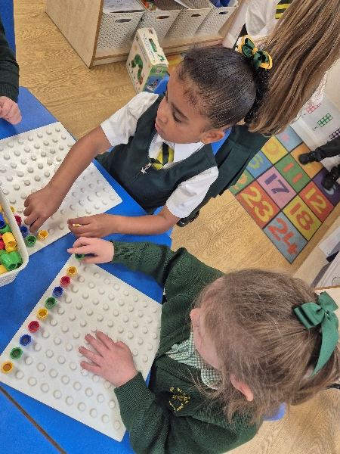
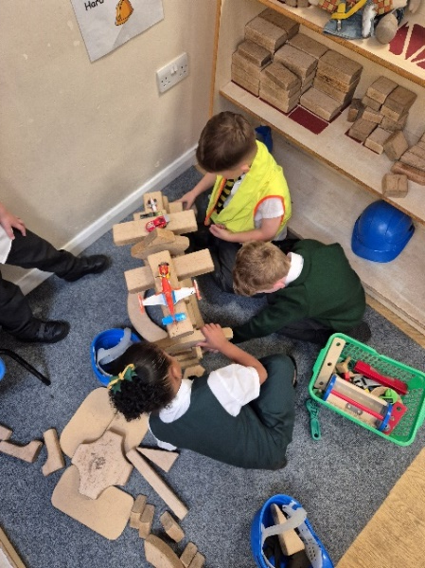
How You Can Help at Home
Everyday Maths Moments
Count steps, fruit, or toys together
Talk about size, shape, and patterns in daily life
Play number games (e.g. board games, puzzles)
Involve them in cooking: measuring, counting ingredients
Sing number rhymes and songs
Go on number hunts.
When out and about - point out shapes and patterns.

Slide 24




Support our school by joining the PTA 200 club. Details on Newsletter (website). We have places available in a number of our year groups. If you know of any families looking for a school place please ask them to contact school. We have an Early Years Open Day scheduled (website) and offer guided tours at times that suit parents.
Photographs from our busy school life are posted on the website (Latest News).
You can also follow everything that happens here at school on social media @ologprestwich
Please take the time to complete the Parent Feedback Questionnaire. Your views are important to us.

