Slide 1

Welcome
Sacramental Programme Parent Meeting 1
1st October 2025

Slide 2


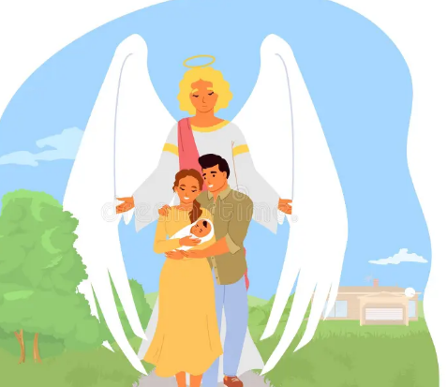

Headteacher Introduction
Home – School - Parish

Slide 3


Mrs Sinclair, Mrs Alou & Mrs Poole

Slide 4

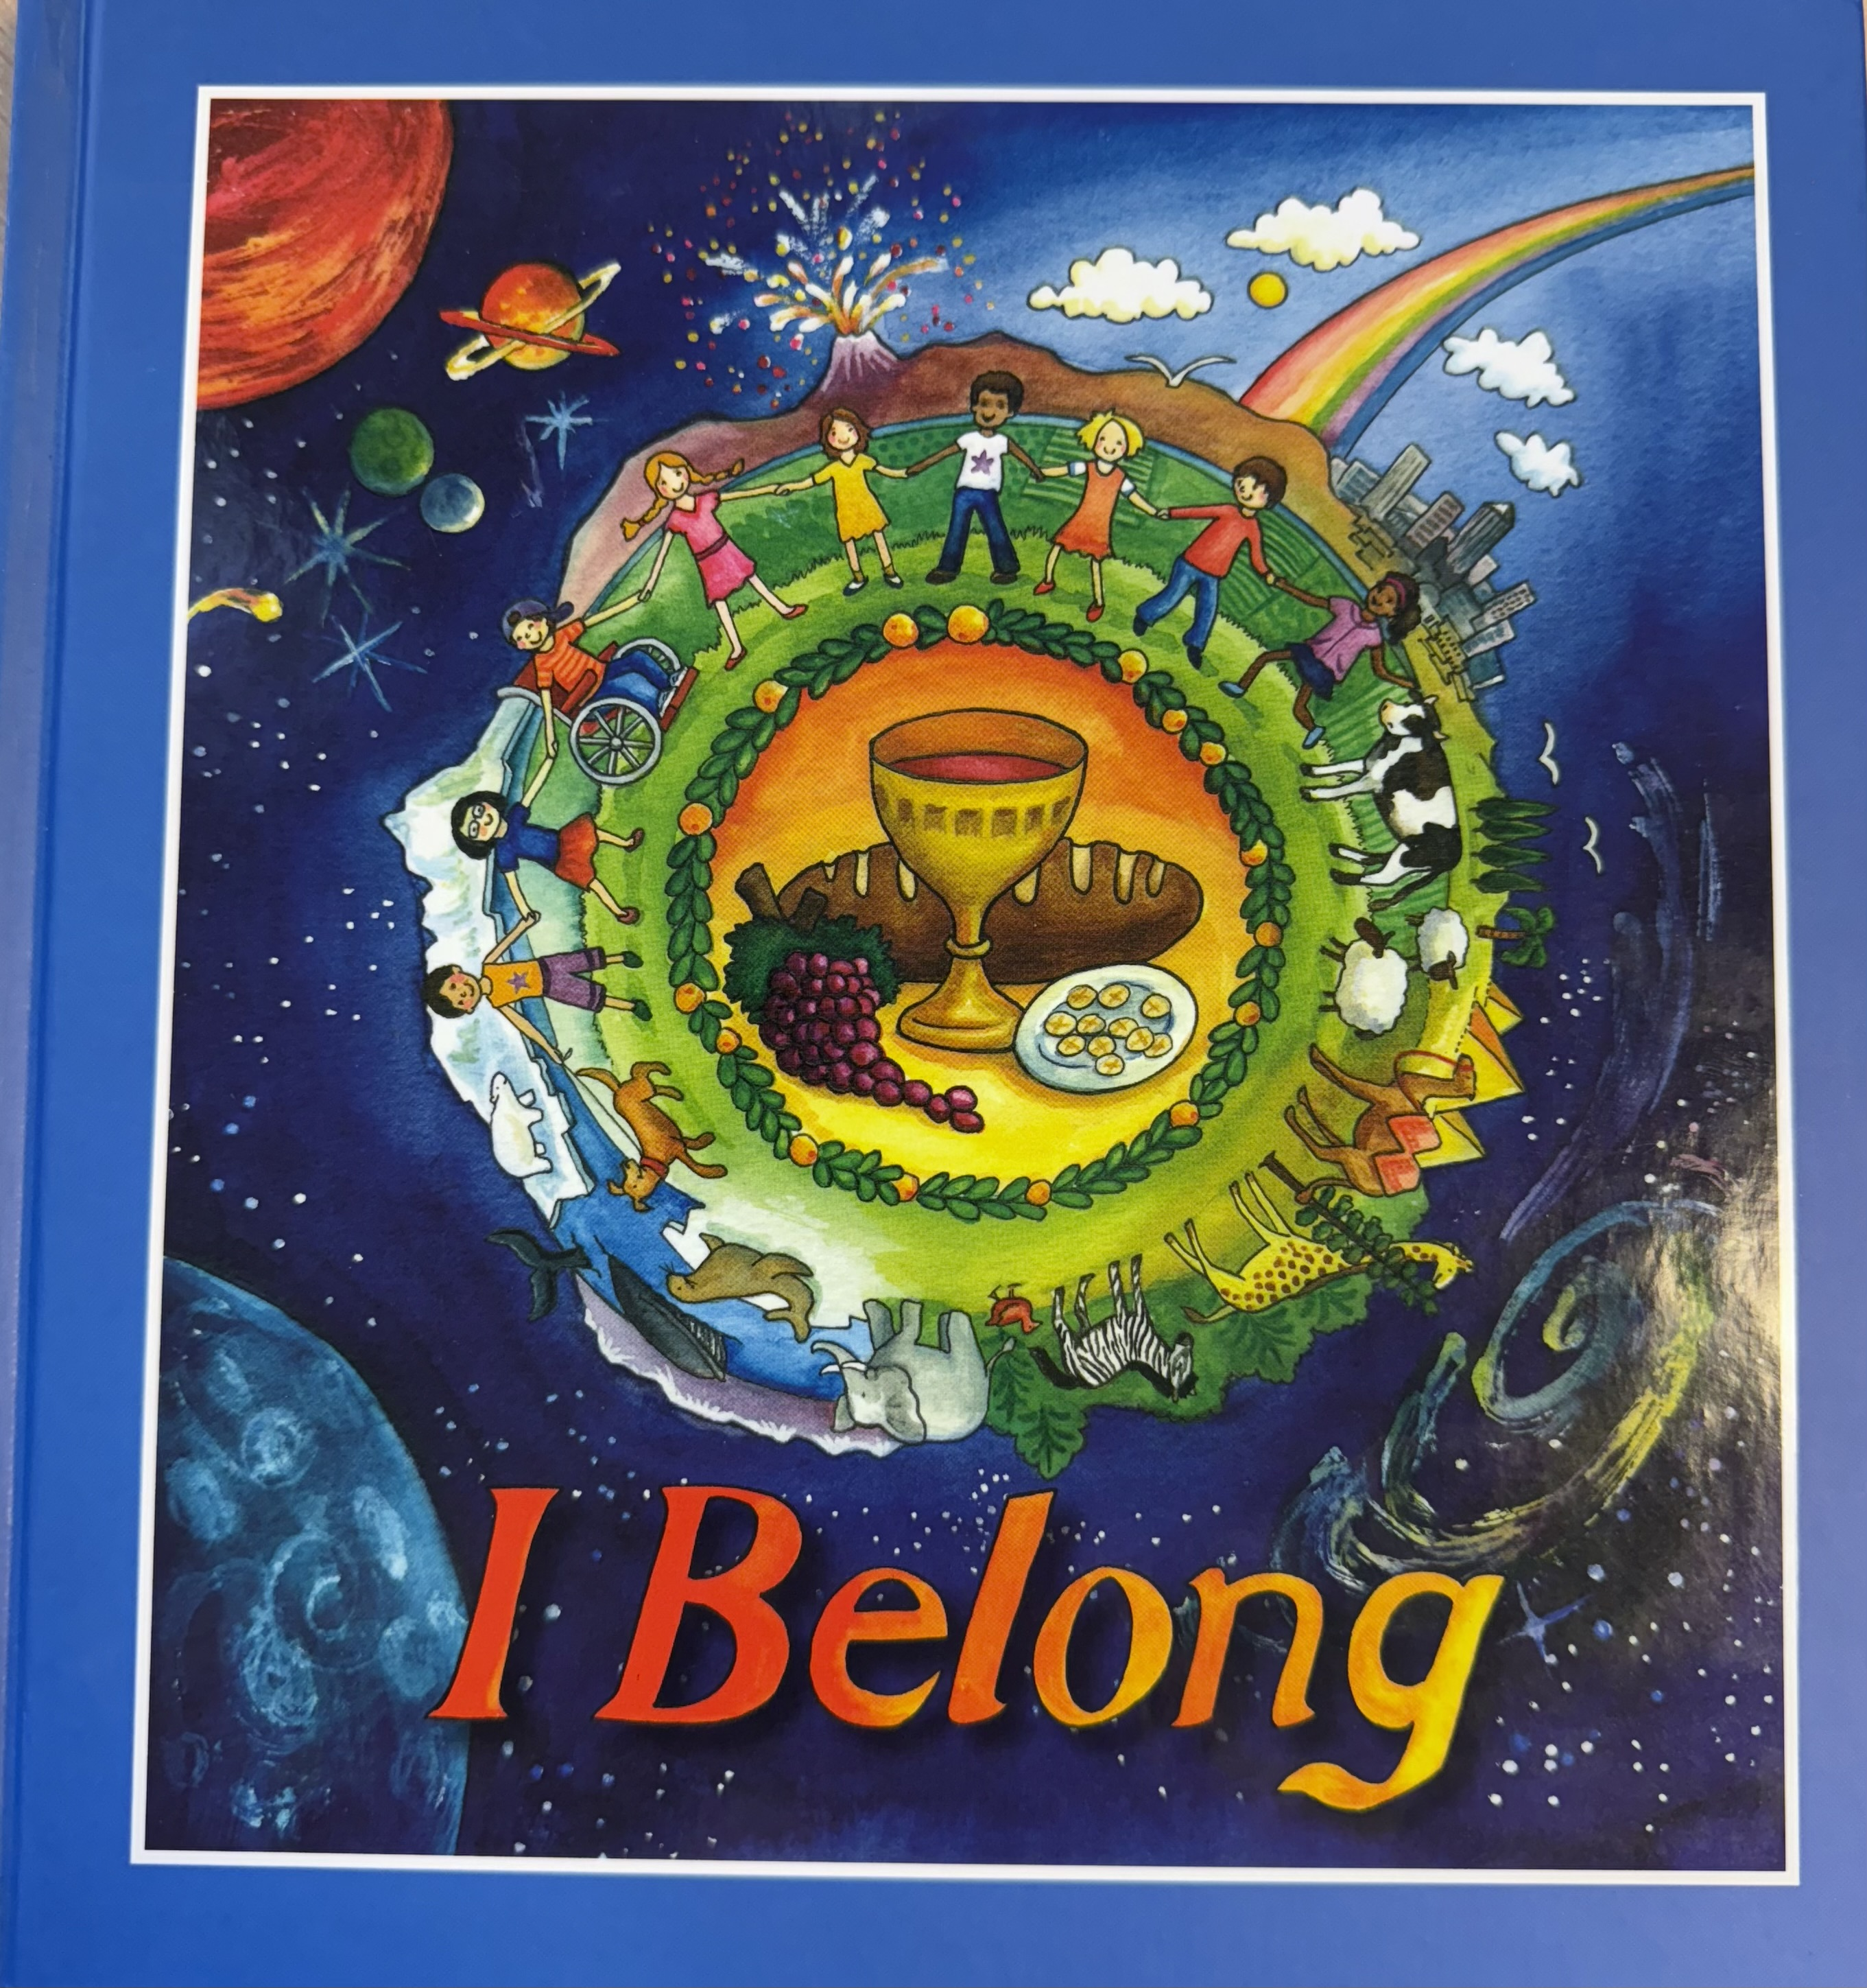

Slide 5
I Belong is a programme that contains lively, colourful material. Illustrations and examples are used to reflect the world where today’s children live and experience faith.

Slide 6
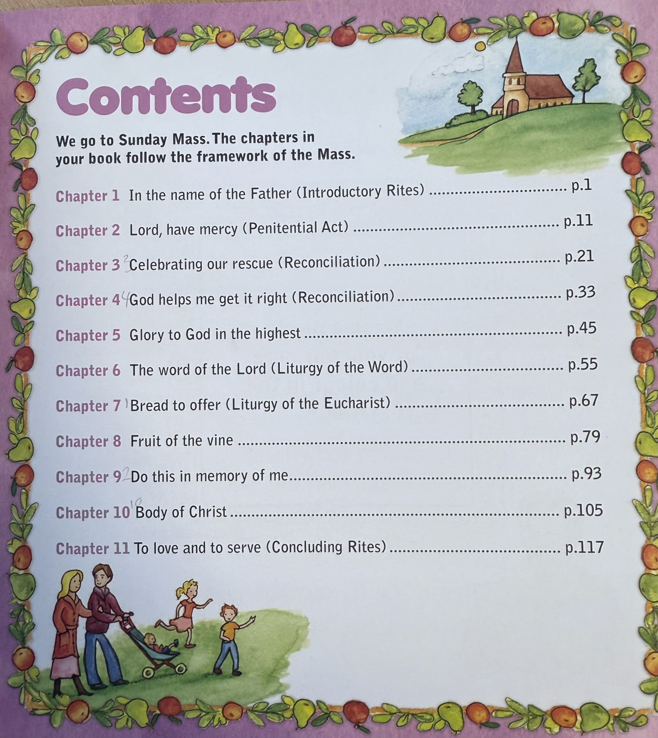

Slide 7
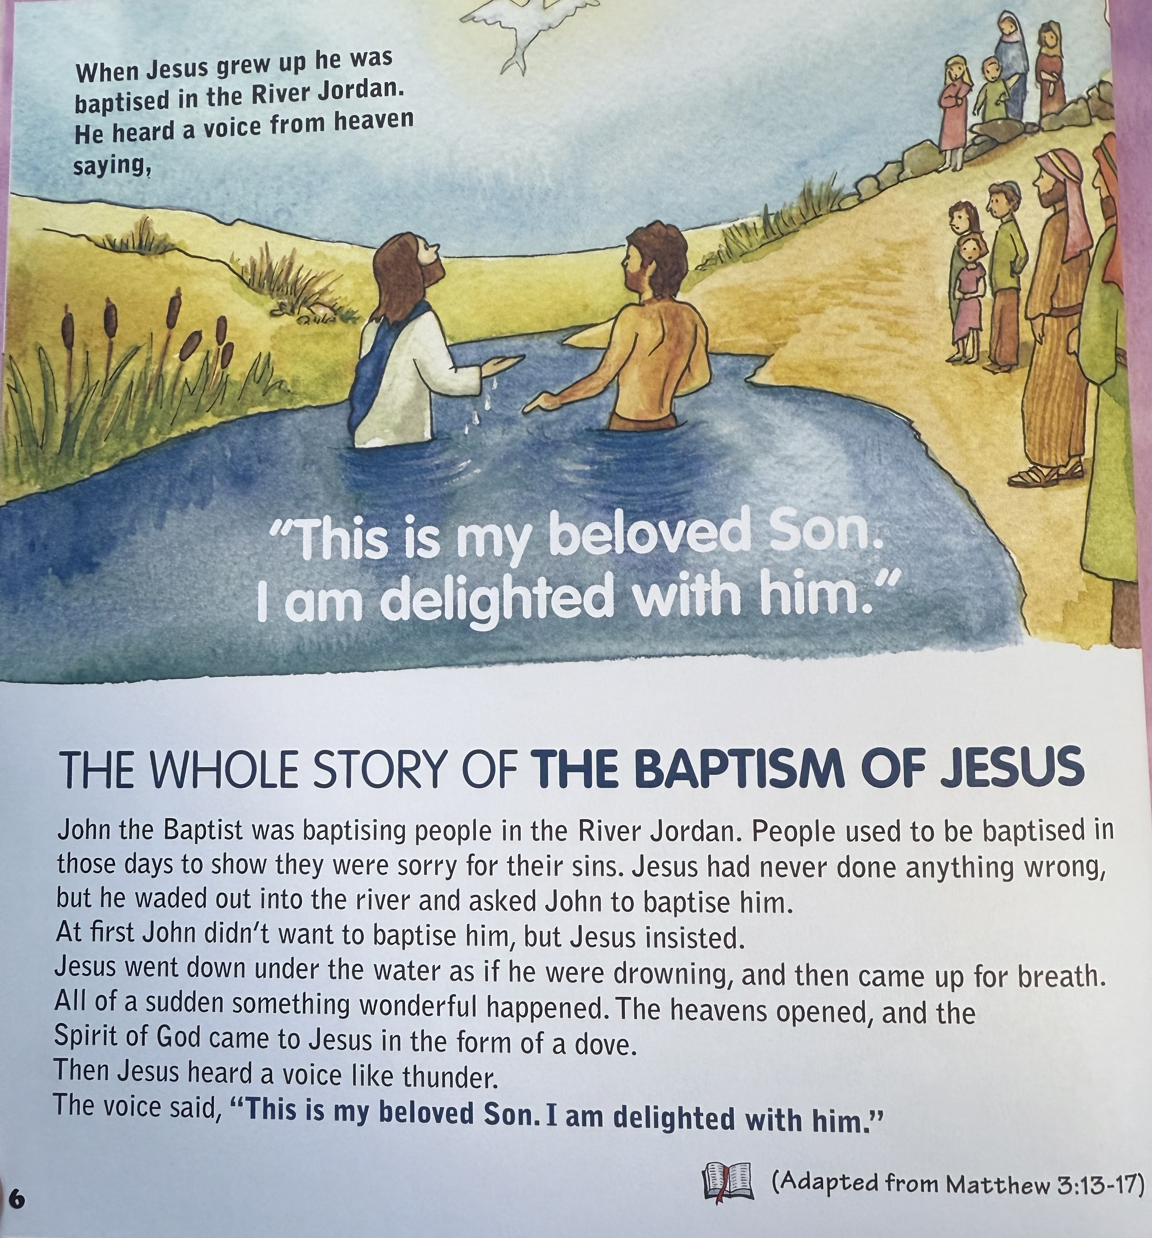

Slide 8
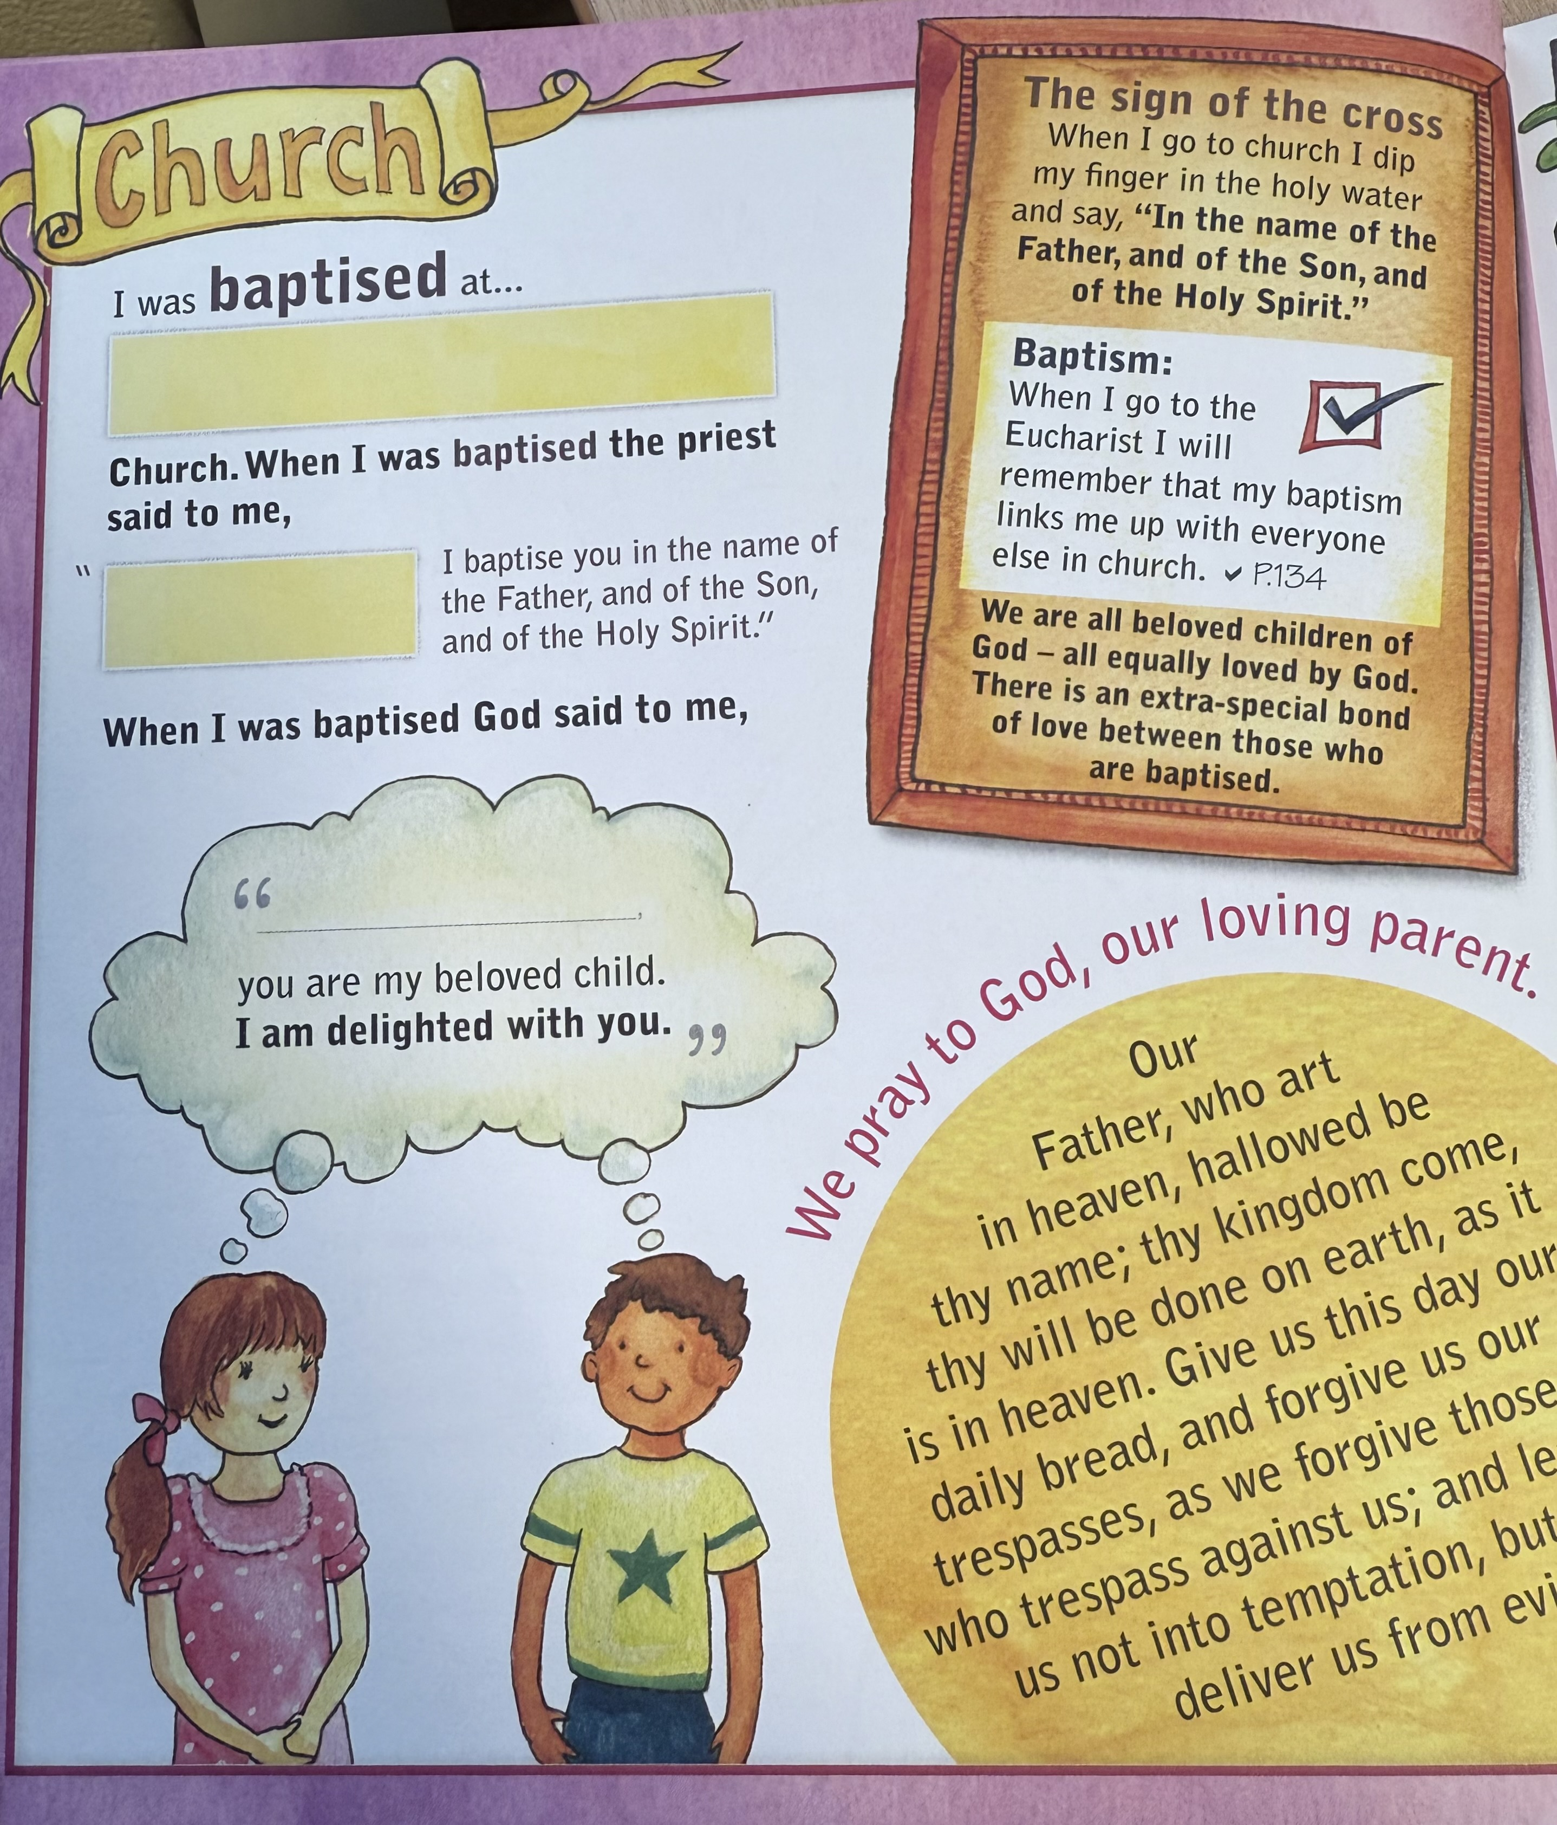

Slide 9
Key Dates
Wednesday 1st October Parent Session 1 at school 4:30pm
Sunday 14th December Mass at Church 11am (please sit with your child/family near the front).
Thursday 22nd January Parent Session 2 at school 4:30pm
Sunday 15th March Mass at Church 11am (please sit with your child/family near the front).
Thursday 19th March. Reconciliation at Church. 3:30pm – 4:30pm
Thursday 7th May Parent Session 3 at school 4:30pm
Sunday 17th May Mass at Church 11am (please sit with your child/family near the front).
Saturday 6th June. Holy Communion Service. (please arrive at the Parish Hall by 10:30am).

Slide 10
Our School Prayer
This is our school
Let it be full of love
Love of one another
Love of life itself
But most of all
The love of Jesus Christ, our Lord.
Amen.

Slide 11




Support our school by joining the PTA 200 club. Details on Newsletter (website). We have places available in a number of our year groups. If you know of any families looking for a school place please ask them to contact school. We have an Early Years Open Day scheduled (website) and offer guided tours at times that suit parents.
Photographs from our busy school life are posted on the website (Latest News).
You can also follow everything that happens here at school on social media @ologprestwich
Please take the time to complete the Parent Feedback Questionnaire. Your views are important to us.

