Slide 1


Slide 3
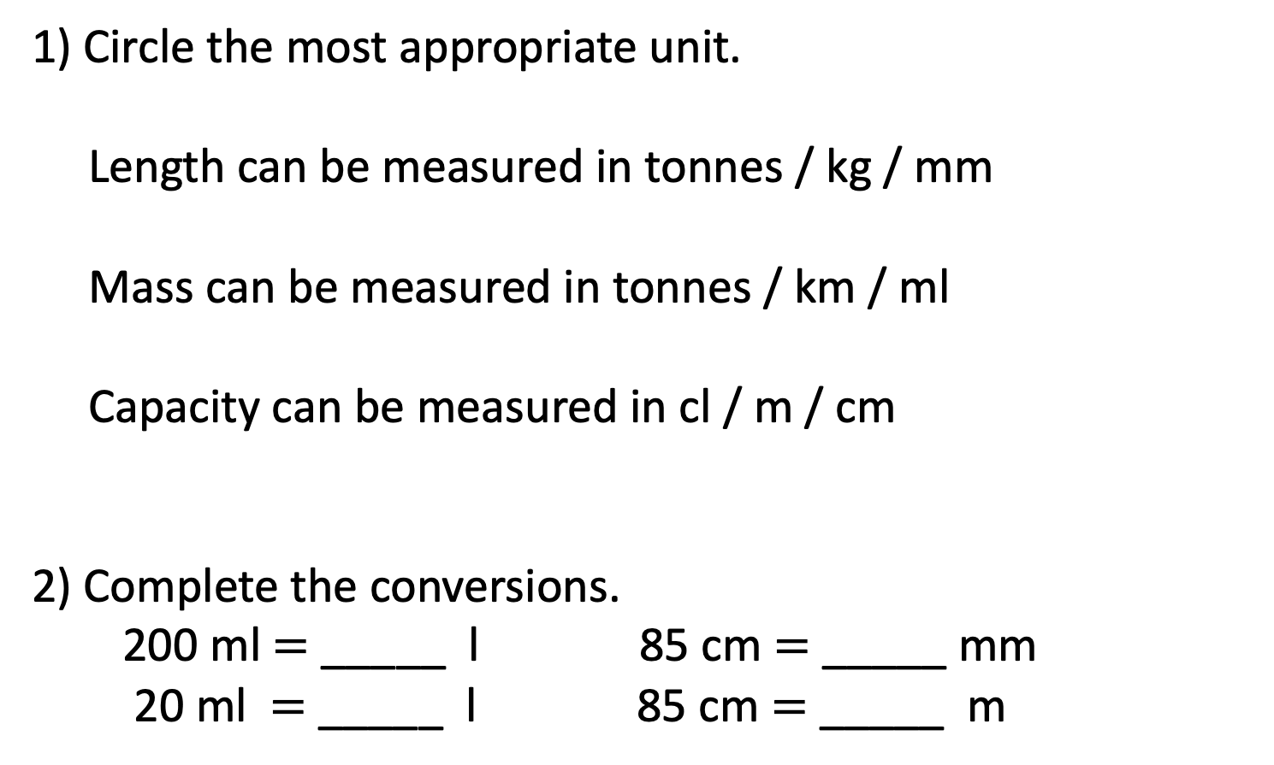
1) Circle the most appropriate unit.
Length can be measured in tonnes / kg / mm
Mass can be measured in tonnes / km / ml
Capacity can be measured in cl / m / cm
2) Complete the conversions.
200 ml $=$ _____ l 85 cm $=$ _____ mm
20 ml $=$ _____ l 85 cm $=$ _____ m

Slide 4
1) Circle the most appropriate unit.
Length can be measured in tonnes / kg / mm
Mass can be measured in tonnes / km / ml
Capacity can be measured in cl / m / cm
2) Complete the conversions.
200 ml $=$ _____ l 85 cm $=$ _____ mm
20 ml $=$ _____ l 85 cm $=$ _____ m
0.2
850
0.02
0.85

Slide 6








16 ounces$=$ 1 pound
14 pounds $=$ 1 stone
Feet and inches
Pints
8 pints $=$ 1 gallon
Pounds and ounces
12 inches $=$ 1 foot
1 inch $≈$ 2.5 cm

Slide 7
Have a go at questions
1 – 2 on the worksheet

Slide 8




1 foot $=$ 12 inches
Have a think
Feet | Inches
1 | 12
2 | 24
3 | 36
5 | 60
10 | 120
12 | 144
16 | 192
$×$ 3
$×$ 3

Slide 9





1 foot $=$ 12 inches
Feet | Inches
1 | 12
2 | 24
3 | 36
5 | 60
10 | 120
12 | 144
16 | 192
$×$ 5
$×$ 5
$×$ 2
$×$ 2

Slide 10


Have a think
5 feet
and 8 inches
1 foot $=$ 12 inches
How tall is Annie in inches?

Slide 11

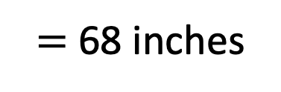




1 foot $=$ 12 inches
Have a think
5 feet and 8 inches
1 foot $=$ 12 inches
$×$ 5
$×$ 5
5 feet $=$ 60 inches
60 inches and 8 inches
$=$ 68 inches
Approximately, how tall is Annie in cm?
1 inch $≈$ 2.5 cm

Slide 12

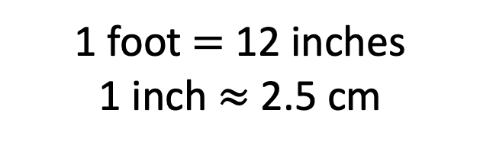
1 foot $=$ 12 inches
1 inch $≈$ 2.5 cm
68 inches
68 $×$ 2.5$≈$
170 cm
68
68
34

Slide 13
Have a go at questions
3 – 5 on the worksheet

Slide 14



1 pound $=$ 16 ounces
Pounds | Ounces
1 | 16
3 | 48
5 | 80
9 | 144
14 | 224
20 | 320
$×$ 5
$×$ 5
14 pounds $=$ 1 stone
Have a think

Slide 15
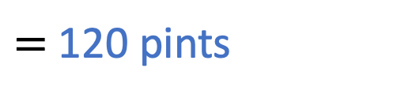


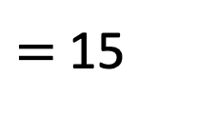
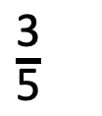
A school buys 25 gallons of water as it’s expected to be a hot day for Sports Day.
Key Stage 1 have $\frac{\text{2}}{\text{5}}$ of the water and Key Stage 2 have the rest.
How many pints of water does Key Stage 2 have?
$\frac{\text{3}}{\text{5}}$
$=$ 15
of 25
25
15 gallons
$=$ 120 pints
1 gallon $=$ 8 pints
?
Have a think

Slide 16
Have a go at the rest of the questions on the worksheet

Slide 17



Slide 18
I do
You do

Slide 19
















Rosie
Alex
Amir
Whitney
Ron
Dexter
Annie
Tommy
Mo
Jack
Eva
Teddy
Max
Kim
Jo
Sam

Slide 20



Speech bubble text – replace with any character head.
Speech bubble text – replace with any character head.
Bee
Diddy
Tiny

Slide 21
27
342
300
2
20
7
40
M | HTh | Tth | Th | H | T | O

Slide 22










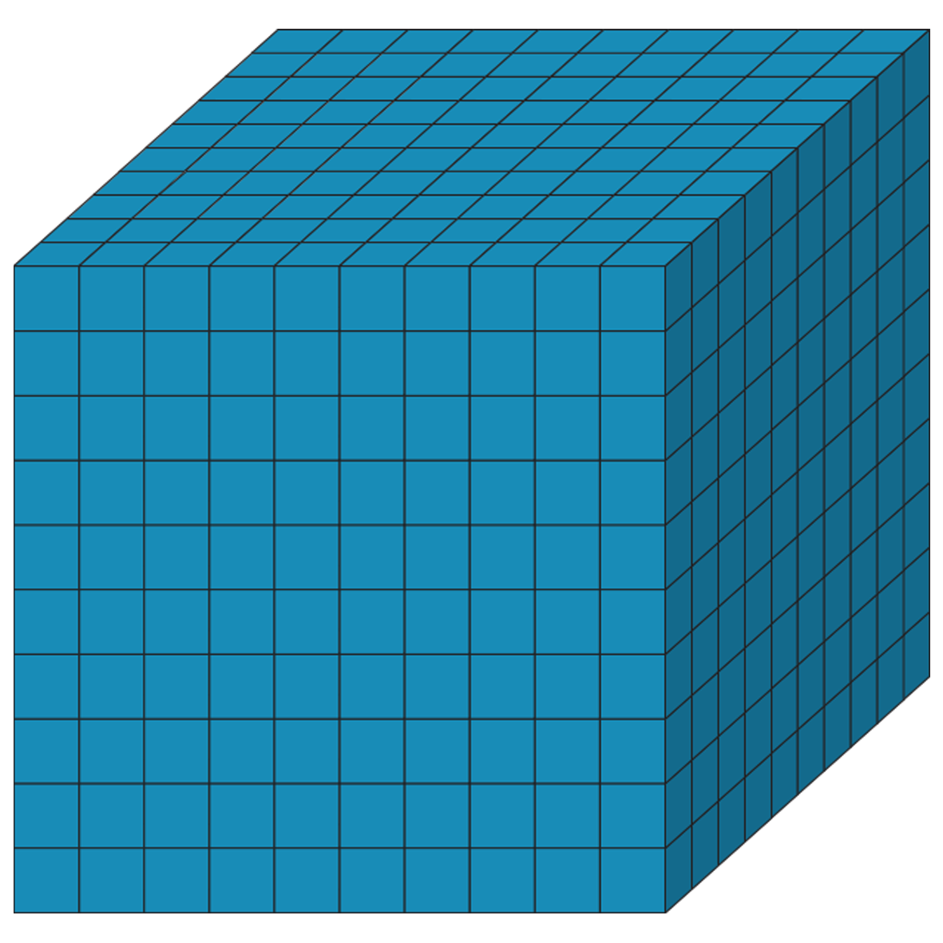









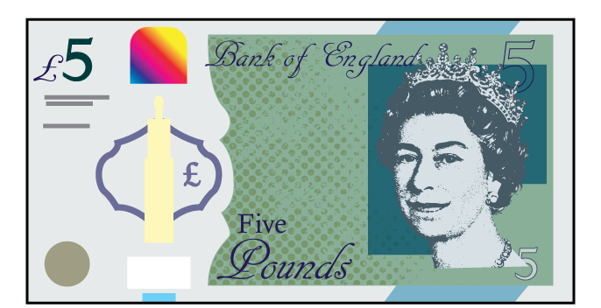



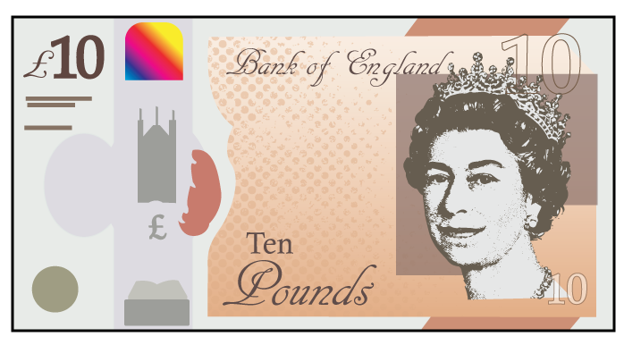





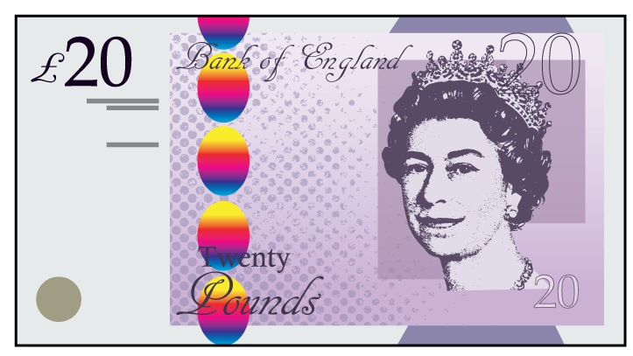


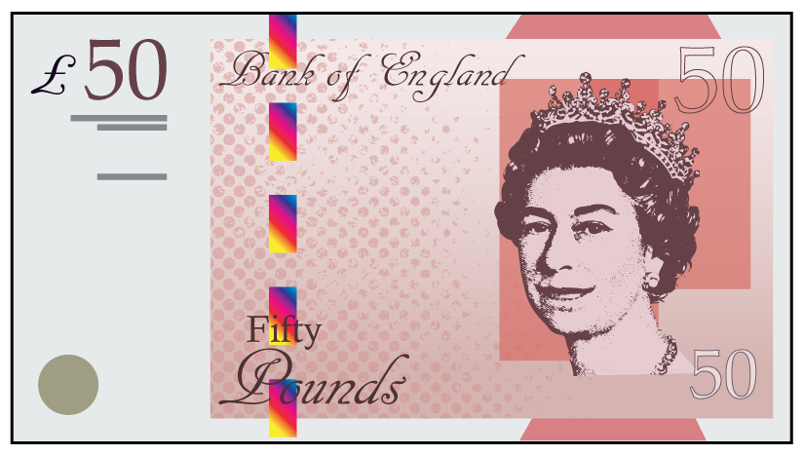

Slide 23
