Slide 1


Slide 3
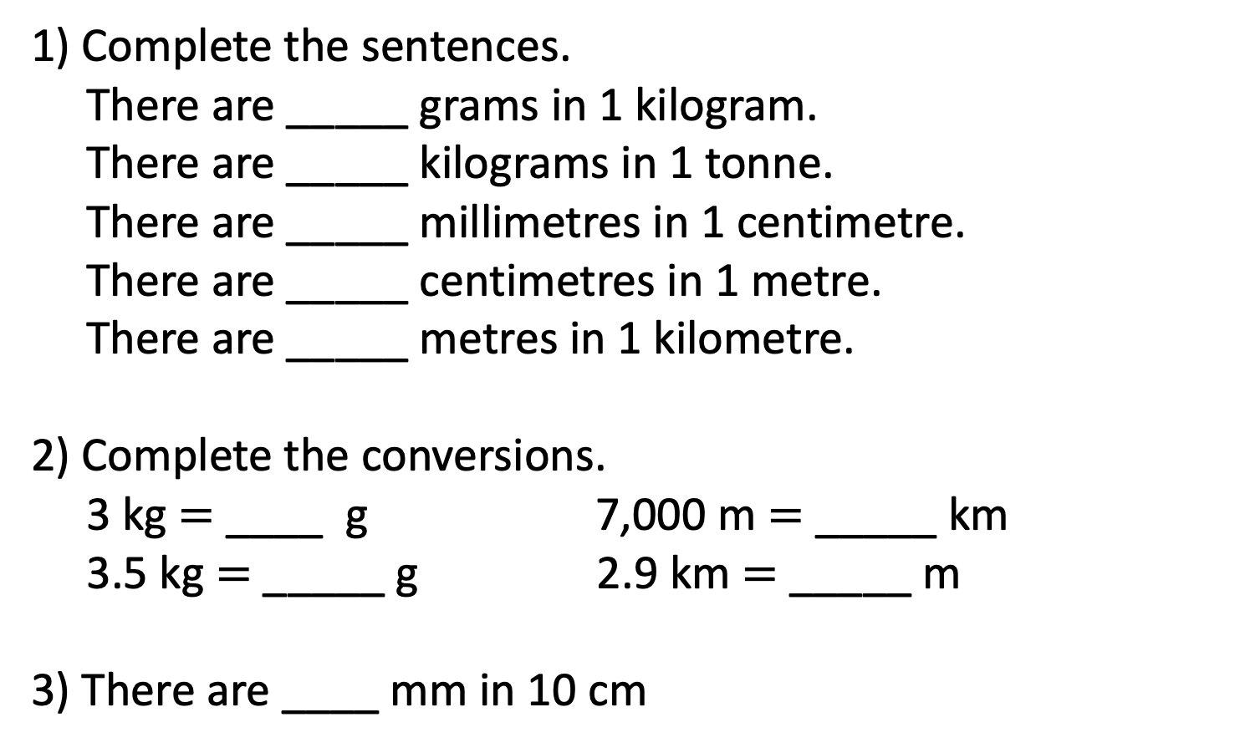
1) Complete the sentences.
There are _____ grams in 1 kilogram.
There are _____ kilograms in 1 tonne.
There are _____ millimetres in 1 centimetre.
There are _____ centimetres in 1 metre.
There are _____ metres in 1 kilometre.
2) Complete the conversions.
3 kg $=$ ____ g 7,000 m $=$ _____ km
3.5 kg $=$ _____ g 2.9 km $=$ _____ m
3) There are ____ mm in 10 cm

Slide 4
1) Complete the sentences.
There are _____ grams in 1 kilogram.
There are _____ kilograms in 1 tonne.
There are _____ millimetres in 1 centimetre.
There are _____ centimetres in 1 metre.
There are _____ metres in 1 kilometre.
2) Complete the conversions.
3 kg $=$ ____ g 7,000 m $=$ _____ km
3.5 kg $=$ _____ g 2.9 km $=$ _____ m
3) There are ____ mm in 10 cm
1,000
1,000
10
100
1,000
3,000
7
3,500
2,900
100

Slide 6
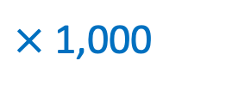
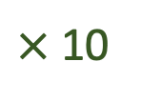
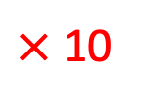
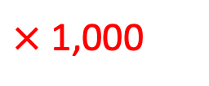
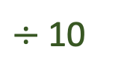
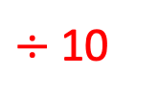
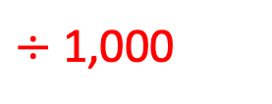
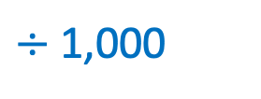
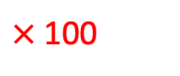
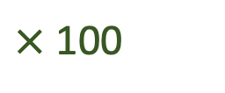
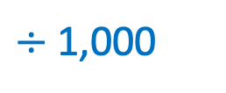
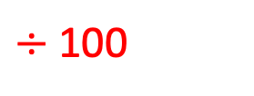
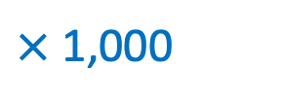
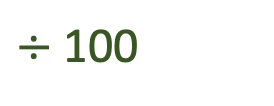
Length
$÷$ 10
$÷$ 100
$÷$ 1,000
mm
cm
m
km
$×$ 10
$×$ 100
$×$ 1,000
Mass
$÷$ 1,000
$÷$ 1,000
g
kg
tonne
$×$ 1,000
$×$ 1,000
Capacity
$÷$ 10
$÷$ 100
ml
cl
l
$×$ 10
$×$ 100

Slide 7

Eva, Alex, Teddy, Tommy and Mo are running around their school playground.
1 lap of the school playground is 300 m.
Eva runs 3 laps.
How far does she run?
900 m
laps
1
2
3
300
600
900
metres

Slide 8
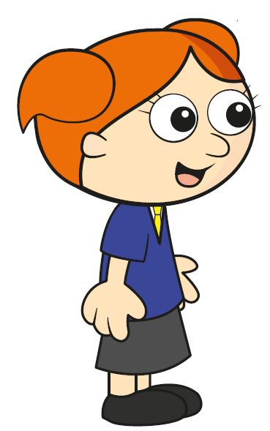

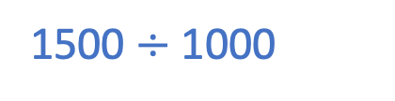
Eva, Alex, Teddy, Tommy and Mo are running around their school playground.
1 lap of the school playground is 300 m.
Alex runs 5 laps.
How far does she run?
Write your answer in kilometres.
1.5 km
Have a think
laps
1
2
3
4
5
300
600
900
1,200
1,500
1500 $÷$ 1000
metres

Slide 9
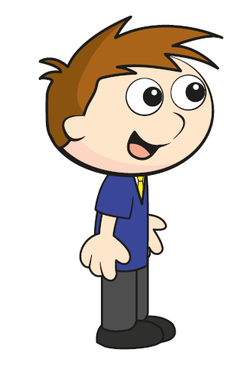
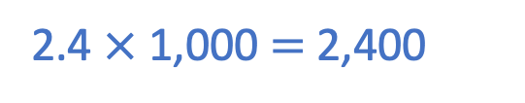


Eva, Alex, Teddy, Tommy and Mo are running around their school playground.
1 lap of the school playground is 300 m.
Teddy runs 2.4 km
How many laps does he run?
Have a think
2.4 $×$ 1,000 $=$ 2,400
8 laps
$×$ 2
laps
1
2
3
4
8
300
600
900
1,200
2,400
$×$ 2
metres

Slide 10
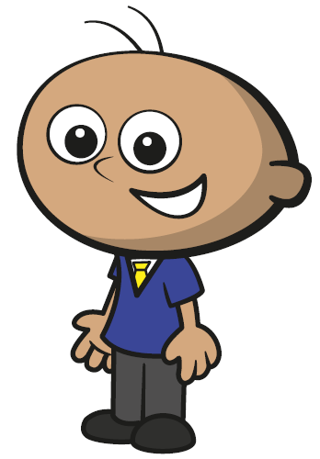
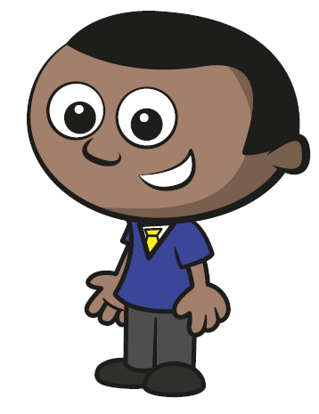
Eva, Alex, Teddy, Tommy and Mo are running around their school playground.
1 lap of the school playground is 300 m.
Tommy runs 900 m
Mo runs 2,100 m
Mo runs 2.1 km
How many more laps did Mo run?
Mo ran 4 more laps
Have a think
laps
1
2
3
4
7
8
300
600
900
1,200
2,100
2,400
metres

Slide 11
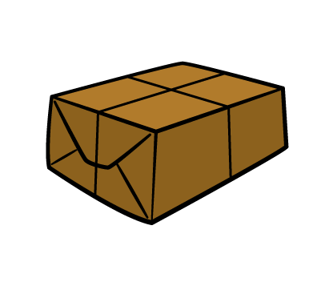
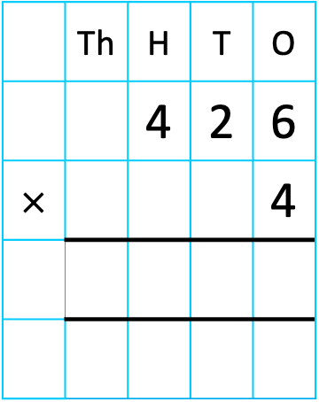
A parcel has a mass of 426 g.
Have a think
The mass of a box is 4 times the mass of the parcel.
What is the mass of the box?
Give your answer in kg.
 | Th | H | T | O
 |  | 4 | 2 | 6
$×$ |  |  |  | 4
P
426 g
B
426 g
426 g
426 g
426 g
1
7
0
4
1
2
1,704 g
1.704 kg

Slide 12
Have a go at questions
1 - 5 on the worksheet

Slide 13

Tommy has 2 litres of orange juice.
He pours 450 ml for Dexter.
He gives a quarter of a litre to Dora.
He drinks 350 ml himself.
How much orange juice is left?
Give your answer in ml.
Have a think

Slide 14
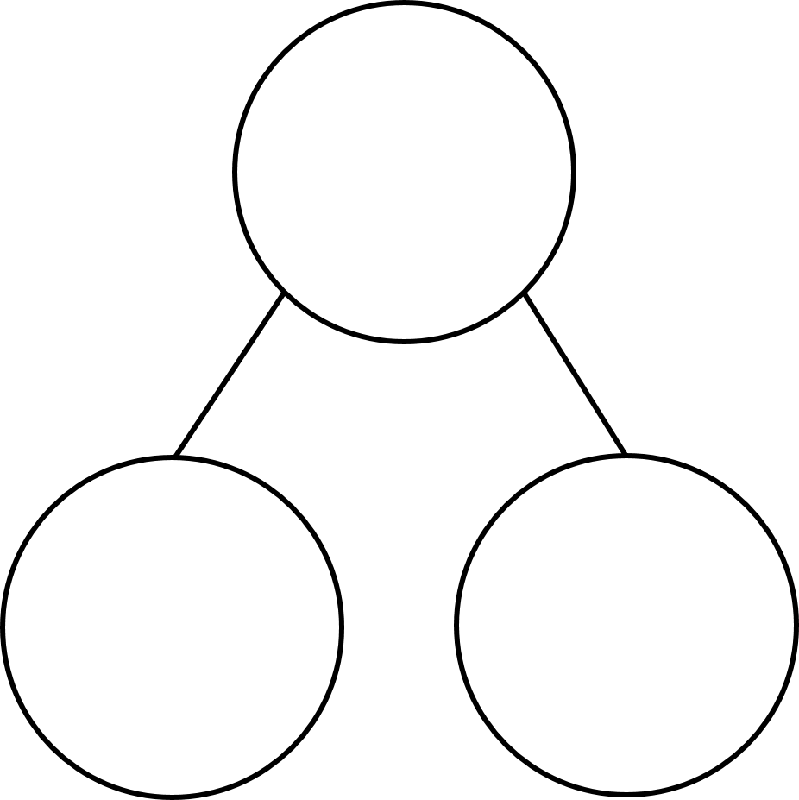
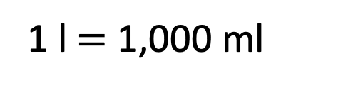
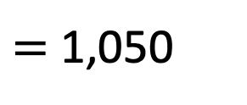


Tommy has 2 litres of orange juice.
He pours 450 ml for Dexter.
He gives a quarter of a litre to Dora.
2,000
He drinks 350 ml himself.
How much orange juice is left?
Give your answer in ml.
950 ml
1,050
950
450
$=$ 1,050
$$+$$
250
$$+$$
350
1 l $=$ 1,000 ml

Slide 15


A bag contains 20 apples.
Each apple has a mass of 75 g.
The bag itself has a mass of 18 g.
Jack has some bags of apples.
The total mass is 9.108 kg.
How many bags of apples does Jack have?
Have a think

Slide 16
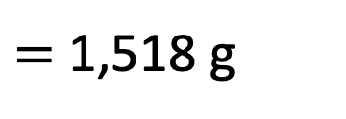
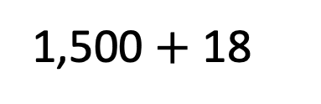
A bag contains 20 apples.
Each apple has a mass of 75 g.
The bag itself has a mass of 18 g.
Jack has some bags of apples.
The total mass is 9.108 kg.
How many bags of apples does Jack have?
Apples
1
2
20
75
150
1,500
Grams
1,500 $+$ 18
$=$ 1,518 g

Slide 17
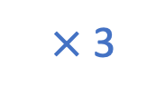
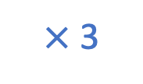
A bag contains 20 apples.
Each apple has a mass of 75 g.
Jack has 6 bags of apples.
The bag itself has a mass of 18 g.
Jack has some bags of apples.
The total mass is 9.108 kg.
How many bags of apples does Jack have?
Apples
Bags
1
2
6
$×$ 3
1,518
9,108
Grams
1,500
3,000
9,000
$×$ 3

Slide 18
Have a go at the rest of the questions on the worksheet

Slide 19



Slide 20
I do
You do

Slide 21
















Rosie
Alex
Amir
Whitney
Ron
Dexter
Annie
Tommy
Mo
Jack
Eva
Teddy
Max
Kim
Jo
Sam

Slide 22

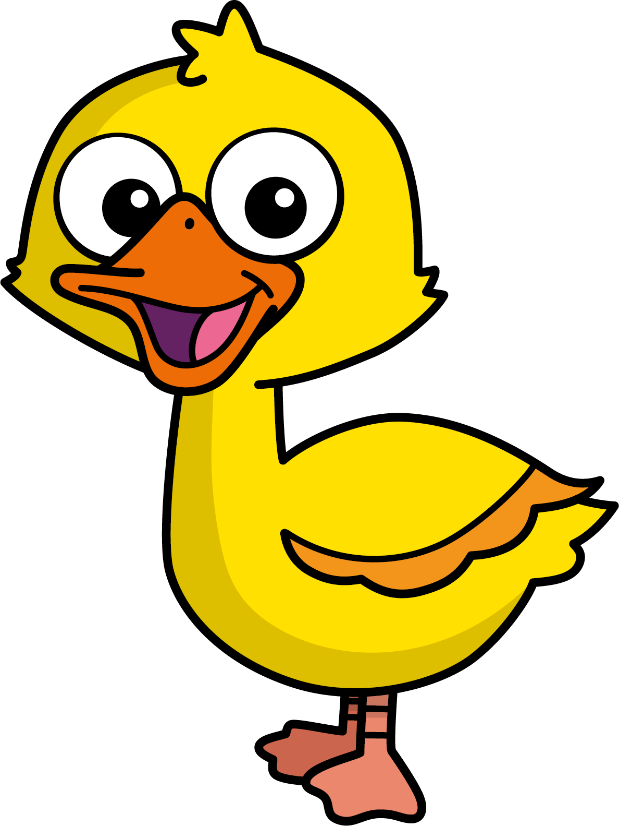
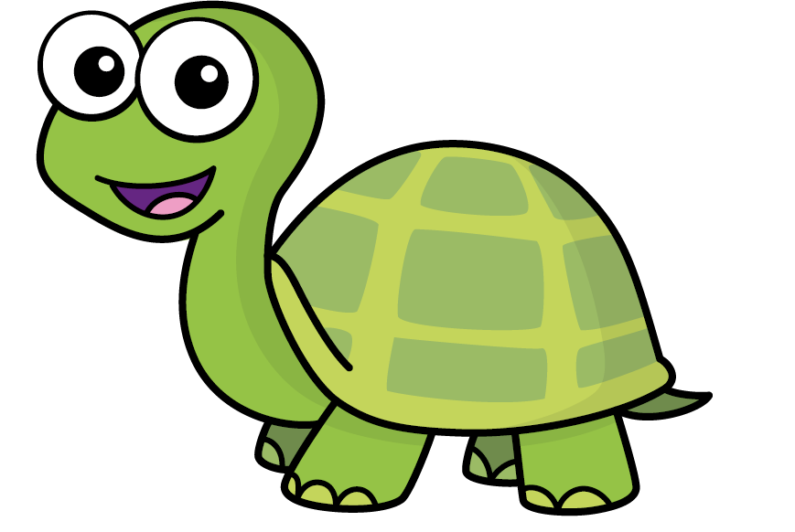
Speech bubble text – replace with any character head.
Speech bubble text – replace with any character head.
Bee
Diddy
Tiny

Slide 23
27
342
300
2
20
7
40
M | HTh | Tth | Th | H | T | O

Slide 24
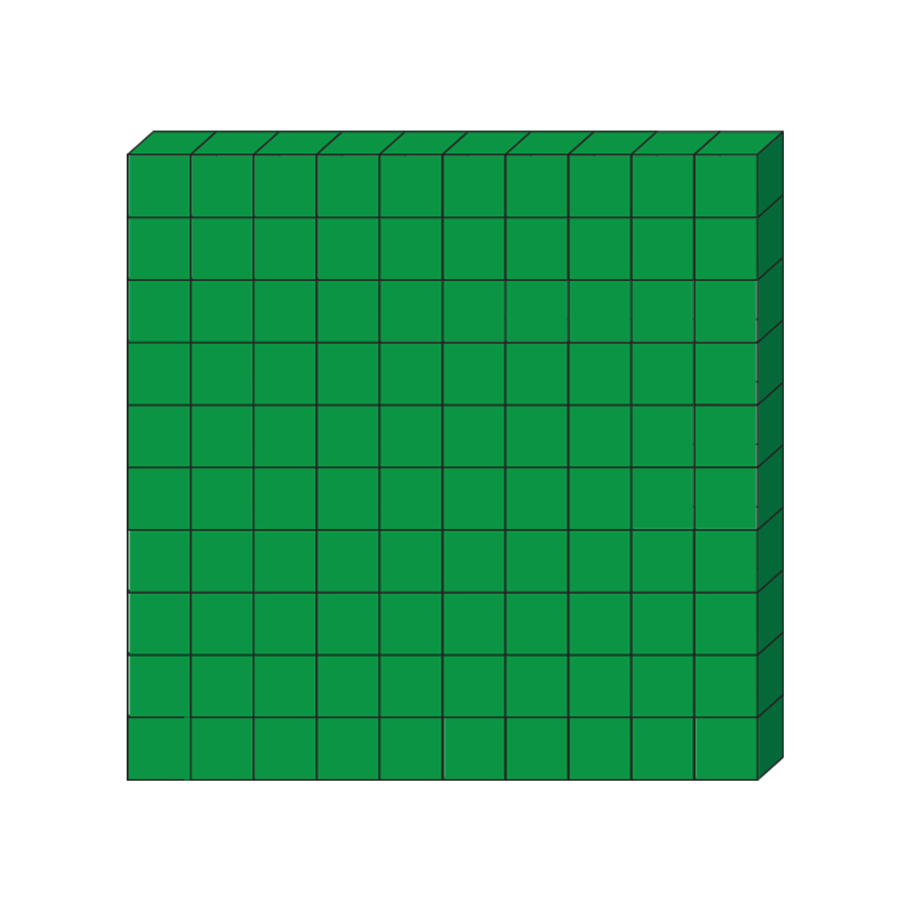

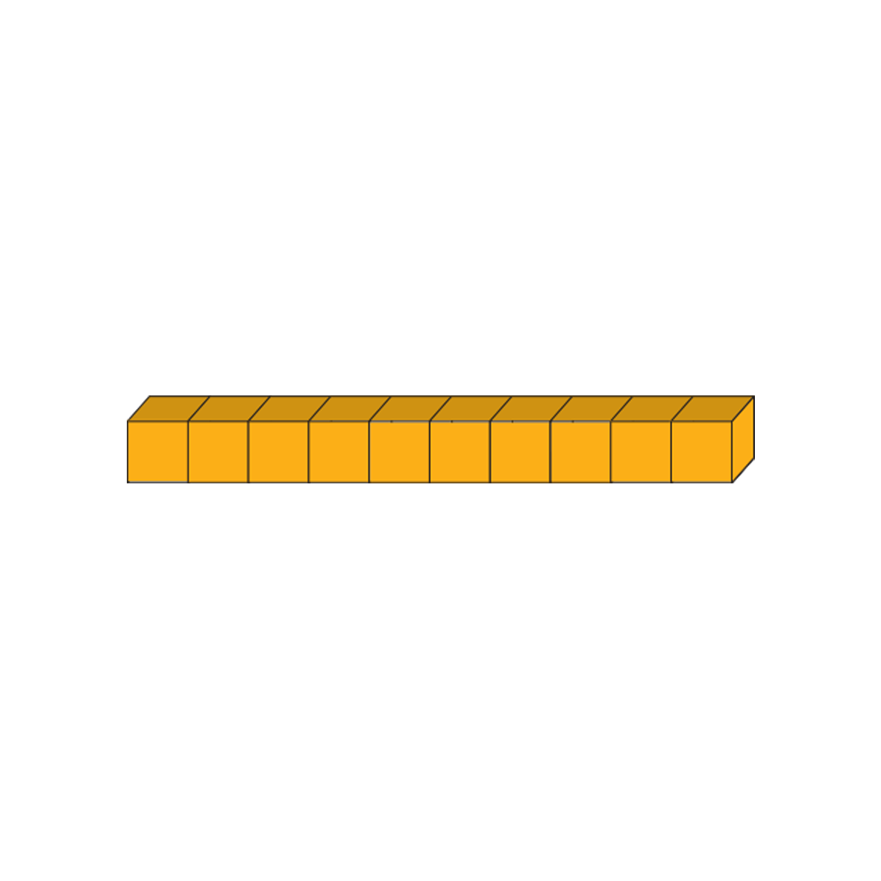



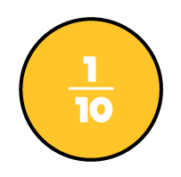


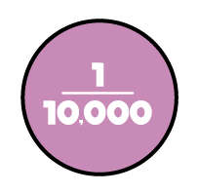
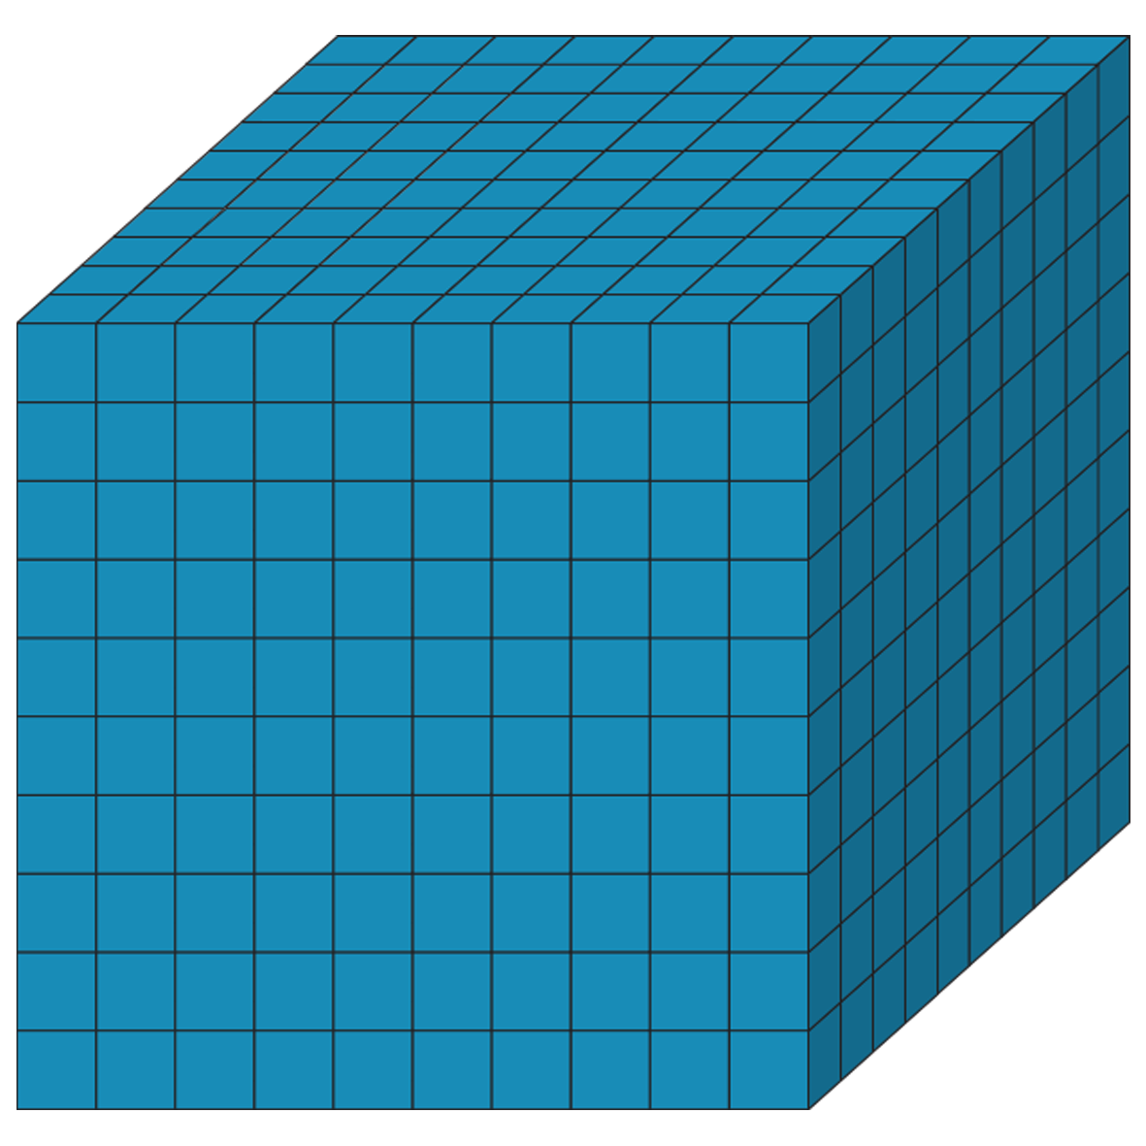
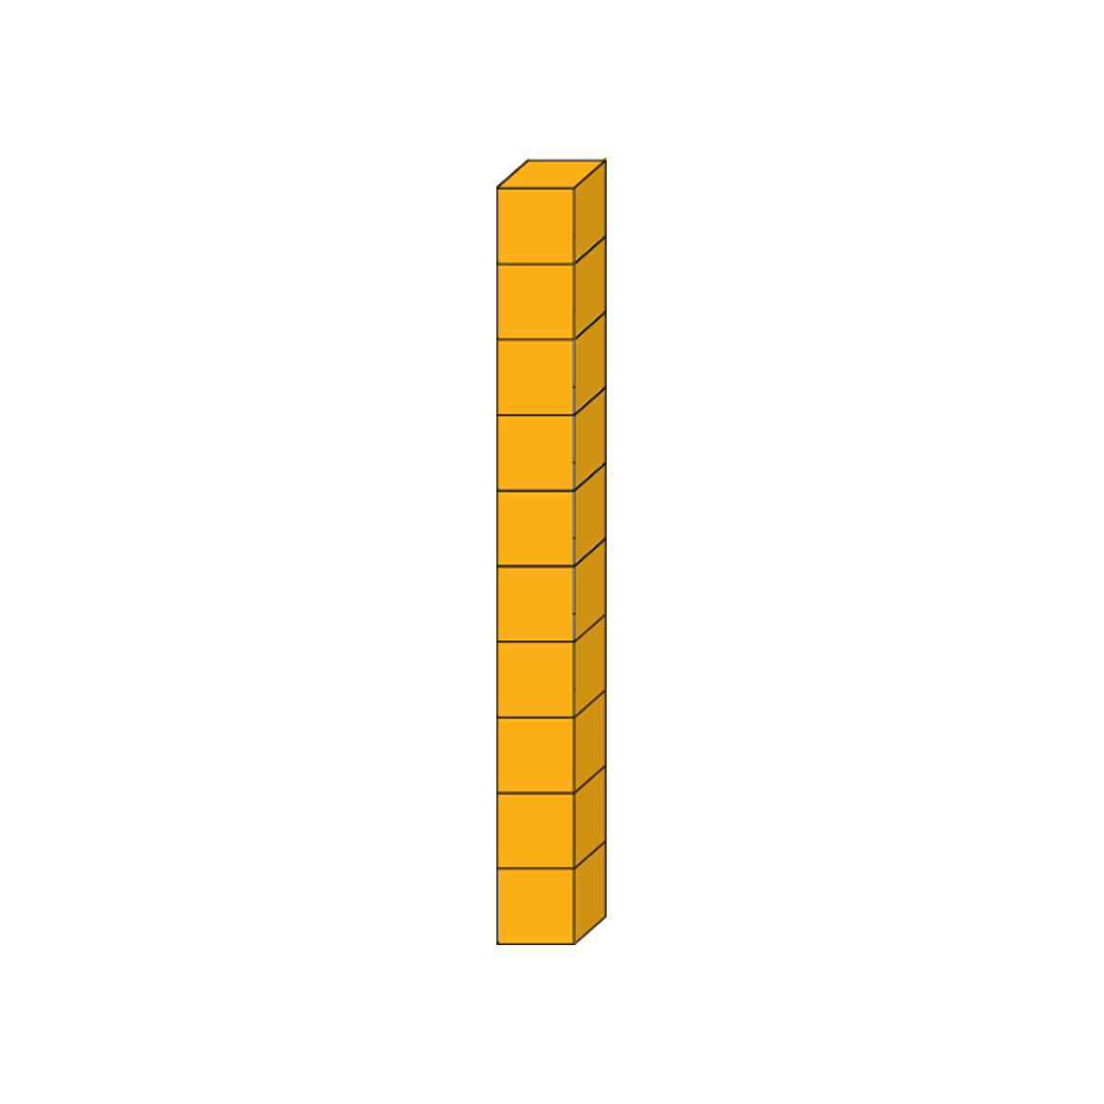





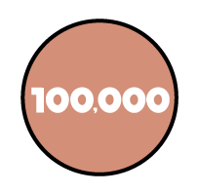
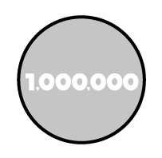
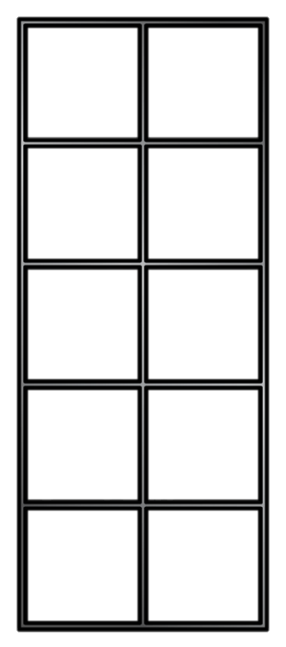
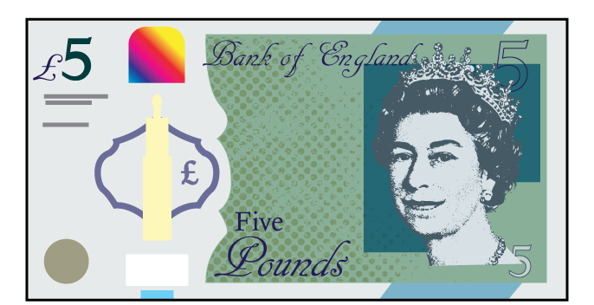

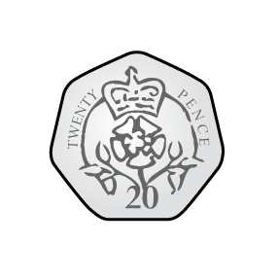
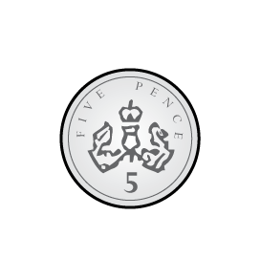
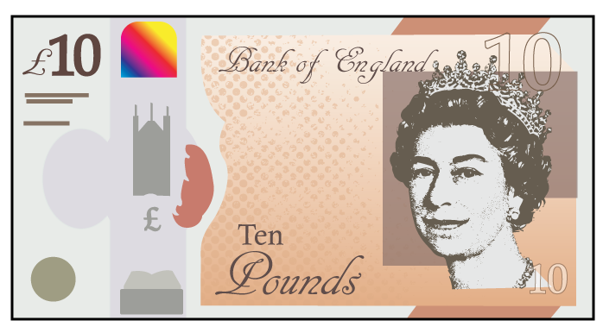
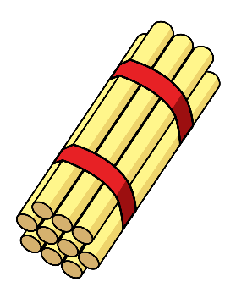

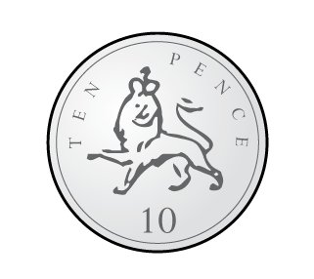
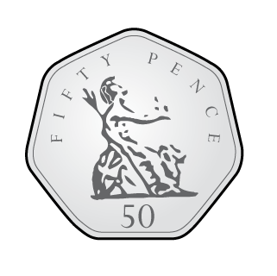

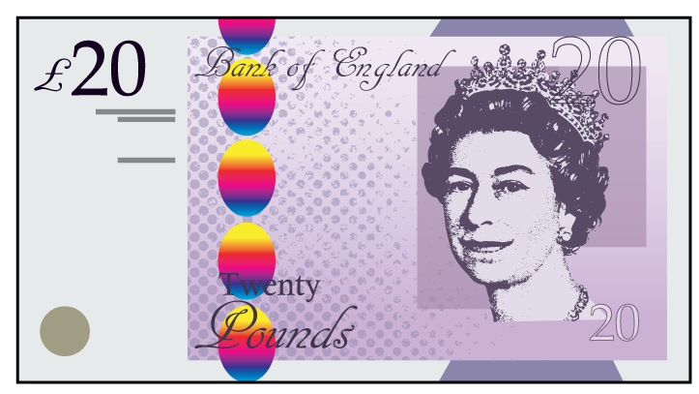


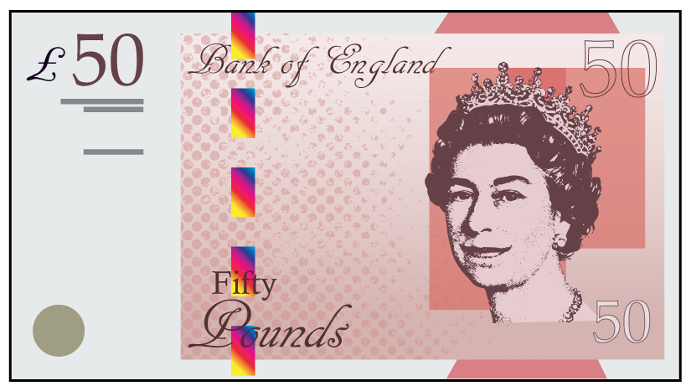

Slide 25


























































