Slide 1


Slide 3
1) Circle the most appropriate unit.
Length can be measured in l / m / g
Mass can be measured in ml / kg / km
Capacity can be measured in l / g / cm
2) Match each item to a sensible estimate.
A can of pop
A tin of paint
A teaspoon of medicine
335 ml
5 ml
5 l

Slide 4
1) Circle the most appropriate unit.
Length can be measured in l / m / g
Mass can be measured in ml / kg / km
Capacity can be measured in l / g / cm
2) Match each item to a sensible estimate.
A can of pop
A tin of paint
A teaspoon of medicine
335 ml
5 ml
5 l

Slide 6







Complete the diagram to show the conversions.
10
1,000
$÷$ _____
$÷$ 100
$÷$ _____
mm
cm
m
km
$×$ _____
10
100
1,000
$×$ _____
$×$ _____
Complete the sentences.
There are ____ millimetres in 1 centimetre.
10
There are ____ centimetres in 1 metre.
100
There are ____ metres in 1 kilometre.
1,000
Have a think

Slide 7



Complete the diagram to show the conversions.
1,000
$÷$ _______
ml
l
1,000
$×$ _______
Complete the sentence.
There are _____ millilitres in 1 litre.
1,000
One thousandth
One thousandth of a litre
1 ml $=$ 0.001 l
Have a think

Slide 8

A large car might have a mass of around 2 tonnes.
1 tonne is 1,000 kilograms

Slide 9




Complete the diagram to show the conversions.
1,000
1,000
$÷$ ________
$÷$ _______
g
kg
tonne
1,000
1,000
$×$ _____
$×$ _____
Complete the sentences.
There are ______ grams in 1 kilogram.
1,000
There are ______ kilograms in 1 tonne.
1,000
Have a think

Slide 10

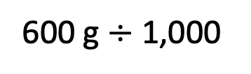
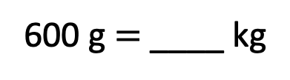
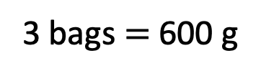
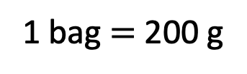
A bag of flour has a mass of 200 g.
Scott uses 3 bags of flour when baking.
How much flour does he use?
Write your answer in kilograms.
0.6 kg
1 bag $=$ 200 g
3 bags $=$ 600 g
600 g $=$ ____ kg
600 g $÷$ 1,000
There are ______ grams in 1 kilogram.
1,000
Have a think

Slide 11
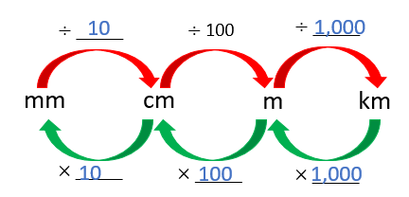
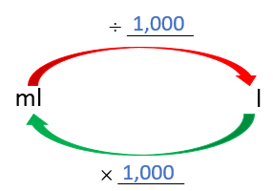
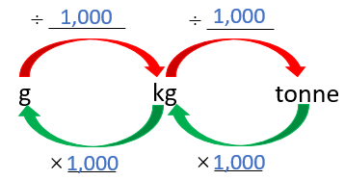
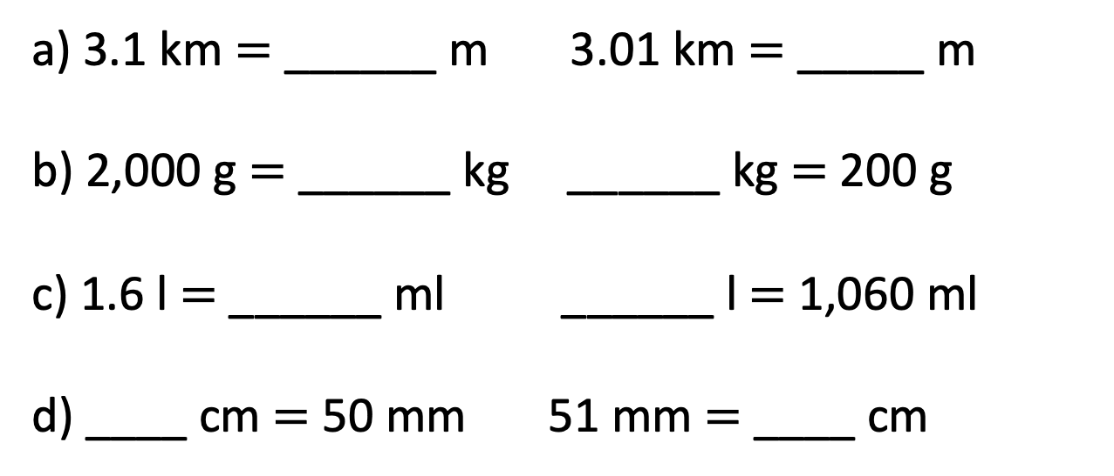
Complete the conversions.
Have a think
3,010
a) 3.1 km $=$ ______ m 3.01 km $=$ _____ m
b) 2,000 g $=$ ______ kg ______ kg $=$ 200 g
c) 1.6 l $=$ ______ ml ______ l $=$ 1,060 ml
d) ____ cm $=$ 50 mm 51 mm $=$ ____ cm
3,100
2
0.2
1,600
1.06
5
5.1

Slide 12
Have a go at the questions on the worksheet

Slide 13



Slide 14
I do
You do

Slide 15
















Rosie
Alex
Amir
Whitney
Ron
Dexter
Annie
Tommy
Mo
Jack
Eva
Teddy
Max
Kim
Jo
Sam

Slide 16



Speech bubble text – replace with any character head.
Speech bubble text – replace with any character head.
Bee
Diddy
Tiny

Slide 17
27
342
300
2
20
7
40
M | HTh | Tth | Th | H | T | O

Slide 18


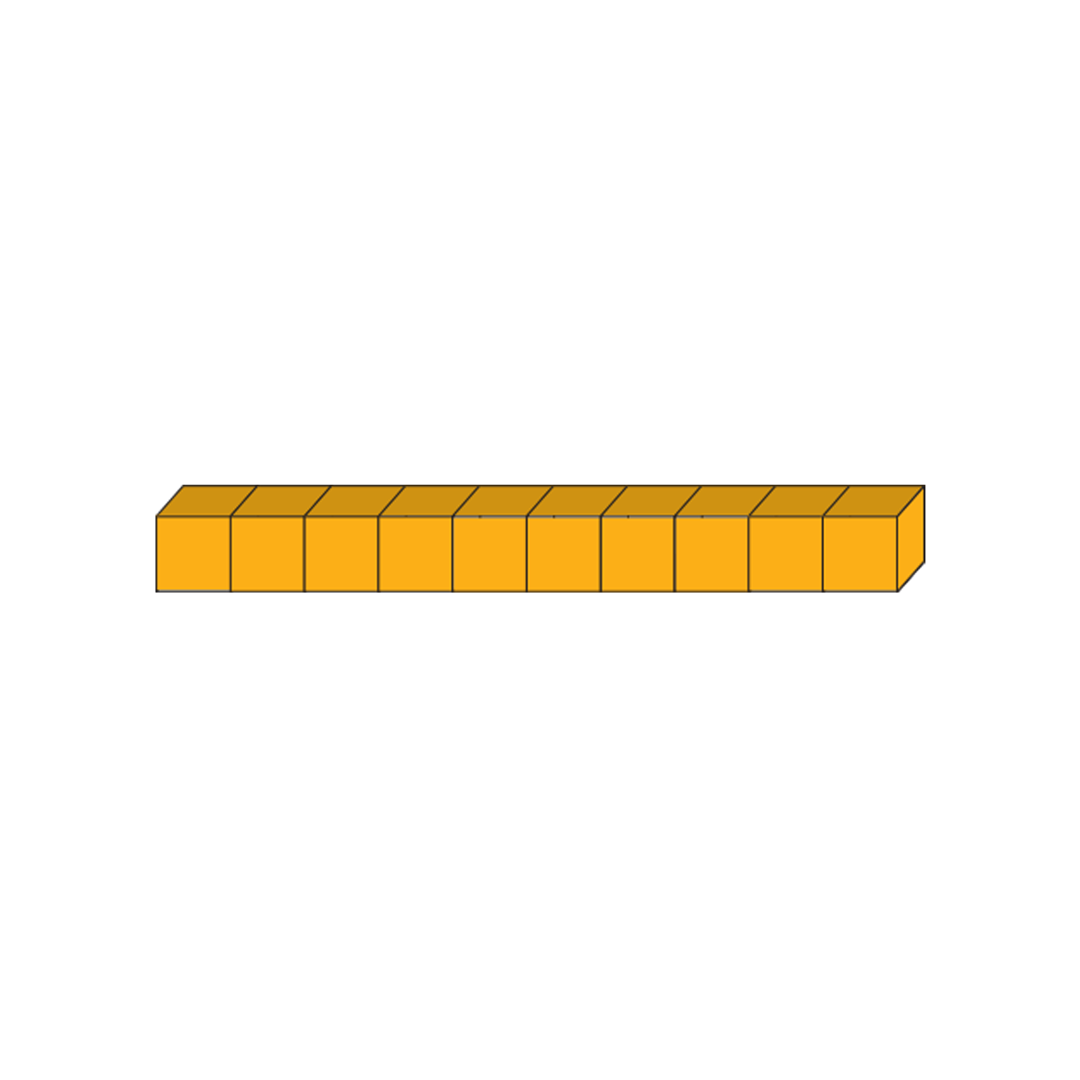







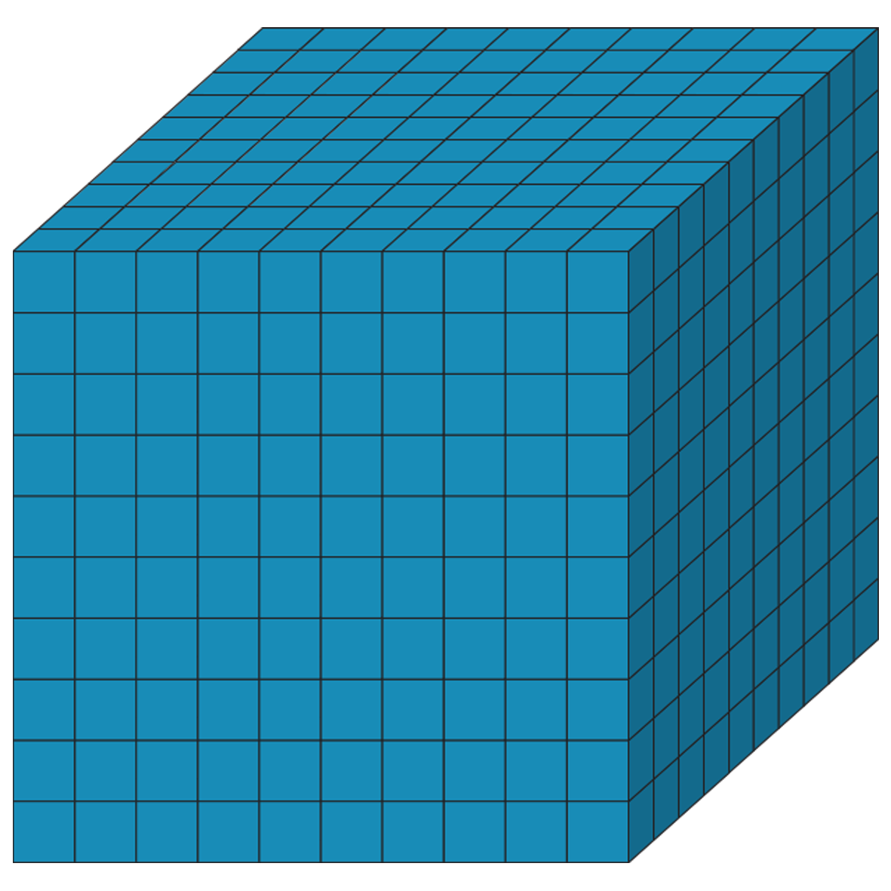
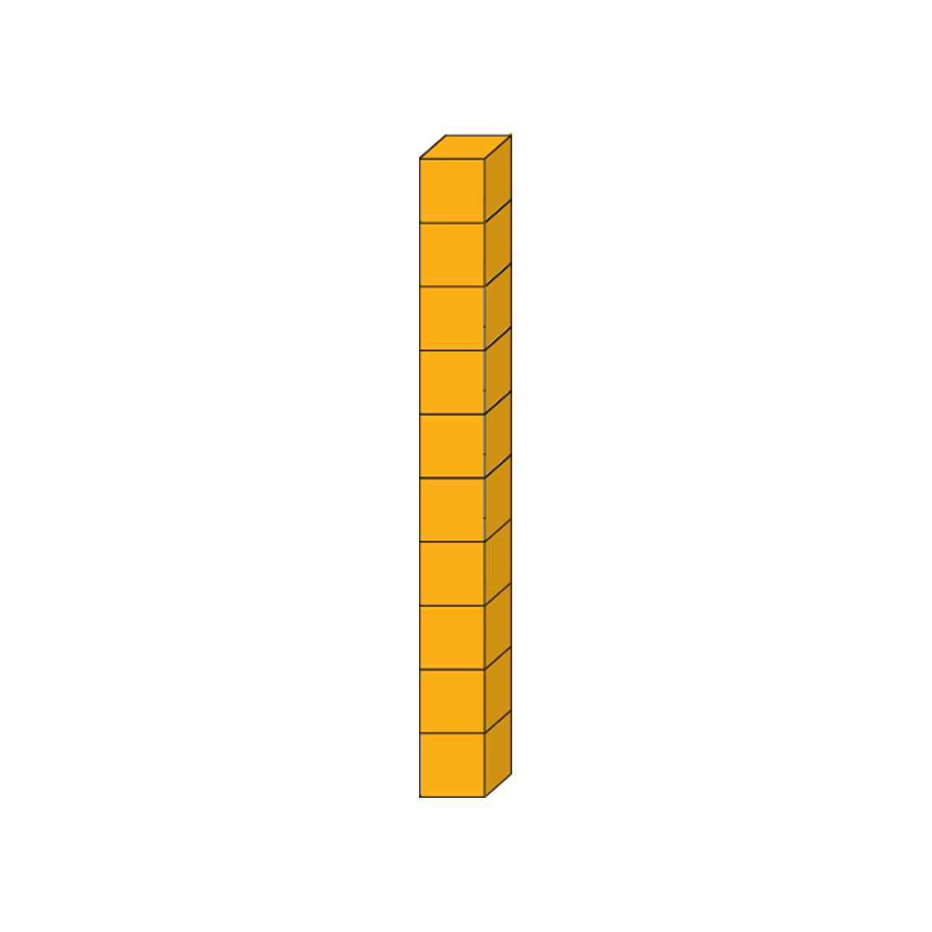







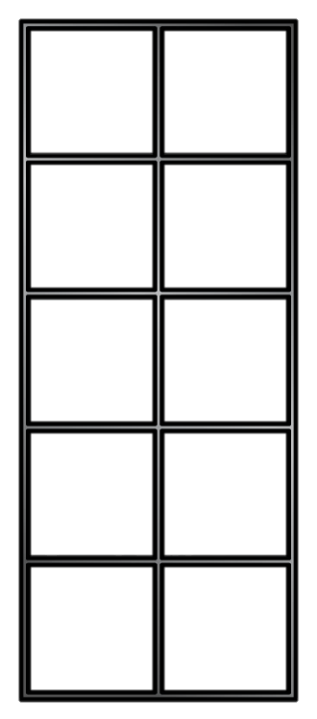
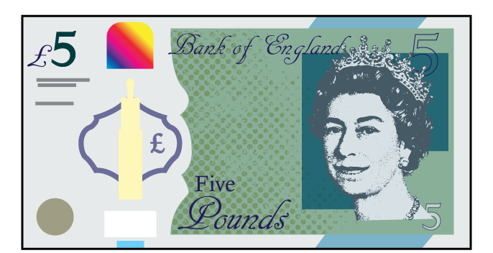



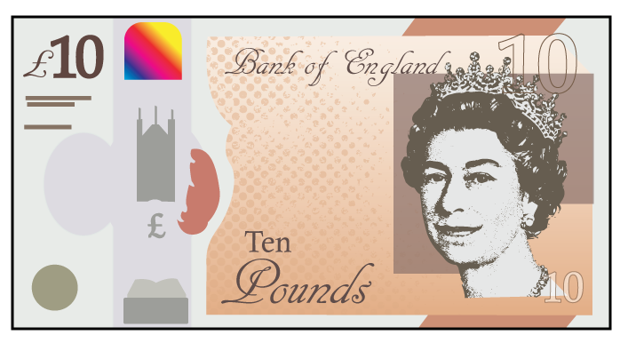


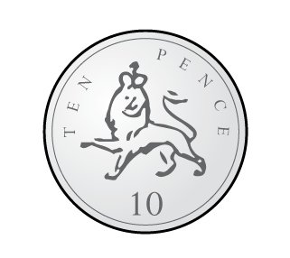


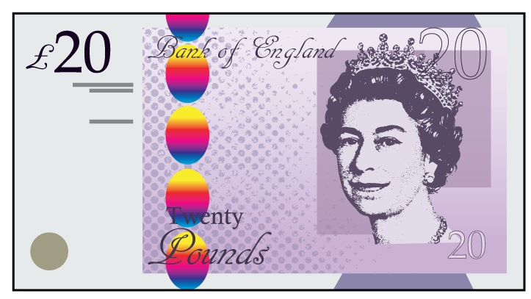


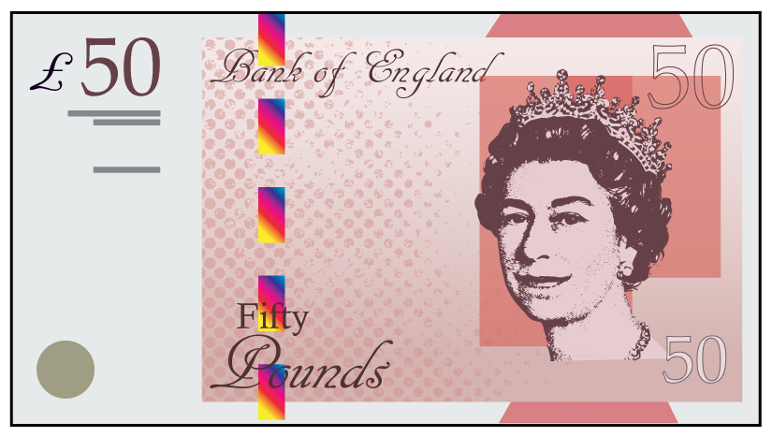

Slide 19
