Slide 1


Slide 3
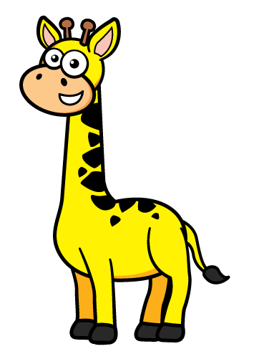


1) Circle the most appropriate unit.
Length can be measured in ml / cm / kg
Mass can be measured in l / tonne / km
Capacity can be measured in mm / g / ml
2) Match each length to a sensible estimate.
The height of a giraffe
The length of a ladybird
The length of a rubber
5 cm
5 m
5 mm

Slide 4
1) Circle the most appropriate unit.
Length can be measured in ml / cm / kg
Mass can be measured in l / tonne / km
Capacity can be measured in mm / g / ml
2) Match each length to a sensible estimate.
The height of a giraffe
The length of a ladybird
The length of a rubber
5 cm
5 m
5 mm

Slide 6

Have a think
Match the measure to its definition.
Length
The amount of matter that makes up an object or substance
The maximum amount that something can contain
Capacity
The measurement of something from end to end
Mass

Slide 7
Length | The measurement of something from end to end
Capacity | The maximum amount that something can contain
Mass | The amount of matter that makes up an object or substance
Sort the metric units into the correct categories.
Can you think of any more units for each category?
Have a think
cm
ml
g
tonne
km
Length | Capacity | Mass
mm
m
l
kg

Slide 8
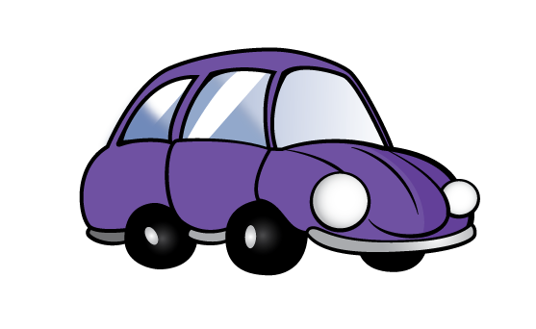
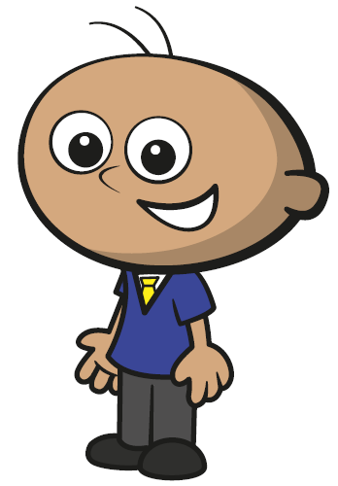

What is the most appropriate unit to measure the mass of each object?
g
kg
tonnes
Have a think

Slide 9



What is the most appropriate unit to measure the capacity of each object?
ml
ml
l
g
Have a think

Slide 10
Have a go at questions
1 - 3 on the worksheet

Slide 11
Circle the best estimate for each item.
The capacity of a bottle of shampoo.
3 l
30 ml
300 ml
3 ml
The length of a book.
20 cm
200 cm
2 m
20 mm
The mass of an adult dog.
15 g
15 kg
1.5 kg
150 kg
Have a think

Slide 12
Circle the best estimate for each item.
The capacity of a bottle of shampoo.
The capacity of a bottle of shampoo.
3 l
30 ml
300 ml
3 ml
The length of a book.
20 cm
200 cm
2 m
20 mm
The mass of an adult dog.
15 g
15 kg
1.5 kg
150 kg

Slide 13
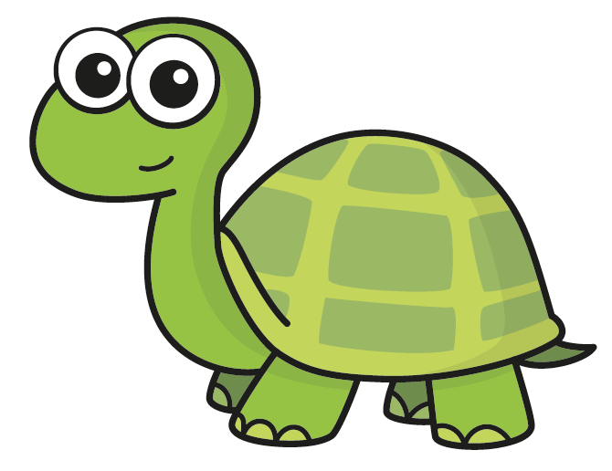

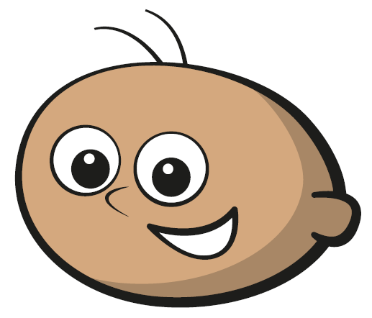
I’m going to measure the length of the desk in mm
You could do Tiny but millimetres is usually used to measure the length of small items. I think centimetres would be better.
Do you agree with Tiny?
... or even metres and centimetres!
Have a think

Slide 14
Have a go at the rest of the questions on the worksheet

Slide 15



Slide 16
I do
You do

Slide 17




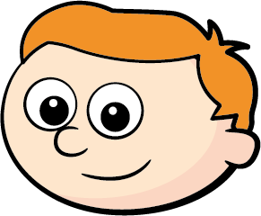
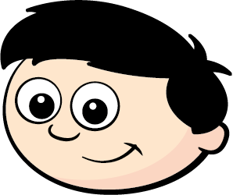

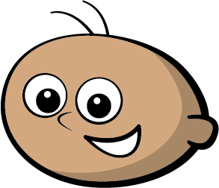




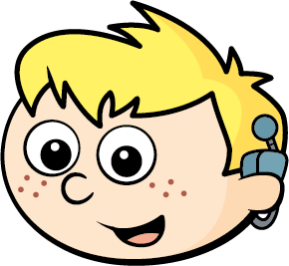



Rosie
Alex
Amir
Whitney
Ron
Dexter
Annie
Tommy
Mo
Jack
Eva
Teddy
Max
Kim
Jo
Sam

Slide 18

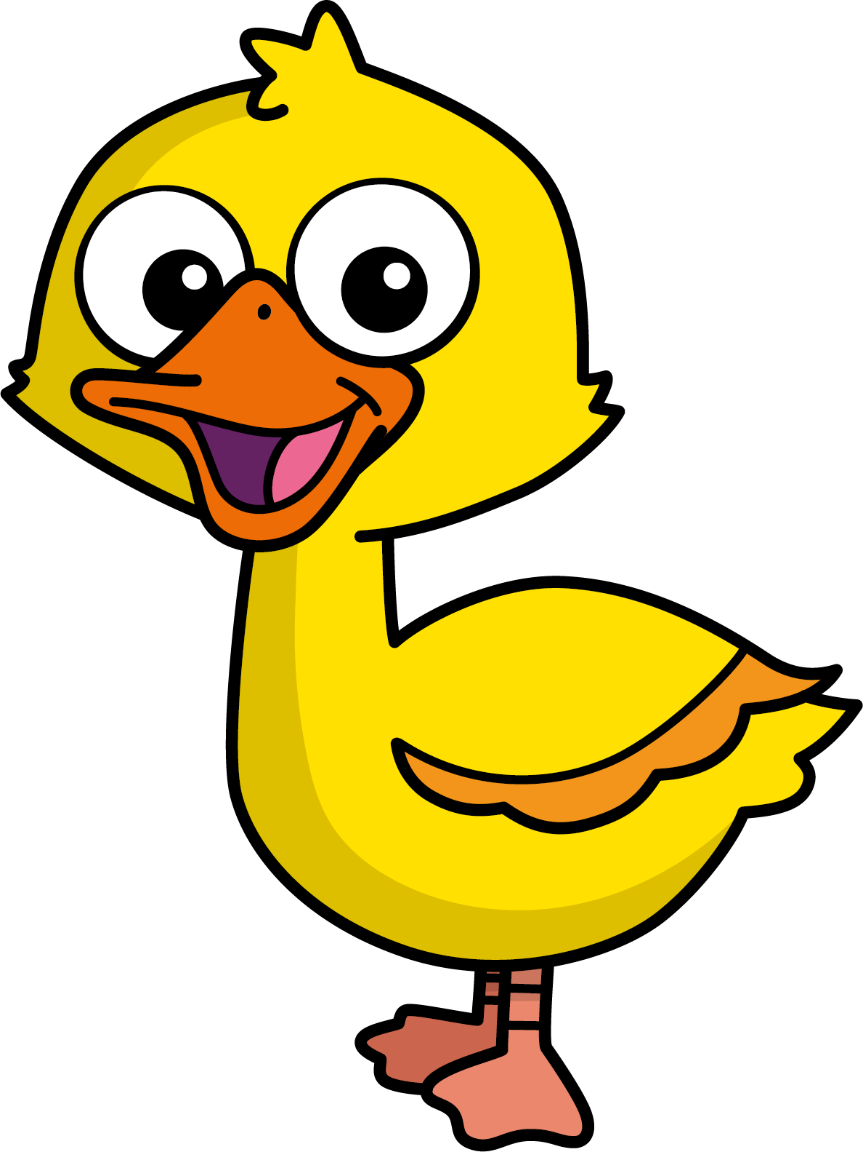
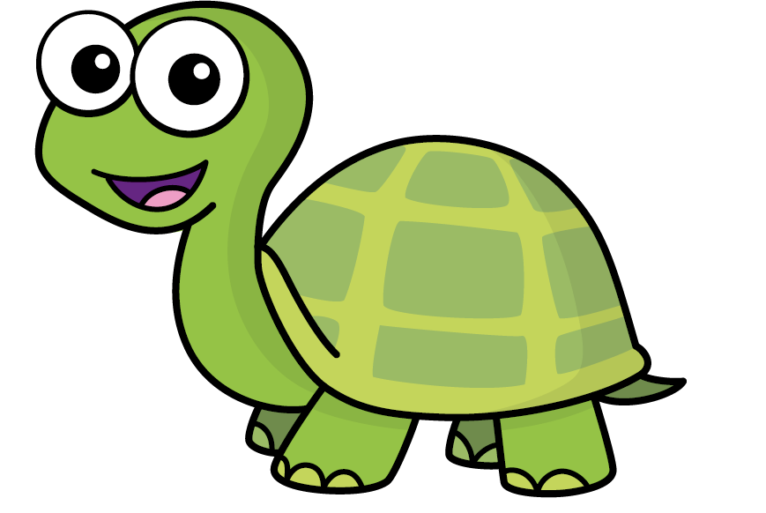
Speech bubble text – replace with any character head.
Speech bubble text – replace with any character head.
Bee
Diddy
Tiny

Slide 19
27
342
300
2
20
7
40
M | HTh | Tth | Th | H | T | O

Slide 20
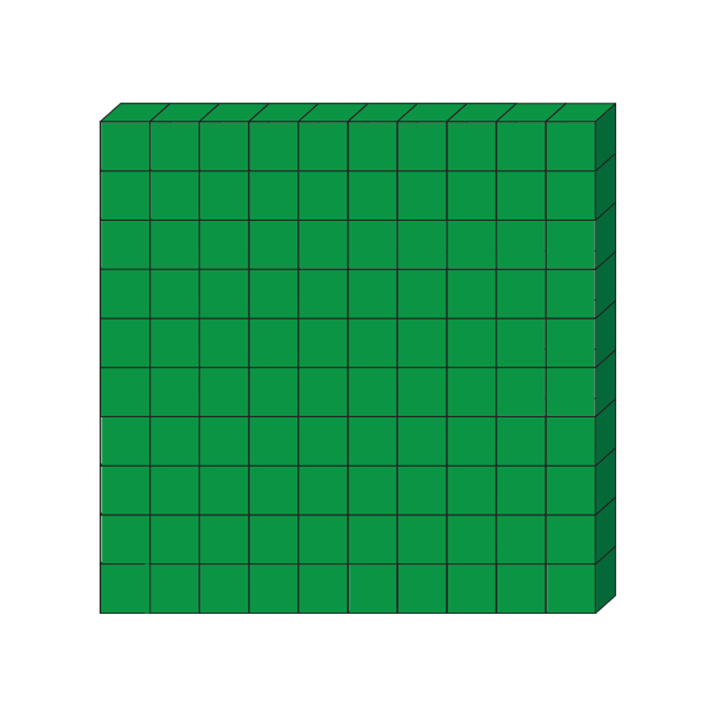

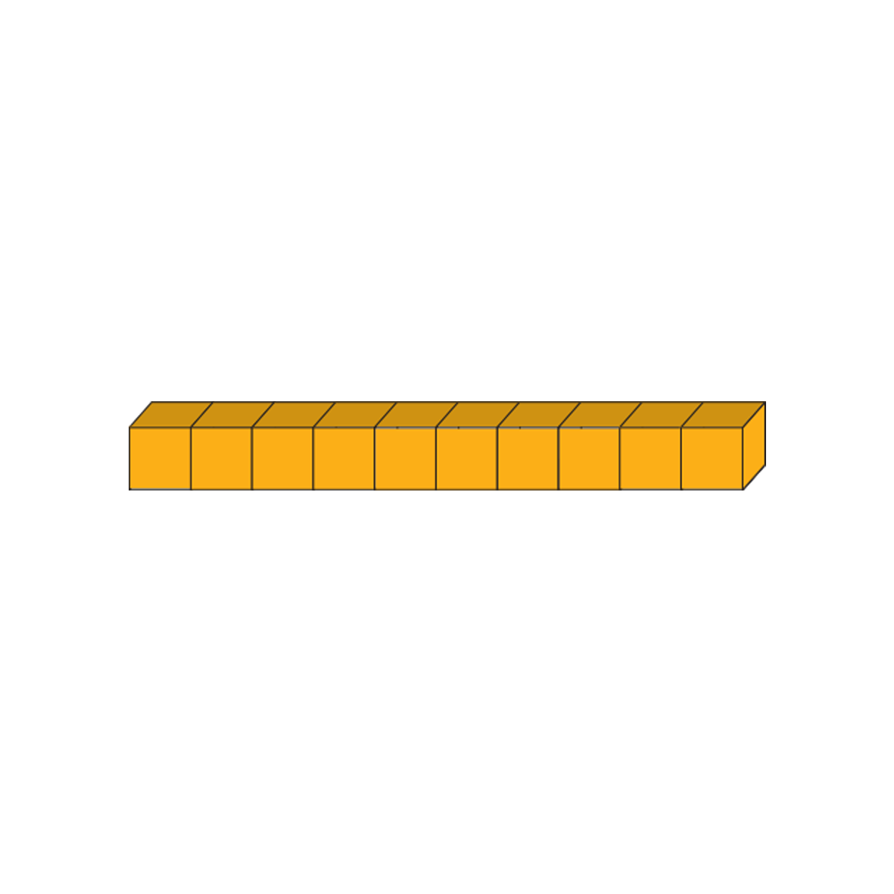






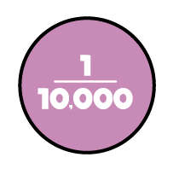
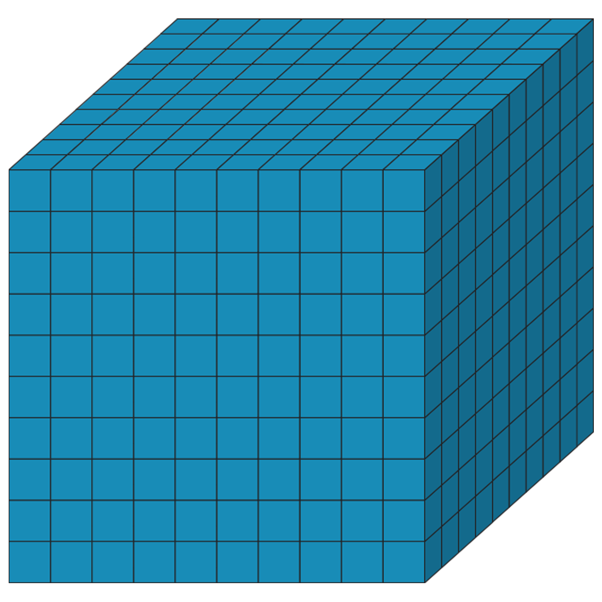
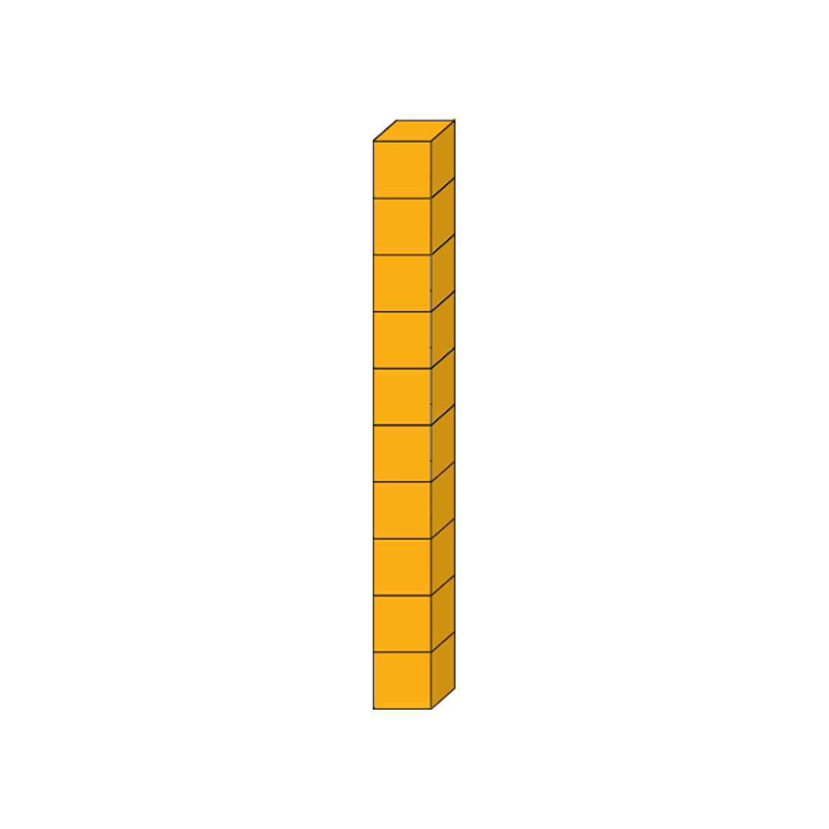







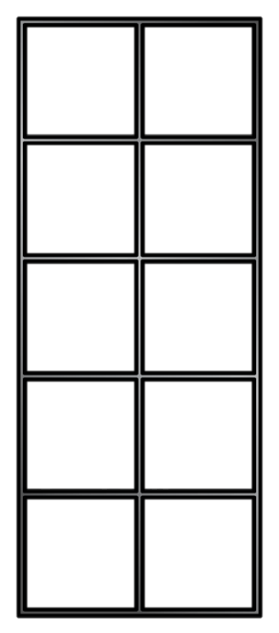
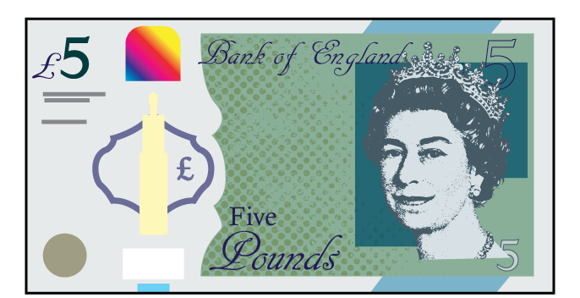
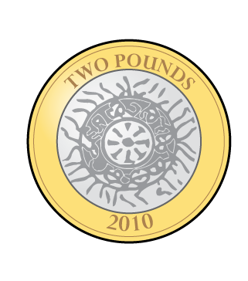
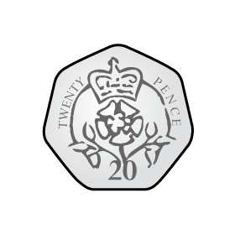
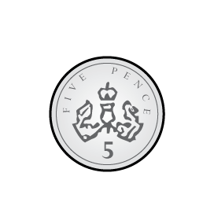
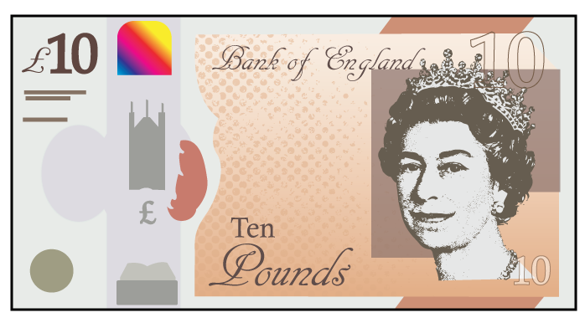
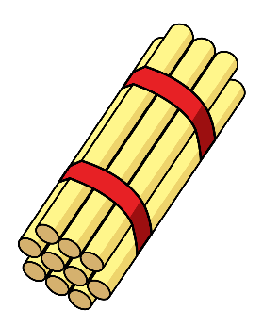

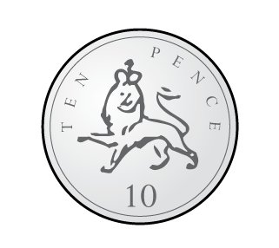
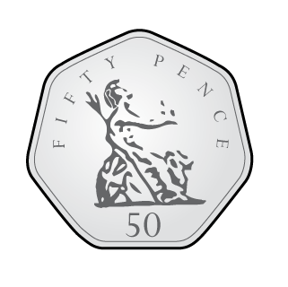

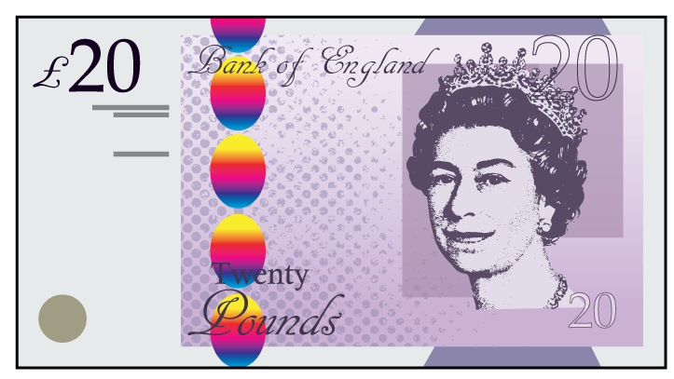
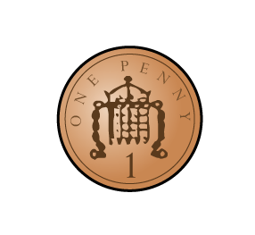

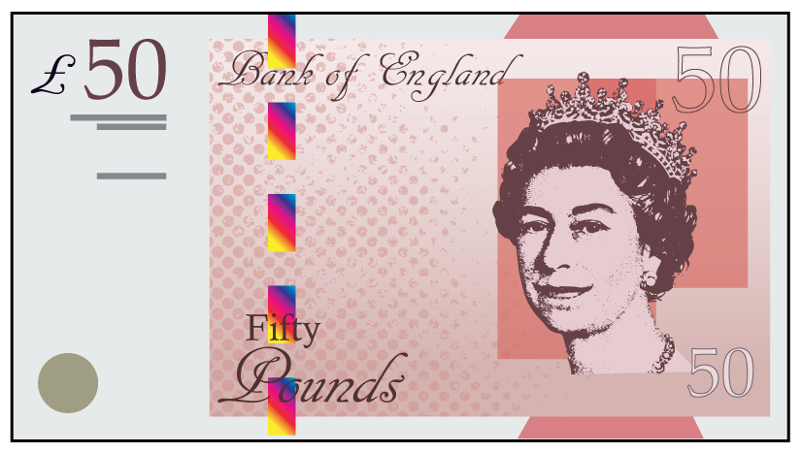

Slide 21
