Slide 1


Slide 3
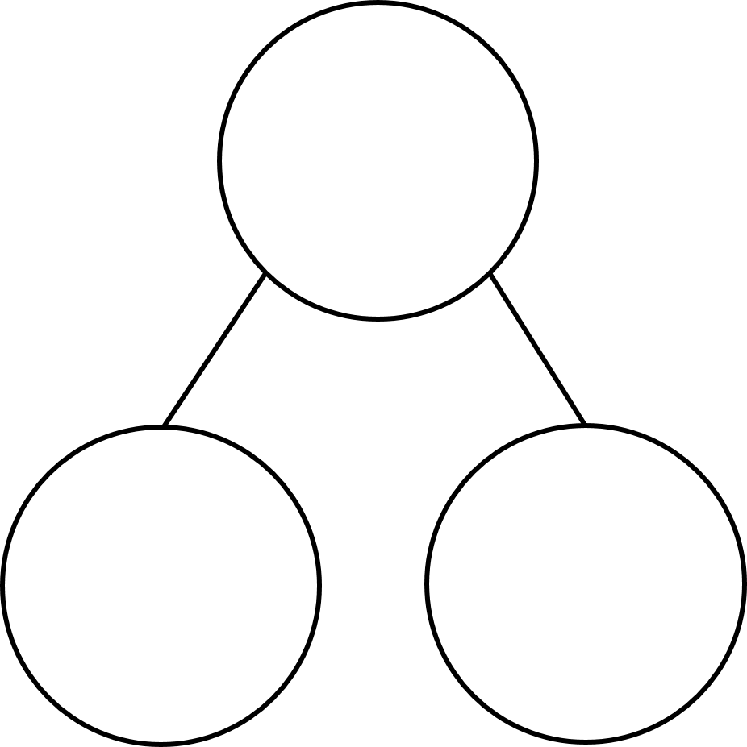

1) Complete the part-whole models.
2) Complete the conversions.
4.3 l $=$ _____ ml 70 mm $=$ _____ cm
43 l $=$ _____ ml 77 mm $=$ _____ cm
3.2 kg
25 m
2,000 g
2,000 cm

Slide 4
1) Complete the part-whole models.
2) Complete the conversions.
4.3 l $=$ _____ ml 70 mm $=$ _____ cm
43 l $=$ _____ ml 77 mm $=$ _____ cm
3.2 kg
25 m
2 kg
1.2 kg
20 m
5 m
2,000 g
2,000 cm
4,300
7
43,000
7.7

Slide 6
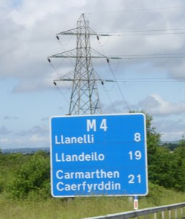
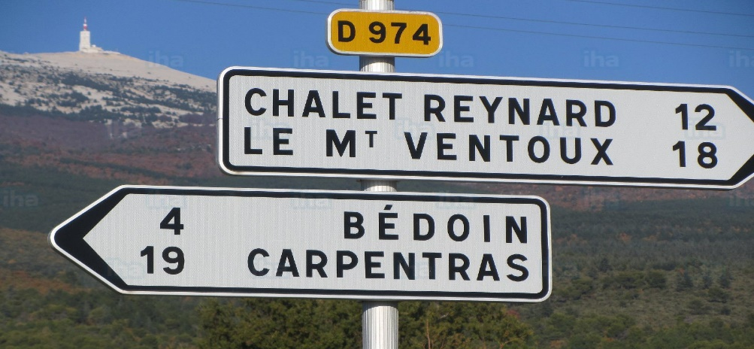
Miles and kilometres
Distances in the UK are usually measured in miles.
Distances in Europe are usually measure in kilometres.

Slide 7
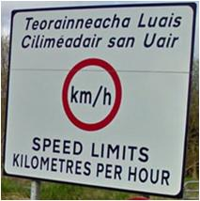
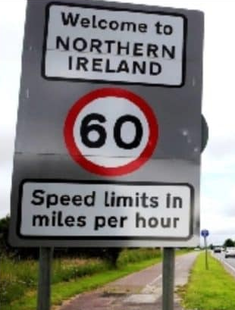

Slide 8



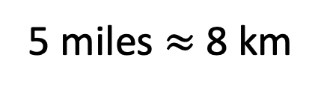


5 miles $≈$ 8 km
Have a think
$≈$ means ‘is approximately equal to’
1 mile
1 mile
1 mile
1 mile
1 mile
1 km
1 km
1 km
1 km
1 km
1 km
1 km
1 km
1 mile 1 km
$$>$$
1 mile 2 km
$$<$$
5 km 8 miles
$$<$$

Slide 9
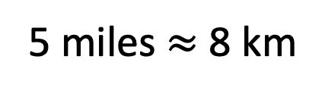
5 miles $≈$ 8 km
Have a think
miles
2.5
5
10
12.5
15
20
km
4
8
16
20
24
32

Slide 10

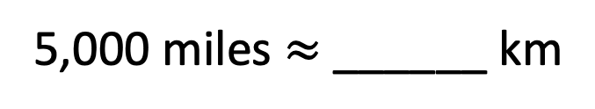
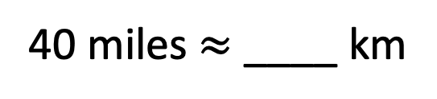
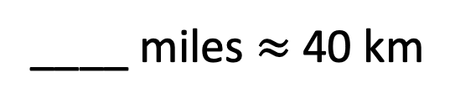
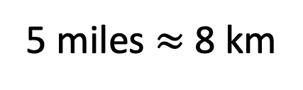
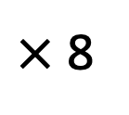

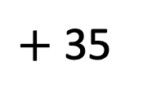
5 miles $≈$ 8 km
× 8
$×$ 8
$+$ 35
$+$ 35
43
64
40 miles $≈$ ____ km
____ miles $≈$ 40 km
25
8,000
5,000 miles $≈$ ______ km
Have a think

Slide 11
Have a go at questions
1 - 5 on the worksheet

Slide 12
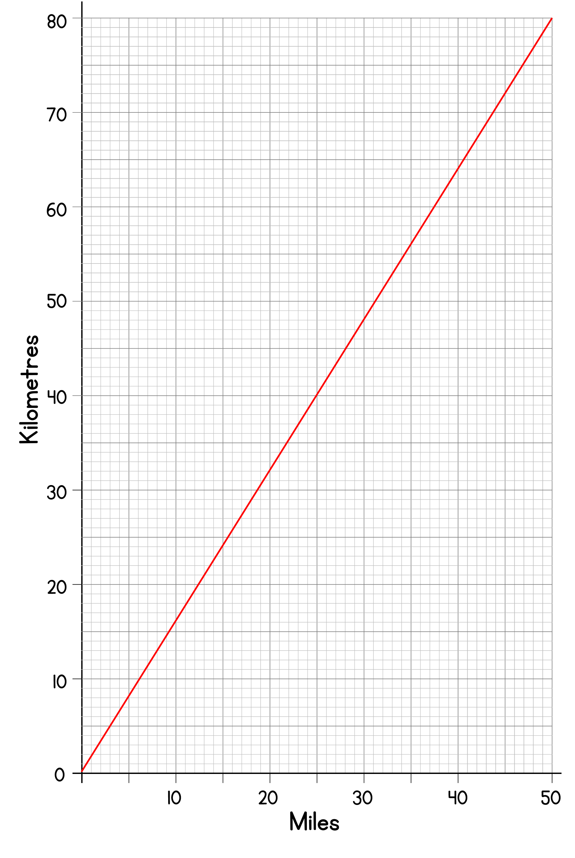
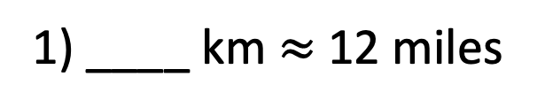

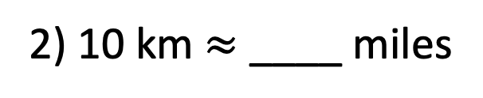
29
____ km $≈$ 18 miles
Have a think
1) ____ km $≈$ 12 miles
19
6
2) 10 km $≈$ ____ miles

Slide 13
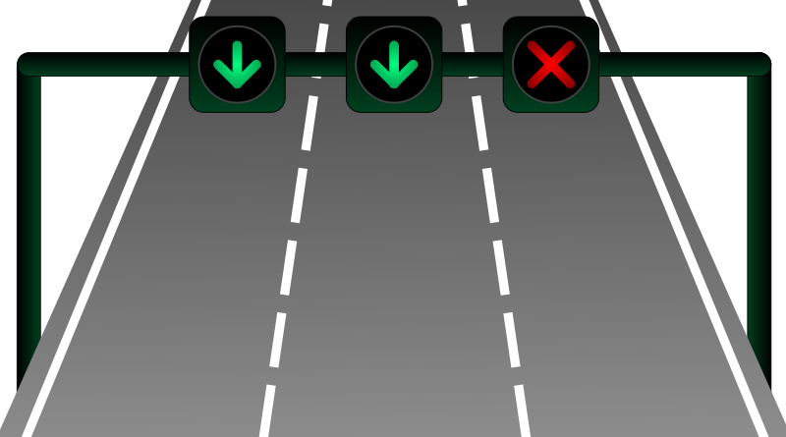
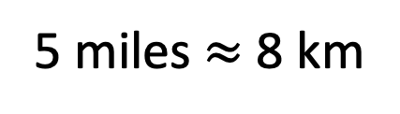
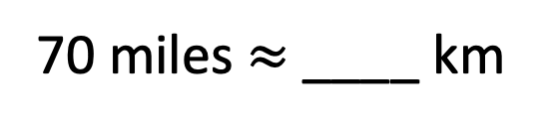
In Italy the motorway speed limit is 130 km/h.
In the UK the motorway speed limit is 70 mph.
In which country is the speed limit higher?
Italy
5 miles $≈$ 8 km
× 14
× 14
112
70 miles $≈$ ____ km

Slide 14

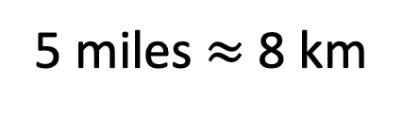


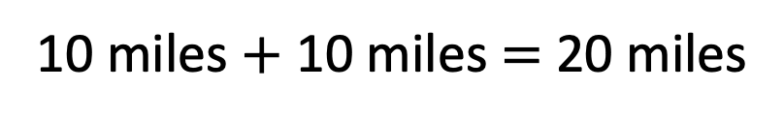
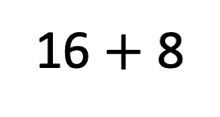
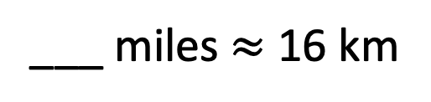
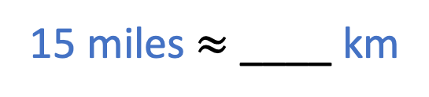
Mo cycles 45 miles over the course of 3 days.
On day 1, he cycles 10 miles.
On day 1, he cycles 16 km.
On day 2, he cycles 10 miles further than he did on day 1
How far does he cycle on day 3?
Give your answer in miles and in kilometres.
5 miles $≈$ 8 km
16 $+$ 8
___ miles $≈$ 16 km
10
10 miles $+$ 10 miles $=$ 20 miles
Day 1 $=$ 10 miles
15 miles $≈$ ____ km
24
Day 2 $=$ 20 miles
Have a think
Day 3 $=$ 15 miles

Slide 15
Have a go at the rest of the questions on the worksheet

Slide 16



Slide 17
I do
You do

Slide 18
















Rosie
Alex
Amir
Whitney
Ron
Dexter
Annie
Tommy
Mo
Jack
Eva
Teddy
Max
Kim
Jo
Sam

Slide 19



Speech bubble text – replace with any character head.
Speech bubble text – replace with any character head.
Bee
Diddy
Tiny

Slide 20
27
342
300
2
20
7
40
M | HTh | Tth | Th | H | T | O

Slide 21


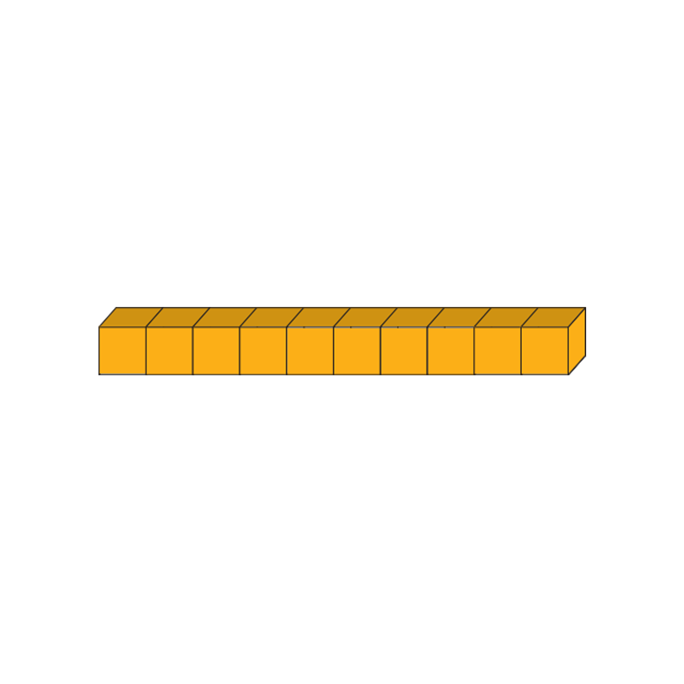







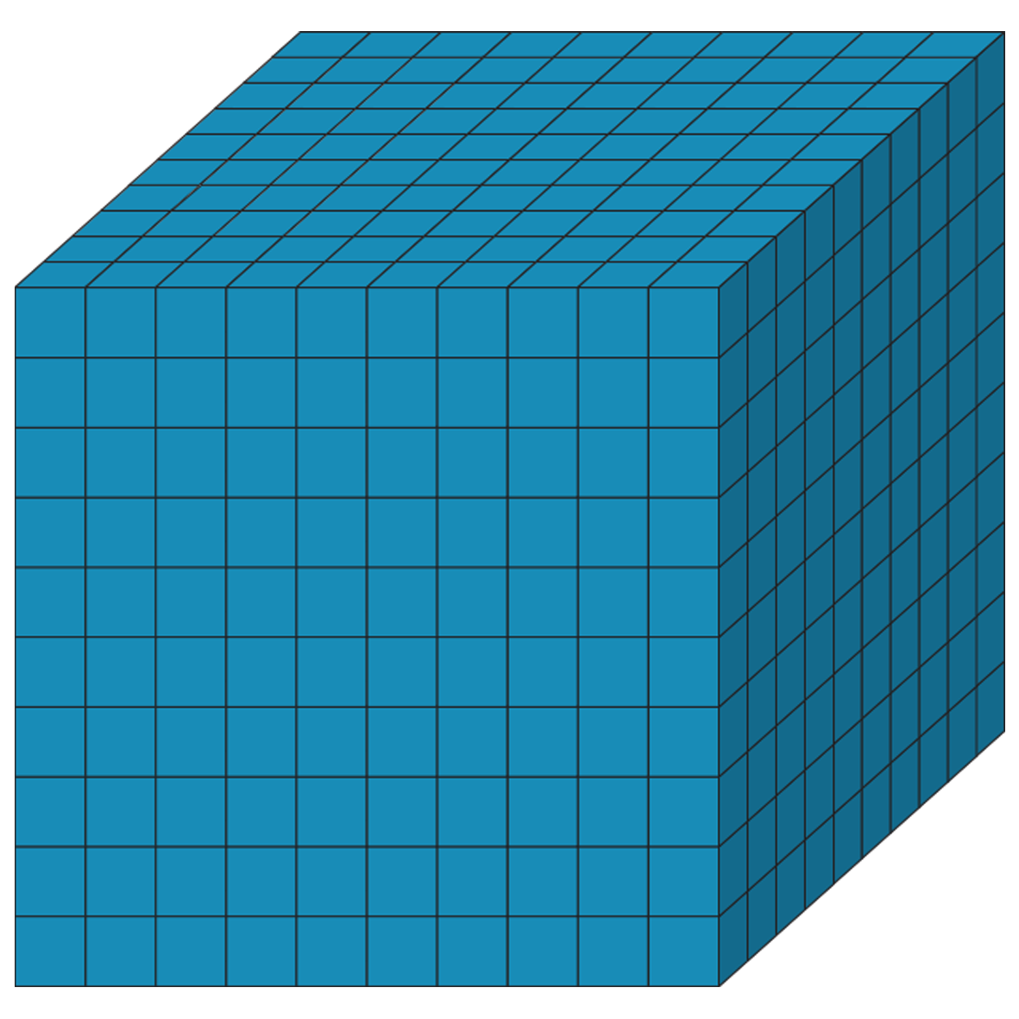
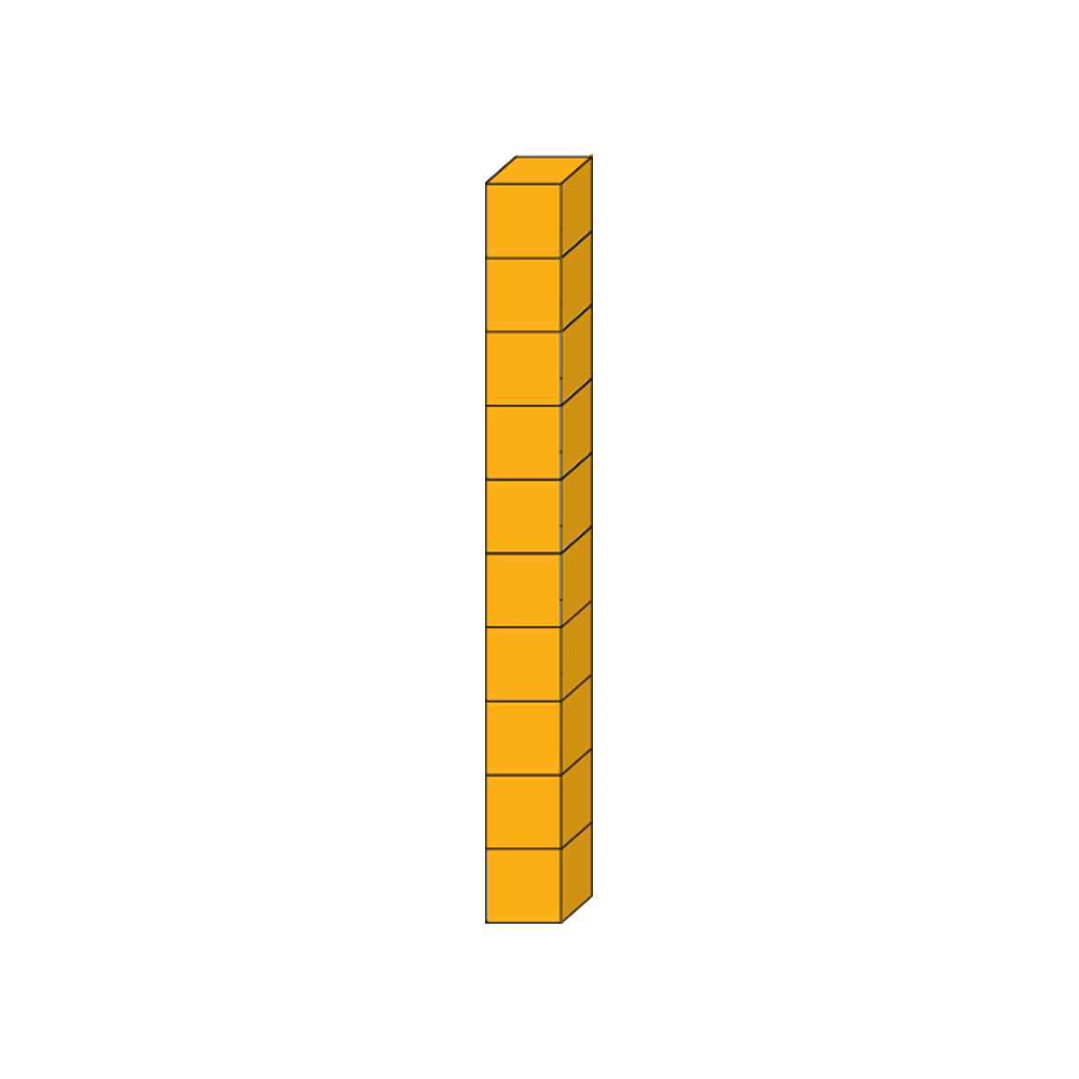







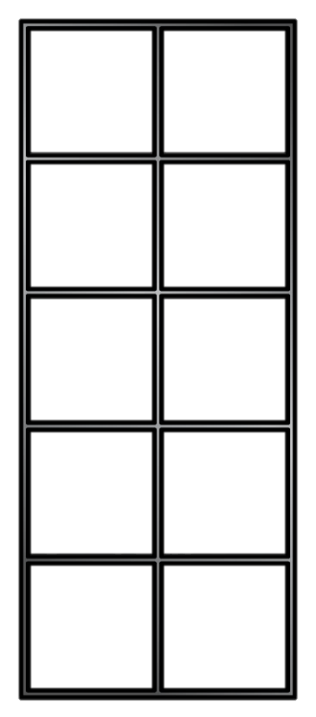
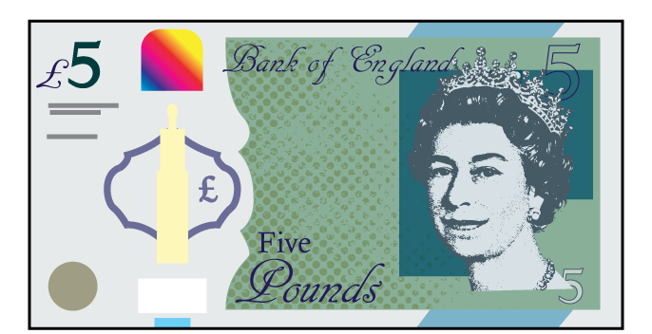



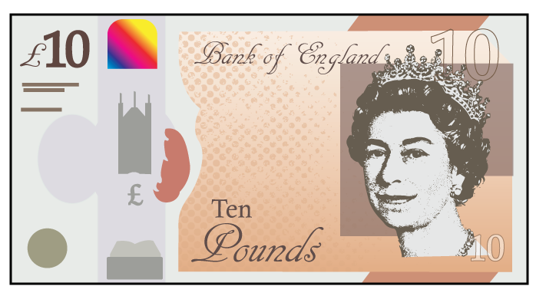


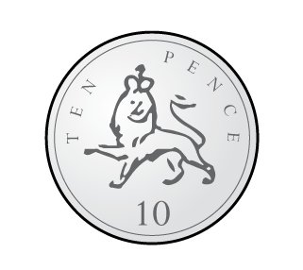
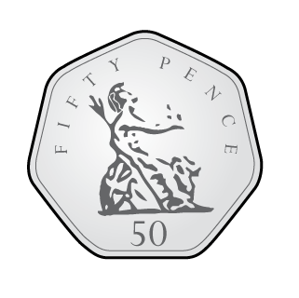

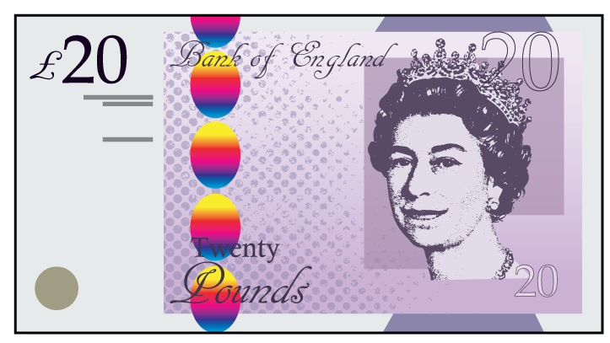


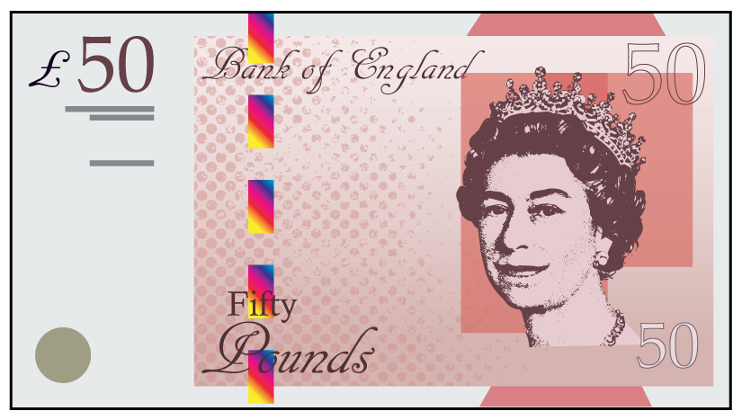

Slide 22
