Slide 1


Welcome to Year 4
to Year 5
Notes:
‹#›

Slide 2
Staff
SENIOR LEADERSHIP TEAM
Headteacher Mrs A K Casey
Deputy Headteacher Mr T Collins (Safeguarding Lead)
Phase Leader Mr S Barker (SEND)
Phase Leader (Years 1 & 2) Mrs E Collins
Phase Leader (Years 3 & 4) Miss H Gray
Phase Leader (Years 5 & 6) Mrs A Smith
Foundation Phase Leader Mrs U Harrington
Year 6 Mr Barker, Mr Collins, Mrs Midgley
Year 5 Mrs Smith, Miss Skarratt

Slide 3
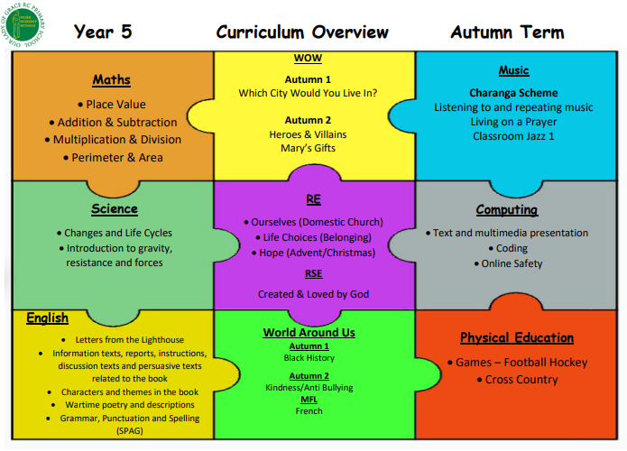
Curriculum Overview

Slide 4
Class Routines
Dojos are awarded for good behaviour in class and around school.
We are very positive and we try to motivate with lots of praise rather than punish with consequences.
We have high expectations in terms of pupils’ work, attitude and behaviour.
A warning will however be given and if necessary sanctions such as missing part of break, speaking to a member of the SLT may be required etc.

Slide 5
Spellings
10 spellings will be sent home on a Wednesday to be tested on the following Wednesday.
Spellings can be found on the Class website every week.
Children can log into Spelling shed for further practice.

Slide 6
Reading Books
I aim to change reading books daily when they are on the reading ladder. Please always bring your reading book into school by keeping it in the school bag.
Please sign your child’s log when they have read with you or discussed the book with you.
Giving your child as many opportunities to read is very important. Reading daily doesn’t just improve pupils fluency and expression. Pupils also benefit from having well written stories modelled to them in terms of both composition and effect and also the correct grammatical conventions.

Slide 7
Homework
Children will be provided with a SPaG and Maths homework book.
I will ask the children to highlight the page number for the next piece of work to be completed. I will also put the page numbers on the class website.
Work will be set in these books on a Wednesday and needs to be completed for the following Wednesday.

Slide 8

Times Tables Rock Stars
Key Stage 2 children must continue to learn and practise the times tables. Please use TimesTablesRockStars to practice.

Slide 9
Going Home
The children will be dismissed from the year 5/6 playground.
Please remind your child if ever you (or whoever is picking them up) is late to stay with the staff.
If any children are left by 3:45pm, whoever is on duty will take the child/children to the office and contact parents. Someone will stay with them until they are collected.
If there is a change in your child’s usual routine please contact the office who will get the message to us.

