Slide 1


Welcome to Year 4
to Year 5
Notes:
‹#›

Slide 2
Staff
Headteacher- Mrs A K Casey
Deputy Headteacher- Mr T Collins (Safeguarding Lead)
SENDCO- Mr S Barker (SEND)
Phase Leader (Years 5 & 6)- Mrs A Smith
Year 5 Teachers- Mrs Smith, Miss Skarratt
PPA teachers- Mrs Neill (Y5S),Mrs Bowers (Y5AS)

Slide 3
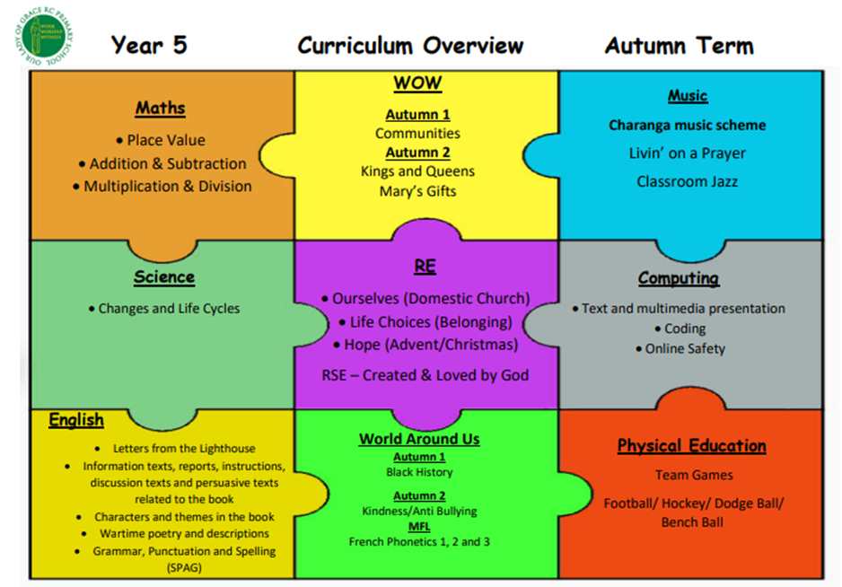
Curriculum Overview

Slide 4
Rewards
Raffle tickets, Dojos are awarded for good behaviour in class and around school.
Star of the Week
Star Writer
WOW Certificates (from January)
We have high expectations in terms of pupils’ work, attitude and behaviour.

Slide 5
Spellings
10 spellings will be set a week.
Spellings can be found on the Class website every half term.
Children can log into Spelling shed for further practice.

Slide 6
Reading Books
Children to always bring their reading book into school by keeping it in the school bag.
Please sign your child’s log when they have read with you or discussed the book with you.
Giving your child as many opportunities to read is very important. Reading daily doesn’t just improve pupils fluency and expression. Pupils also benefit from having well written stories modelled to them in terms of both composition and effect and also the correct grammatical conventions.

Slide 7
Homework
Children will be provided with a SPaG and Maths homework book.
We will ask the children to highlight the page number for the next piece of work to be completed.
We will also send out the children's Arithmetic tests each week.

Slide 8
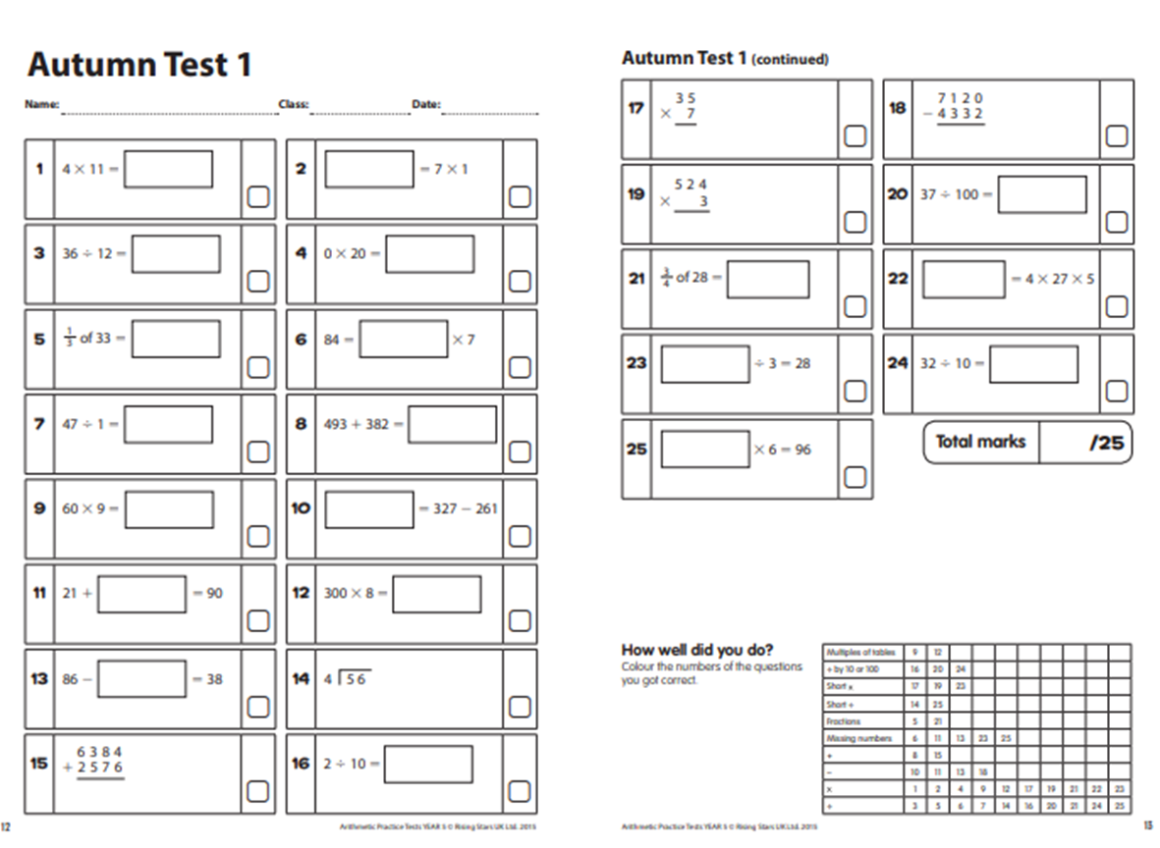
Homework

Slide 9
5S Homework
Maths and Grammar homework will be set each Monday and to be handed in for the following Monday.
Spelling will also be on a Monday. The list can be found on the class website.

Slide 10
5AS Homework
Maths and Grammar homework will be set each Friday and to be handed in for the following Friday.
Spelling will also be on a Friday. The list can be found on the class website.

Slide 11

Times Tables Rock Stars
Key Stage 2 children must continue to learn and practise the times tables. Please use TimesTablesRockStars to practice.

Slide 12
Parents’ Evening
Individual Parents’ Evenings are held twice a year. At those meetings you will be able to discuss your child’s progress.
We will inform you of the details when they become available.
If you feel you need to speak to your child’s teacher, please make an appointment via the school office .

Slide 13
Going Home
The children will be dismissed from the year 5/6 playground.
Please remind your child if ever you (or whoever is picking them up) is late to stay with the staff.
If any children are left by 3:35pm, whoever is on duty will take the child/children to the office and contact parents. Someone will stay with them until they are collected.
If there is a change in your child’s usual routine please contact the office who will get the message to us.

Slide 14

Thank you
Thank you for attending. We look forward to working alongside you in educating your children in Year 5.

