Slide 1

Meet the Teacher 2023-2024

Slide 2

Key Staff:
Headteacher- Mrs. Casey
Deputy Headteacher- Mr. Collins
EYFS Senior Leader - Mrs. Harrington
Senior Leader of Y1&2 - Mrs. Collins
Senior Leader of Y3&4 - Miss Gray
Senior Leader of Y5&6 – Mrs. Smith
Senior Leader of SEND – Mr. Barker

Slide 3
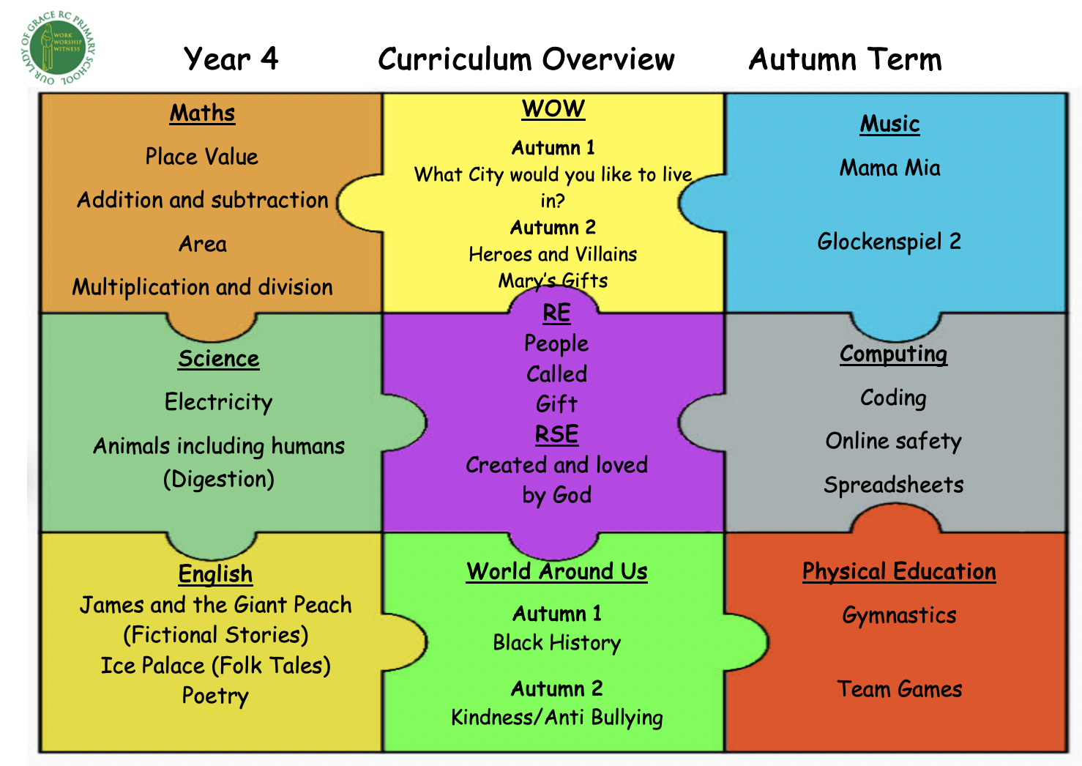
Our Curriculum:
Please see the School Website > Curriculum > Overviews to see what we’re learning each half term.

Slide 4
Class routines:
Please see our display boards. Here you can find our class rules, daily timetable and subjects.
In our school, we promote consistency and clarity. Our rules and routines are there to support our pupils.

Slide 5

Rewards:
In year 4P, we have raffle tickets for individual rewards and class points to reward whole-class behaviour and actions to reinforce teamwork and virtues such as patience, tolerance of others, the ability to listen to others and collaboration.

Slide 6
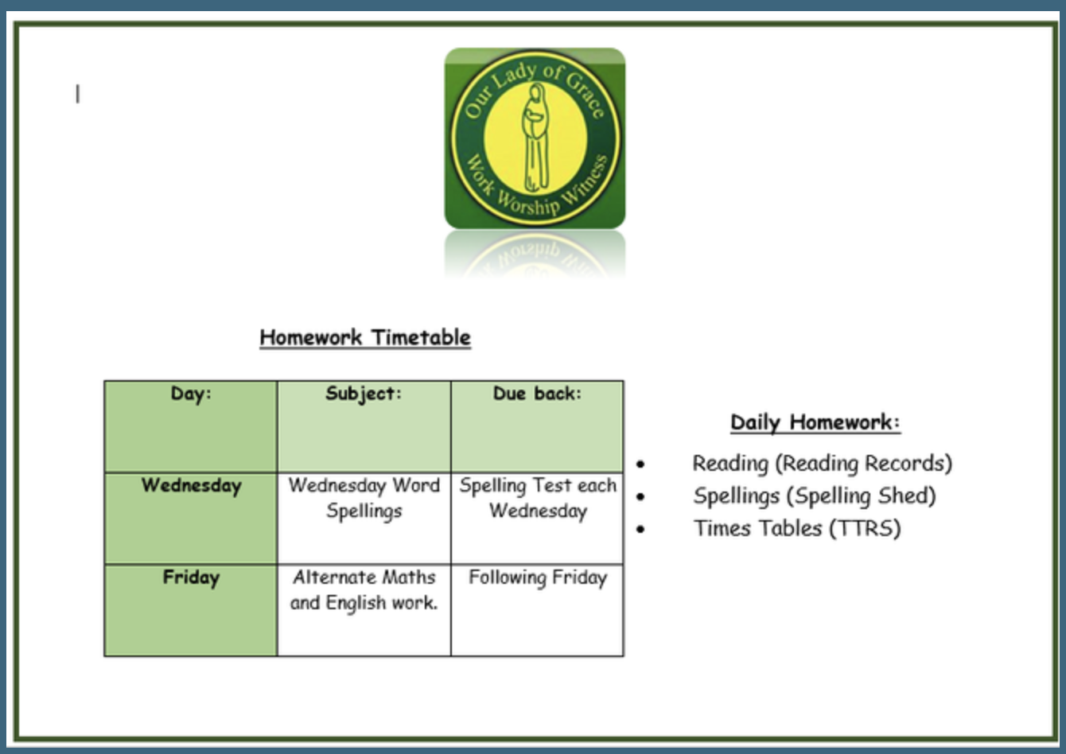
Homework:

Slide 7
Homework:
Daily reading is also very important. Thank you for all your help in ensuring your child is reading at home and for signing their reading record books.
Pupils’ comprehension skills are equally as important as their reading fluency. Please continue to ask your child questions based on what they’ve read. Thank you!

Slide 8
Homework:
This year, in the Summer Term, each child will take the statutory Multiplication Tables Check (MTC).
Times tables practice is essential. Any time spent on these each day will be much appreciated.

Slide 9
Parents Evening:
Individual parent’s evenings are twice a year.
At these meetings you will be able to discuss your child’s progress.
Teachers are available throughout the year if you feel you need to speak to them by making an appointment via the school office.

Slide 10
Thank you!
It has been lovely to meet you all and it is so nice to have our children back ready for the new school year!
Please may I ask that if you would like to discuss a certain individual in more detail, you make an appointment to speak to me separately due to time constraints. Thank you.

