Slide 1
How do we teach Reading at Our Lady of Grace?
KS2 Information Slides

Slide 2
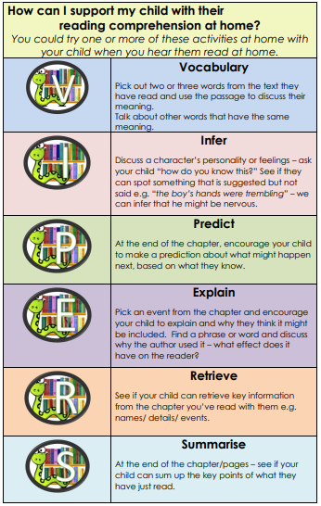
BEAR Time
BEAR time stands for Be Excited About Reading.
This is our formalised daily reading time which takes place between 13:15-13:45.
Children in each class are divided into groups based on their reading ability to provide as much opportunity for challenge as possible.
Each group is given a book mark (containing questions) specific to the focus for that week (VIPERS).
For example:
Week 1 – V focus
Week 2 – I focus

Slide 3


Reading Vipers
Vocabulary
Infer
Predict
Explain
Retrieve
Summarise

Slide 4
BEAR Time
These can be found at the back of your child’s home reading record book. Please encourage your child to focus on the specific skill for the week by asking questions and leaving a comment on how they have progressed.
Please see the handout for example questions you could ask your child.

Slide 5
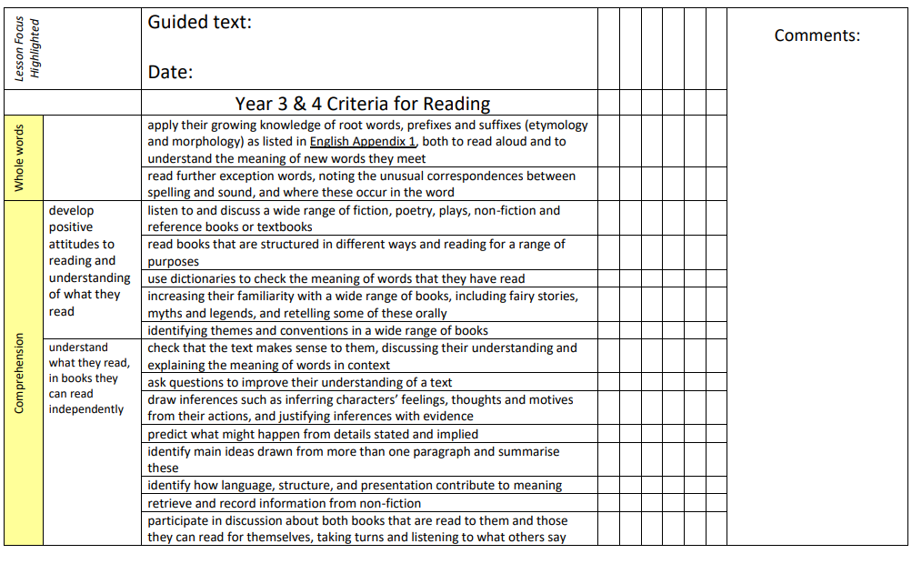
BEAR Time
Your child’s group will read with the teacher one day a week in a guided reading session. The day will be written at the front of your child’s reading record book.
During this session, the group will focus on and work towards one of the reading expectations for their year group.

Slide 6
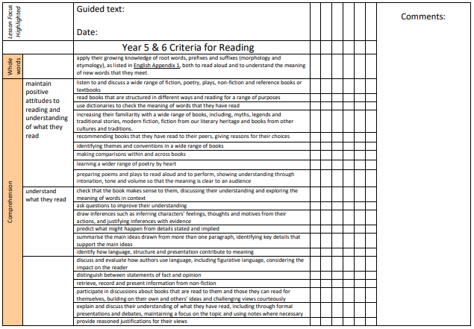
BEAR Time

Slide 7
KS2 English Reading Test Framework
Pupils working at the expected standard are able to:
• show an understanding of the meaning of vocabulary in context (2a)
• retrieve key details and quotations from fiction and non-fiction to demonstrate understanding of character, events and information (2b)
• provide developed explanations for key information and events and for characters’ actions and motivations (2b)
• accurately and selectively summarise main ideas, events, characters and information in fiction and non-fiction texts (2c)
• make developed inferences drawing on evidence from the text (2d)
• explain and justify inferences, providing evidence from the text to support reasoning (2d)
• make developed predictions that are securely rooted in the text (2e)
• identify / explain how information in non-fiction is related and contributes to meaning as a whole (2f)
• identify / explain how the sequence of events in narrative fiction contributes to meaning as a whole (2f)
• identify / explain how the choice of language enhances the meaning of texts (2g)
• make accurate and appropriate comparisons within texts (2h)
The Reading VIPERS target the specific skills pupils need in order to become fluent, avid readers. The VIPERS also prepare pupils for their academic tests (including SATs). It is an invaluable skill for pupils to recognise what the question is asking. By using VIPERS, pupils will be able to spot the skill that is required to answer the question and will boost their confidence and reading ability as a result.
Thank you for your ongoing support with your child’s reading.
Any questions?

