Slide 1
Reading in Year 1 and 2

Slide 2
Welcome
This meeting is an opportunity to explain in a little more detail how we teach Phonics to your child. We also want to give you ideas for how you can further support your child at home in developing their phonic and reading skills.

Slide 3

National Curriculum: Year KS1
Children need to develop:
pleasure in reading;
motivation to read;
increased vocabulary;
improved level of understanding.
They will do this by frequently listening to:
stories;
poems;
information texts;
texts that they cannot yet read for themselves.
By reading with an adult, children can also be shown the processes of finding information within a book, such as the use of contents or index pages.
Notes:
Review the National Curriculum aims for year 1, highlighting the importance of motivating children to read both at school and at home. Highlight some methods of supporting parents with motivating children to want to read. You may wish to mention the use of a reading reward chart to help children to get in good reading habits. Ensure that parent and carers also understand that a number of the skills needed will be developed by hearing adults read to them, not just necessarily by reading texts themselves. Discuss the impact of reading texts to children at a higher level than they can read for themselves in order to develop their vocabulary and understanding.

Slide 4

How to Help
Initially, reading with your child is about reading to them. Model clear reading with fluency and expression. Model how to read unknown words.
Read a range of different texts, such as: recipe books; nursery rhymes; instruction manuals; leaflets for places you wish to visit; traditional tales.
Show your child how to find information in a book rather than quickly finding it for them.
Notes:
Cover some initial ideas about how parents can support the National Curriculum aims highlighted on the previous slide.
These ideas are also included in the Reading with Your Year 1 Child Parent Advice Booklet.

Slide 5
Year 1 Common Exception Words
Notes:
Share the Year 1 Common Exception Words handout and explain that pupils need to be able to read and spell these words by the end of the year.

Slide 6
Year 2 Common Exception Words
Notes:
Share the Year 2 Common Exception Words handout and explain that pupils need to be able to read and spell these words by the end of the year.

Slide 7

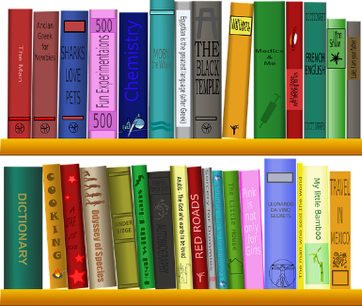
SATs Reading Coverage
In the KS1 reading tests, your child’s understanding of reading is tested through different strands.
Vocabulary
Looking at the choices of words that an author uses in a text.
Inference
What is suggested but not said in the text? Read between the lines and find ‘hidden’ meaning.
Predict
What might happen next based on what has happened in the text?
Explain
Explain an aspect of the text. This may include why the author includes it.
Retrieve
Retrieve information from the text to answer questions.
Sequencing
Sequence the key events in the story.
Getting your child used to answering questions from each of these areas prepares them for the SATs reading assessment. Asking a few questions per night will build your child’s experience.
Notes:
Introduce parents and carers to the Year 2 SATs using the Totally Pawsome Gang to cover each content domain.

Slide 8

Helping Your Child at Home
Talk about what can be inferred from the pictures before you read the text, e.g. ‘Why might the girl on the cover be sad?’
Discuss alternative words the author could have used, e.g. ‘Happy is a bit of a boring adjective, isn’t it? What word could we use instead?’
Make predictions
and be able to
justify them.

Slide 9


Helping Your Child at Home
Discuss the setting of the story. Have you read another book with the same setting?
How does the setting in the first chapter differ to the setting at the end of the story?
Have you learnt
anything while reading this book that you didn’t
know before?

Slide 10
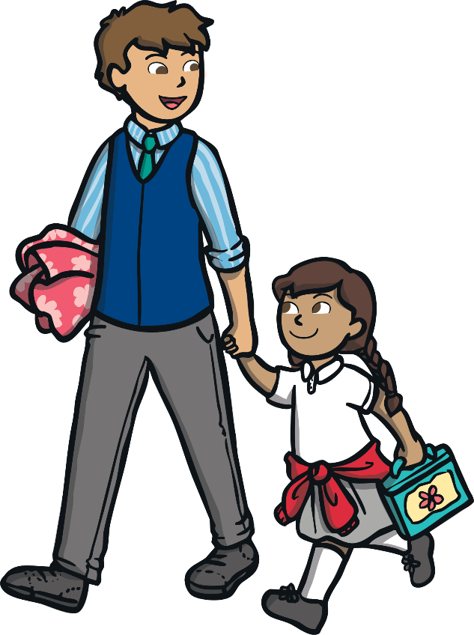

Reading Every Day
Reading to your child every day is just as important as hearing your child read to you.
Reading to your child will help your child to develop their understanding of what they hear. It can also inspire them to want to read for themselves.
Try to read to your child at a higher level than they can read
by themselves.
Remember to talk about new words you come across together.
Why not use a dictionary?

Slide 11

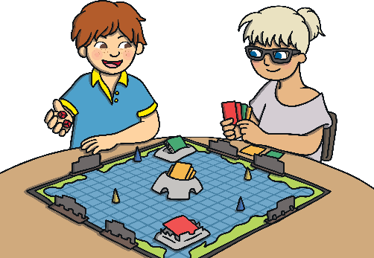
Reading Game Ideas
Playing simple reading games will help your child to see the relevance
of reading while having fun.
Play board games that include reading. Ask your child to read out the clues.
Notes:
Share some simple games and ideas that families can do together at home to inspire a culture of reading.

Slide 12

Reading Game Ideas
Playing simple reading games will help your child to see the relevance
of reading while having fun.
Ask your child to read menus, notices or posters when you are out and about.
Notes:
Share some simple games and ideas that families can do together at home to inspire a culture of reading.

Slide 13


Reading Game Ideas
Playing simple reading games will help your child to see the relevance
of reading while having fun.
What was the best thing about school today?
Hide notes with words or sentences on around the house.
Encourage your child to hunt for them and to read the notes that they find.
I love playing games.
Notes:
Share some simple games and ideas that families can do together at home to inspire a culture of reading.

Slide 14
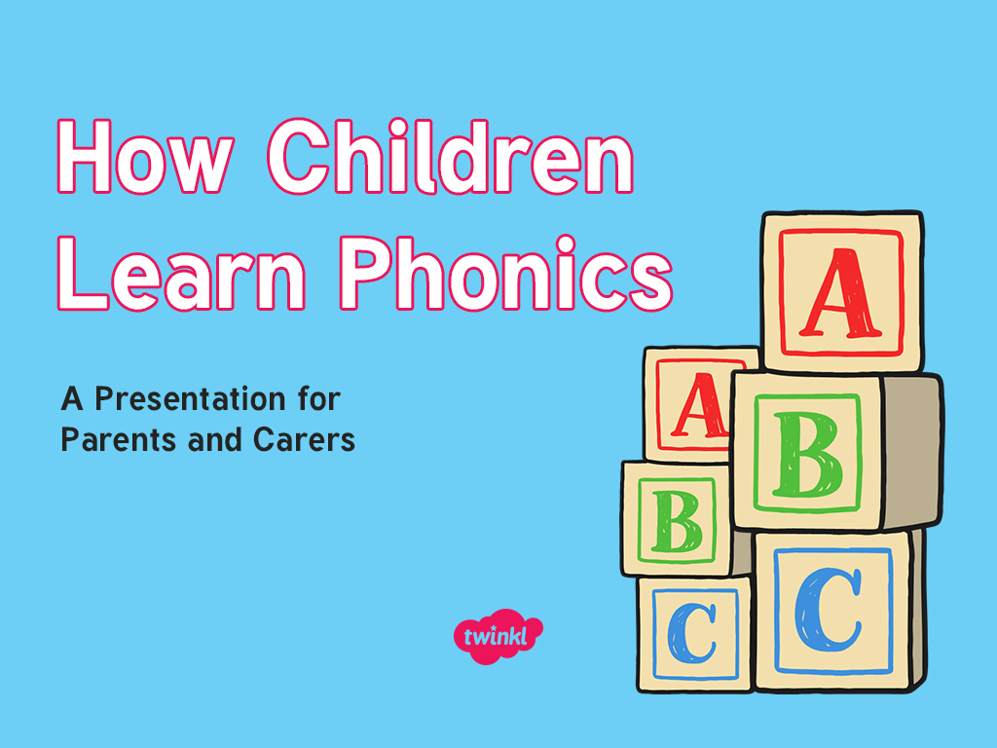

Slide 15

Did You Know…?
The English language has:
26 letters
X
Y
Z
44 sounds
over 100 ways to spell those sounds
It is one of the most complex languages to learn to read and spell.

Slide 16
The Jargon – A Quick Guide
phonics (also known as ‘synthetic phonics’) – The teaching of reading by developing awareness of the sounds in words and the corresponding letters used to represent those sounds.
phoneme - Any one of the 44 sounds which make up words in the English language.
grapheme – How a phoneme is written down. There can be more than one way to spell a phoneme. For example, the phoneme ‘ay’ is spelt differently in each of the words ‘way’, ‘make’, ‘fail’, ‘great’, ‘sleigh’ and ‘lady’.
blending – Putting together the sounds in a word in order to read it, e.g. ‘f – r – o – g, frog’
segmenting – Breaking a word into its constituent sounds in order to spell them, e.g. ‘frog, f – r – o – g’’
Notes:
It can be interesting to see how many ways there are to spell other sounds – try ‘igh’, ‘ee’ or ‘ow’.
A fun way to learn blending with young children is to talk to them in segmented words, for example ‘Please g – e – t’ the ‘m – i – l – k’ out of the ‘f – r – i – dge’.
When children begin to segment to spell they will often use the wrong spelling of phonemes, for example ‘I luv yoo’ or ‘Migh naym is…’. This is not a problem, as the key skill at this stage is that they can hear the sounds in the words and have a go at writing them down.

Slide 17
What Is Phonics?
Phonics is a method for teaching reading and writing.
It develops phonemic awareness – the ability to hear, recognise and use the sounds within words.
Learners are also taught the correspondence between sounds and the graphemes (spelling patterns) that represent them.
Phonics is currently the main way in which children in British primary schools are taught to read in their earliest years.
Children will also be taught other skills, such as whole-word recognition (see ‘tricky words’), book skills and a love and enjoyment of reading.
Notes:
Typically, children begin to develop the listening skills essential to phonics in their preschool years. Some children begin to learn letter sounds at preschool but most children will begin their main phonics learning once they start their reception year at primary school (age 4-5). This teaching continues through year 1 (age 5-6) and into year 2 (age 6-7) until the child is a confident and fluent reader.
Once children are fluent readers, the emphasis in reading teaching moves more towards comprehension and analysis skills.
Book skills include holding books correctly, turning pages right to left, recognising that print represents words, talking about pictures, retelling familiar stories, asking and answering questions about stories and non-fiction texts and treating books with respect.

Slide 18
Why Are Children Taught Phonics?
Phonics, taught in a structured way, is generally accepted to be the most effective way to teach reading and writing.
Children learn to hear and recognise sounds in words and spell them correctly.
This assists with their confidence, accuracy and fluency.
Phonics should not be taught in isolation — children also need to learn other reading and comprehension skills alongside phonic knowledge.

Slide 19
The Importance of Listening Skills
Phonics learning relies on children being able to hear and distinguish the sounds within words.
Children with poor listening and/or attention skills can struggle with phonics learning.
Listening skills begin at birth and there are lots of things that parents and carers can do to support these skills.
Children are also taught listening and attention skills during their early years education (age 0-5).
The first phase of formal phonics education (Phase 1) also focuses on key listening skills. Without these skills, children may struggle to master the next stage of their phonics learning.

Slide 20
Letters and Sounds
Letters and Sounds is a resource for the teaching of phonics which was issued by the Department for Education in 2007.
It remains the most common way to teach phonics in British primary schools.
It is divided into six sections, or phases, intended to begin in the preschool years and finish at the end of year 2 (age 7).

Slide 21
Phase Two
In Phase 2, children begin to learn some letter sounds and to match them to graphemes.
Most of the first sounds are single-letter sounds but there are also several digraphs, where one sound is represented by two letters, e.g. ‘ck’, ‘ll’, ‘ss’.
Children also begin to blend the sounds to make words. By the end of Phase 2, children will be able to read some ‘vowel-consonant’ (vc) and ‘consonant-vowel-consonant’ (cvc) words, e.g. up, in, cat, pin.
Five sets of letters are introduced – one set per week.
Children will also learn to read the ‘tricky’ words the, to, go, I, no, which cannot be read phonetically.
Notes:
Set 1: s, a, t, p
Set 2: i, n, m, d
Set 3: g, o, c, k
Set 4: ck, e, u, r
Set 5: h, b, f, ff, l, ll, ss
Phase 2 usually begins when children start their formal education in reception, though some preschools may also begin to teach letter sounds.

Slide 22

Teaching Phonics in School
Children are taught reading and spelling daily throughout the week, and each session will follow a structured format.
The activities used to teach will vary and can be adapted. They are multisensory and appeal to different learning styles. They involve games and individual and group activities as well as teacher-led sessions.
Teachers will assess children’s understanding throughout each session and will also assess knowledge of sounds to see whether a child is ready to move on to the next phase.
Notes:
Assessment at the end of a phase will usually involve asking children to name sounds to check that they know all of the Phase 2 sounds before they move on to Phase 3. Teachers may also assess ability to blend sounds to read words.

Slide 23
Phase Three
Phase 3 usually lasts around 12 weeks. Children are taught another 25 graphemes.
The final single-letter sounds are taught, together with more consonant digraphs (e.g. zz, qu) and several vowel digraphs (e.g. ai, ee, igh).
Children also continue to learn how to blend and segment CVC words using the new sounds, e.g. tail, sheet, night – note that these words still only have three sounds.
Children will then move on to blending and segmenting two-syllable words such as cooker, eating, broken.
Tricky words also continue to be taught.
Notes:
Set 6: j, v, w, x
Set 7: y, z, zz, qu
Consonant digraphs: ch, sh, th, ng
Vowel digraphs: ai, ee, igh, oa, oo, ar, or, ur, ow, oi, ear, air, ure, er

Slide 24
Phase Four
By Phase 4, children are able to represent each of 42 phonemes with a grapheme. Children will be able to read CVC words and begin to segment them to spell them.
Phase 4 is consolidation of children’s knowledge. Children also move on to blending and segmenting using adjacent consonants, e.g. st, sp, tr, br, spr, str in words such as string, blow, train.
Phonics teaching continues to be regular and structured and children play games to consolidate their learning.
Notes:
Set 6: j, v, w, x
Set 7: y, z, zz, qu
Consonant digraphs: ch, sh, th, ng
Vowel digraphs: ai, ee, igh, oa, oo, ar, or, ur, ow, oi, ear, air, ure, er

Slide 25



Yes or No?
Can a clock clap hands?
Can a spoon grab a fork?
Do trains run on tracks?

Slide 26
Phase Five
Children will broaden their knowledge of graphemes and phonemes.
They will learn alternative ways of spelling the phonemes they have already learnt.
They will learn strategies to help them choose the correct grapheme for spelling.
Children will be reading with more and more fluency, no longer needing to ‘sound out’ most familiar words.
Notes:
Children will be taught new graphemes and alternative graphemes for the sounds they already know. They will begin to learn to choose the appropriate grapheme when spelling. The children will be automatically decoding a large number of words for reading by this point.

Slide 27
The Year 1 Phonics Check
In June, all year 1 children are expected to complete the year 1 phonics screening check.
The aim is to check that a child is making progress in phonics. They are expected to read a mixture of real words and ‘nonsense’ words.
If a child has not reached the expected standard, schools must give additional support to help the child to make progress in year 2.
Notes:
Pupils who have achieved the expected standard at the end of year 1 will have experience of decoding all of the types of words that appear in the year 1 phonics screening check. They will know the correct grapheme to go with most sounds and be able to blend phonemes in words in the screening check.
‘Nonsense’ words or ‘alien’ words are designed to test pure phonic ability rather than knowledge of words. Examples might include ‘baf’, ‘gip’, ‘leet’, ‘stoof’.
For more information about the format of the phonics check, see Twinkl’s ‘Year 1 Phonics Screening Check’ Powerpoint.

Slide 28
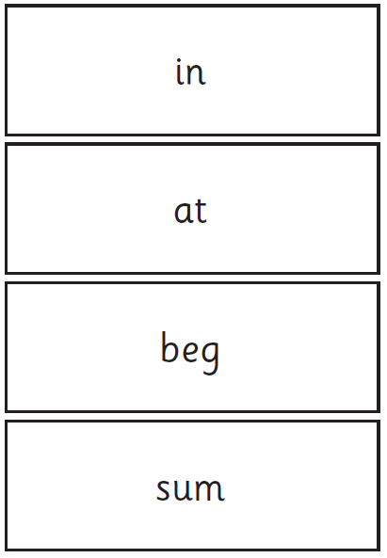
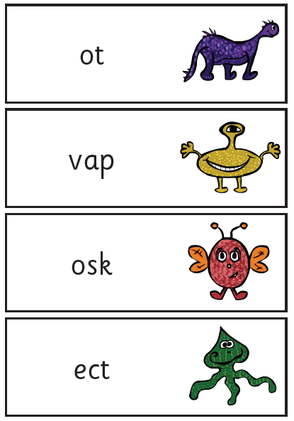
Examples of words:

Slide 29
Phase Six and Beyond
Phase 6 is mainly taught as children progress through year 2 (age 6-7).
Children are becoming fluent readers and more accurate spellers. They learn more spelling patterns such as the use of prefixes and suffixes, contracted forms of words (e.g. can’t, won’t) and other words in common usage such as days of the week.
At this stage, children can read hundreds of words automatically. They are now reading for pleasure and reading to learn rather than learning to read.
They can decode words quickly and silently and only need to sound out longer or more unfamiliar words.
Notes:
In Phase 6, children will be reading longer and less familiar texts independently and fluently. It is crucial that, at this point, children are now reading to learn and reading for pleasure.
Children should be able to read the 300 high-frequency words. At this point, it is important that comprehension strategies are developed so that children clarify meaning, ask and answer questions about the texts that they are reading, construct mental images during reading and summarise what they have read.
In spelling, children are introduced to the adding of suffixes and how to spell longer words. Throughout the phase, children are encouraged to develop strategies for learning spellings.

Slide 30
Helping Your Child at Home
Work on listening skills.
Practise segmenting and blending.
Look for familiar sounds and words in the world around you.
Support your child to complete homework.
Practise new sounds and graphemes.
Look for picture clues in the book
Use V.I.P.E.R.S questions when reading with your child
Read to and with your child every day.

Slide 31

Have you got any questions?

