Slide 1


Welcome to Year 5

Slide 2
Staff
Head Teacher - Mrs Casey
Deputy Head - Mr Collins
SENCO – Mr Barker
Upper Key Stage 2 Leader – Mrs Smith
Teachers – Mrs Smith and Miss Skarratt
PPA teachers – Mrs Neill (Y5S)
Mrs Bowers (Y5AS)

Slide 3
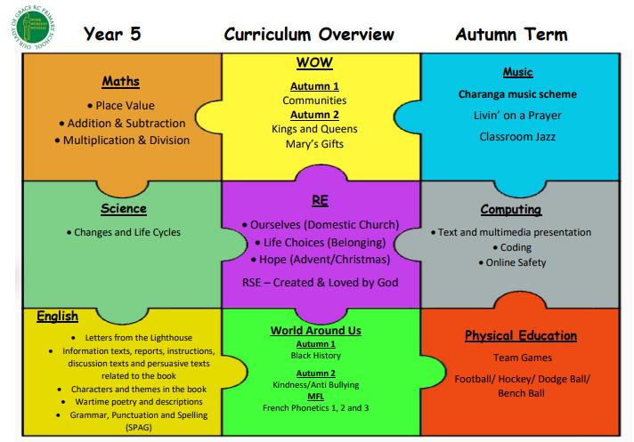
Subjects
*
It is essential that kits are in school each day. The tee-shirts should be in the child’s house colour. They can bring in warmer clothes in the winter and also trainers rather than pumps for outdoors.
*

Slide 4
Class Routines
Raffle tickets, Dojos or House Points are awarded for good behaviour in class, behaviour around the school and good work.
Group points
Star of the Week
Star Writer
WOW Certificates (from January)
Notes:
Warnings for small disruptive things
Class routines rewards/sanctions
After warnings
Final Loose some of playtime – limit rights!!!
Year group incident book for continual low level disruption or major incidents

Slide 5
Homework
Day | Subject | Due in
Monday
Tuesday | Spellings/ Maths/ English (5S) | The following Tuesday
Wednesday | Spellings/ Maths/ English (5AS) | The following Wednesday
Thursday
Friday
Daily homework
Reading Arithmetic Practice
Spellings (homework lists/Spelling Shed)
Times tables (TT Rock Stars/Purple Mash)

Slide 6
Ongoing skills to practise at home regularly
The spelling homework lists need constant reinforcement at regular intervals.
Daily reading whenever possible.
It is essential for pupils to continue to practice their number bonds to 10, 20, 100 and 1000.
Key Stage 2 children must continue to learn and practise their times tables.
All tables are expected to be known by the end of Year 4 but must regularly be consolidated in the following year groups.
All division facts are expected to be known by end of Year 6.
Arithmetic skills (from tests in class)

Slide 7
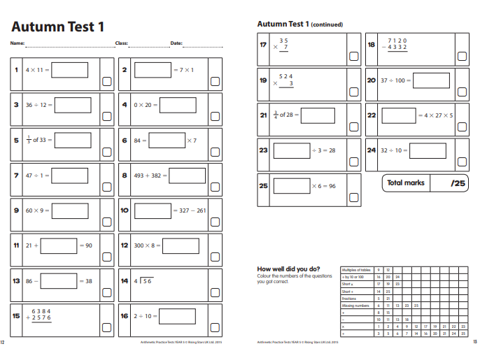

Slide 8
Parents’ Evening
Individual Parents’ Evenings will held twice a year. At these meetings you will be able to discuss your child’s progress.
We will inform you of the details when they become available.
If you feel you need to speak to your child’s teacher, please make an appointment via the school office .

Slide 9
Going Home
The children will be dismissed from the playground by their class teacher.
Please remind your child that if you (or whoever is picking them up) are running late, they must stay with their teacher.
If any children are left by 3:40pm, their teacher will take the child/children to the office and contact parents. Someone will stay with them until they are collected.
If there is a change in your child’s usual routine, please contact the school so that the office staff can get the message to us.

Slide 10

Thank you for attending. We look forward to working alongside you in educating your children in Year 5.
Any questions?
School website:
http://www.ourladyofgracercprimaryschool.co.uk/

