Slide 1


Welcome
Maths Evening 2025
This Power Point is available on the school website

Slide 2
Contents
Introduction
Gaus
Aids for counting, mental speed & confidence.
Number Lines
Number Bonds
Halving & Doubling
Addition & Subtraction
Multiplication & Division
Fractions & decimals.

Slide 3
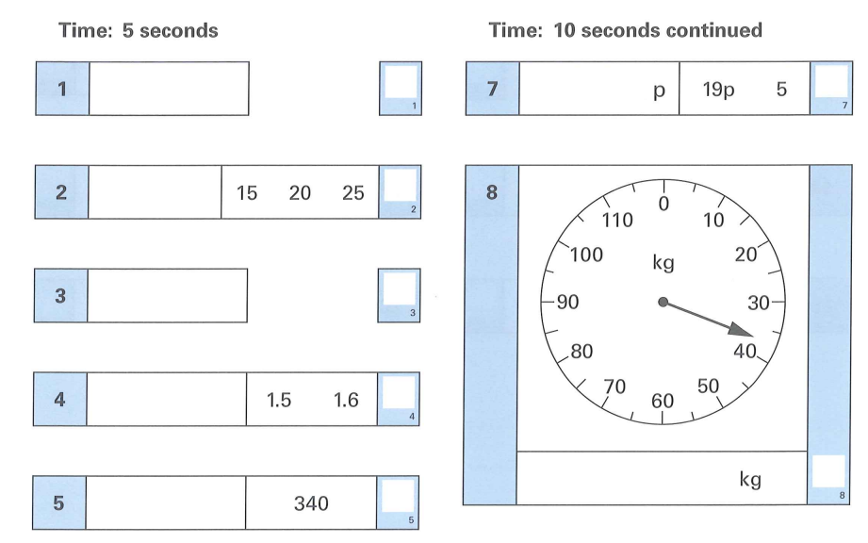
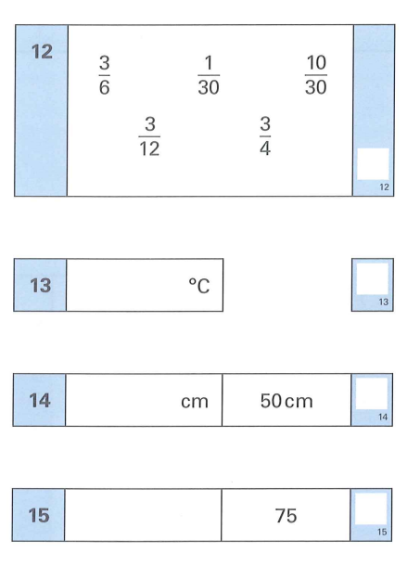
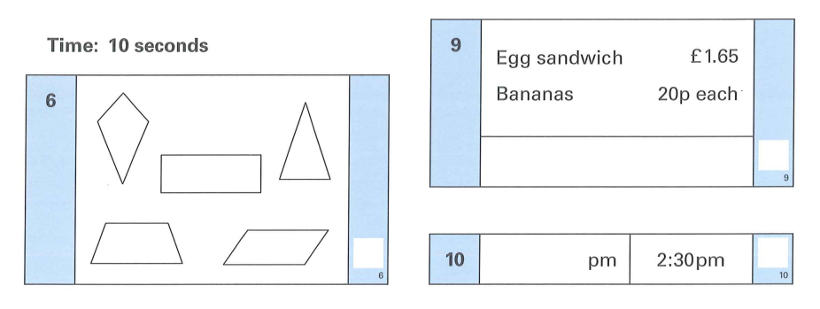
What we aim for at Primary School

Slide 4
00
Warm Up
0
7
00
18
25
0
7
0
0.25

Slide 5
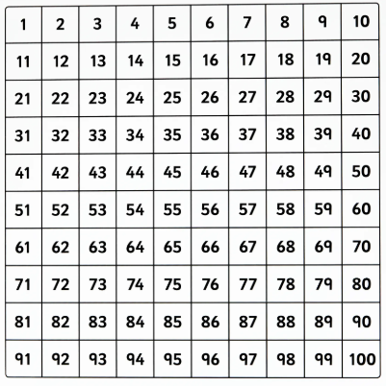
Warm Up
What do all the numbers of a 100 square add up to?

Slide 6
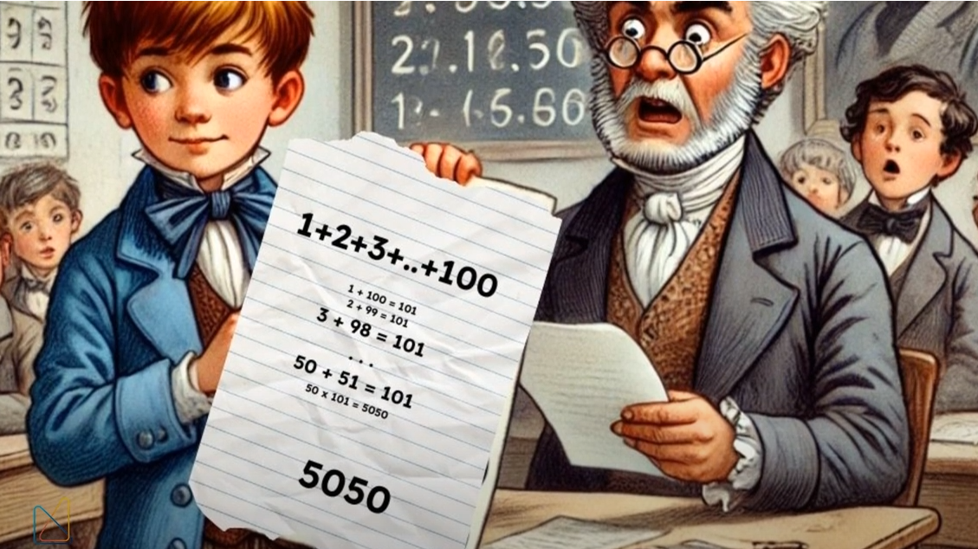
Carl Gaus in 1785

Slide 7
1. Children develop at different speeds & see numbers in different ways. We use key techniques & resources in school to help combat this.
To aid counting
Hundred Square
Number Line
Counters
Rounding
To aid mental speed/confidence
Number Bonds
Maths Facts e.g. square numbers (inc. songs)
Doubling & Halving
Making 100

Slide 8
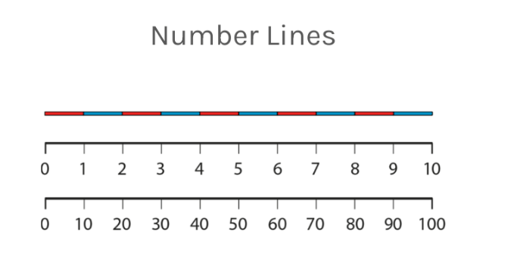

Slide 9
Number Bonds – Key Understanding required to keep up
To make 10 = 5+5 6+4 7+3 8+2 9+1
Calculate 58 + 7 = ?
How did you really work this out?

Slide 10
Number bonds to 7
3+4
6+1
5+2
Children ‘good’ at maths see these quickly

Slide 11
Easy ways to practice at home!
1. Double
23, 47, 3.6, 98 etc
2. Half
50, 250, 3.6, 98 etc
3. Make me 100
23, 47, 62, 79 etc

Slide 12

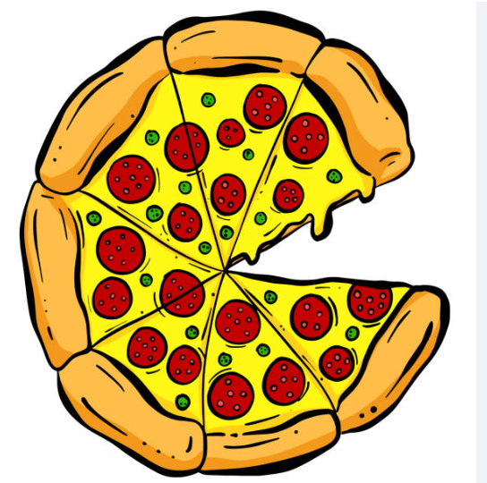
Fractions, Decimals & Association
Money – Children love it. Think Decimals Think Money.
1 divided by 4?
Pizza – Children love it. Think Fractions Think Pizza.
½ + ½ + ¼ =

Slide 13
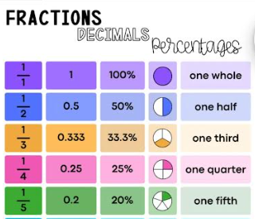
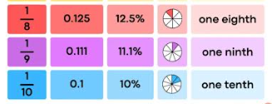

Slide 14
BBC Bitesize Addition & Subtraction
Add
https://www.bbc.co.uk/bitesize/articles/z3kmrwx#z4qpb7h
Subtract
https://www.bbc.co.uk/bitesize/articles/zc78srd#zv8xfdm

Slide 15
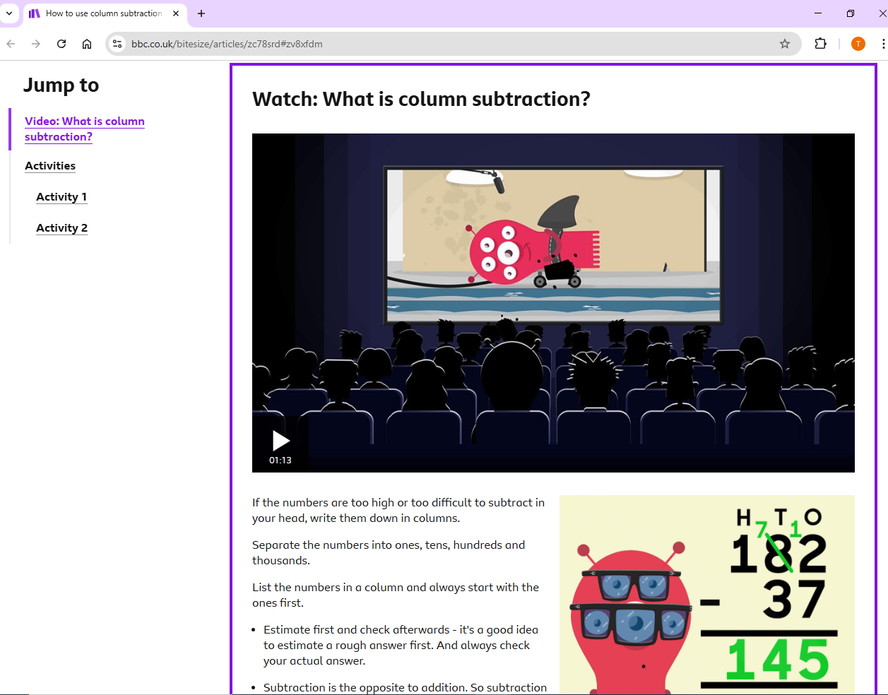

Slide 16
BBC Bitesize Multiplication & Division
Division
https://www.bbc.co.uk/bitesize/articles/zmcpscw#zct97v4
Multiplication
https://www.bbc.co.uk/bitesize/topics/z36tyrd/articles/z4chnrd

Slide 17
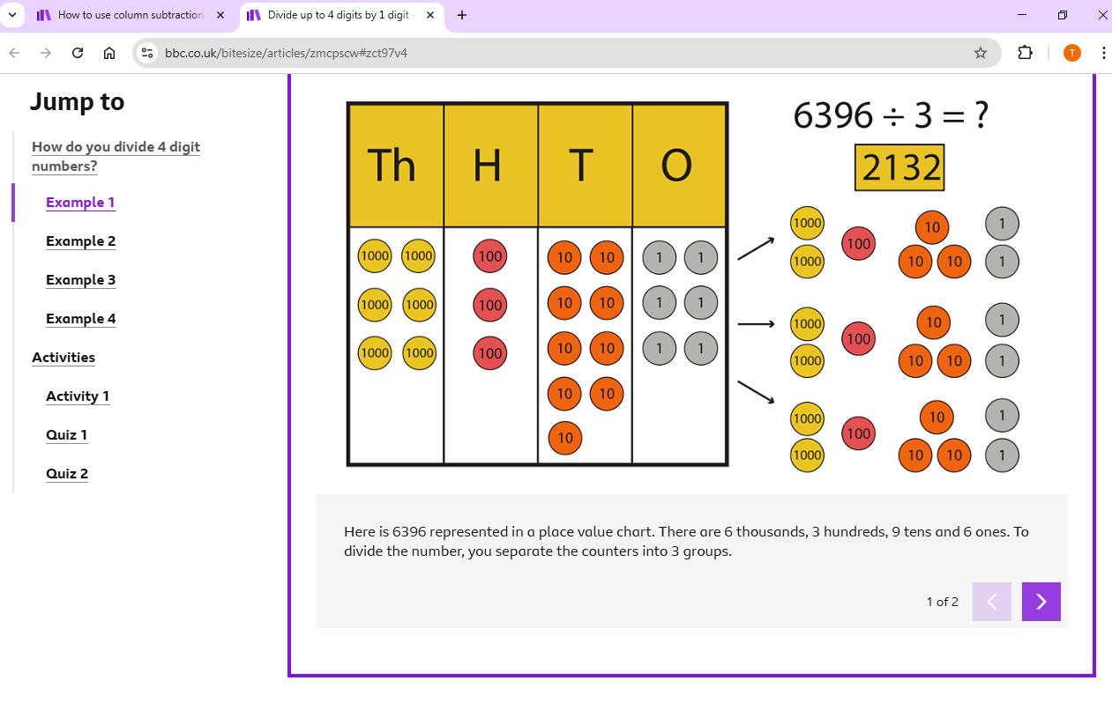

Slide 18
Workshops!
Please join some of our Y5 & Y6 children as they demonstrate some of the different written methods of calculation they use at school.

Slide 19
