Slide 1
Key Stage 2 SATs
Standard Assessment Tests

Slide 2
Scaled Scores
What is meant by ‘scaled scores’?
It is planned that 100 will always represent the ‘national standard’.
Each pupil’s raw test score will therefore be converted into a score on the scale, either at, above or below 100.
The scale will have a lower end point somewhere below 100 and an upper end point above 100.
A child who achieves the ‘national standard’ (a score of 100) will be judged to have demonstrated sufficient knowledge in the areas assessed by the tests.
In July 2016 for the first publication of test results, each pupil will receive:
A raw score (number of raw marks awarded).
A scaled score in each tested subject.
Confirmation of whether or not they attained the national standard.
What is meant by ‘scaled scores’?
100 will always represent the ‘national standard’.
Each pupil’s raw test score will therefore be converted into a score on the scale, either at, above or below 100.
The scale will have a lower end point somewhere below 100 and an upper end point above 100.
A child who achieves the ‘national standard’ (a score of 100) will be judged to have demonstrated sufficient knowledge in the areas assessed by the tests.
Each pupil will receive:
A raw score (number of raw marks awarded).
A scaled score in each tested subject.
Confirmation of whether or not they attained the national standard. (AS)

Slide 3
Scaled Score Examples
On publication of the test results in July 2016:
A child awarded a scaled score of 100 is judged to have met the ‘national standard’ in the area judged by the test.
A child awarded a scaled score of more than 100 is judged to have exceeded the national standard and demonstrated a higher than expected knowledge of the curriculum for their age.
A child awarded a scaled score of less than 100 is judged to have not yet met the national standard and performed below expectation for their age.
A child awarded a scaled score of 100-109 was judged to have met the ‘national standard’ in the area judged by the test.
This is called working at the expected standard.’
A child awarded a scaled score of more than 110 was judged to have exceeded the national standard and demonstrated a higher than expected knowledge of the curriculum for their age.
This is called ‘greater depth’.
A child awarded a scaled score of less than 100 was judged to have not yet met the national standard
This is called ‘working below the expected standard.
https://www.gov.uk/government/uploads/system/uploads/attachment_data/file/534106/2016_KS2_scaled_scores.pdf

Slide 4
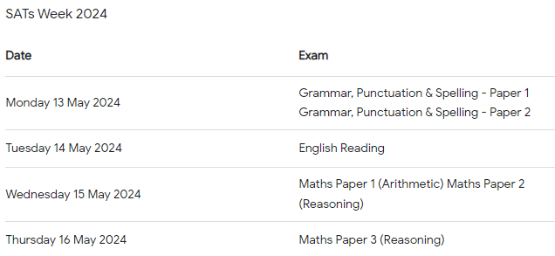
The Tests
Key Stage 2 SATs take place nationally in the week commencing 9th -12th May 2023
Statutory tests will be administered in the following subjects:
Punctuation , Vocabulary and Grammar ( 45 mins) and Spelling ( 20mins) Tuesday 9th May
Reading ( 60 mins) Wednesday 10th May
Mathematics
- Paper 1: Arithmetic (30 minutes)
- Paper 2: Reasoning (40 minutes) both on Thursday 11th May
- Paper 3: Reasoning (40 minutes) Friday 12th May
All tests are externally marked.
Writing will be ‘Teacher Assessed’ internally, as in all primary schools.
Key Stage 2 SATs take place nationally in the week commencing 9th May 2016.
Statutory tests will be administered in the following subjects:
Reading (60 minutes)
Spelling (approximately 15 minutes)
Punctuation, Vocabulary and Grammar (45 minutes)
Mathematics
- Paper 1: Arithmetic (30 minutes)
- Paper 2: Reasoning (40 minutes)
- Paper 3: Reasoning (40 minutes)
In addition, some schools will be required to take part in Science testing, consisting of three tests in Biology, Physics and Chemistry. Not all schools will take part in this sampling, which takes place on a later date.
All tests are externally marked.
Writing will be ‘Teacher Assessed’ internally, as in recent years.

Slide 5
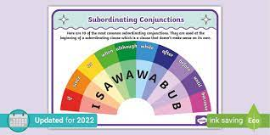
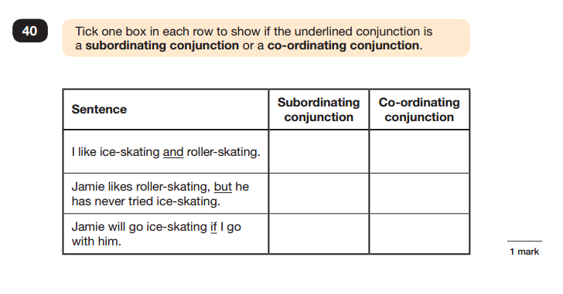
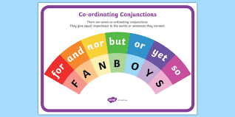
Sample Questions
Grammar, Punctuation and Spelling Paper 1

Slide 6
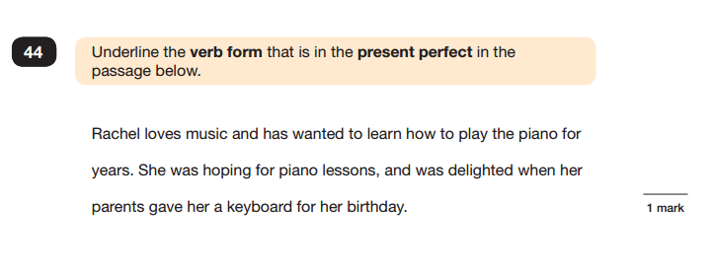
Sample Questions
Grammar, Punctuation and Spelling Paper 1
The present perfect tense is an English verb tense used for past actions that are related to or continue into the present. It’s easily recognized by the auxiliary verbs (or helper verbs) have and has, as in, “I have gone fishing since I was a child.”
This links to the SPAG work we complete weekly

Slide 7
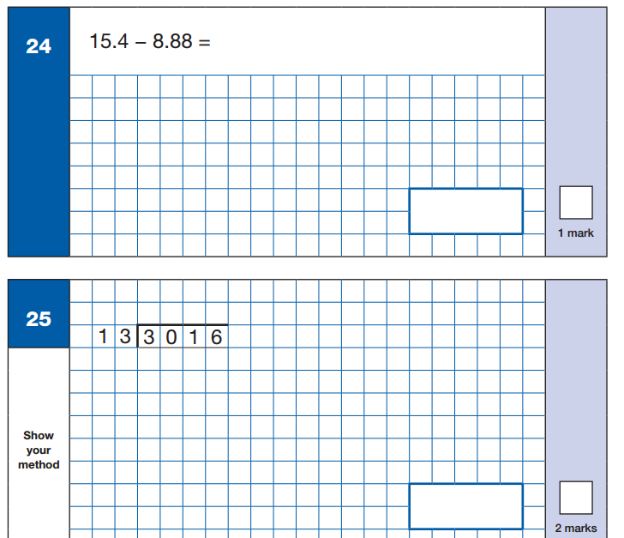
Sample Questions
Maths Paper 1: Arithmetic
This test is out of 40 and is the one where you can really pick up marks. Children should aim for full marks (this is achievable for all)

Slide 8
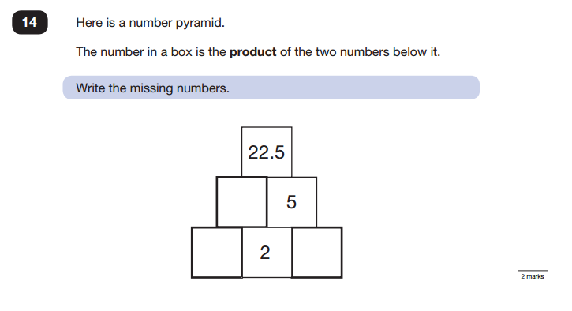
Sample Questions
Maths Paper 2 / Paper 3 : Reasoning
This links to the Ninja homework we have been sending home and the Maths practise we do daily

Slide 9
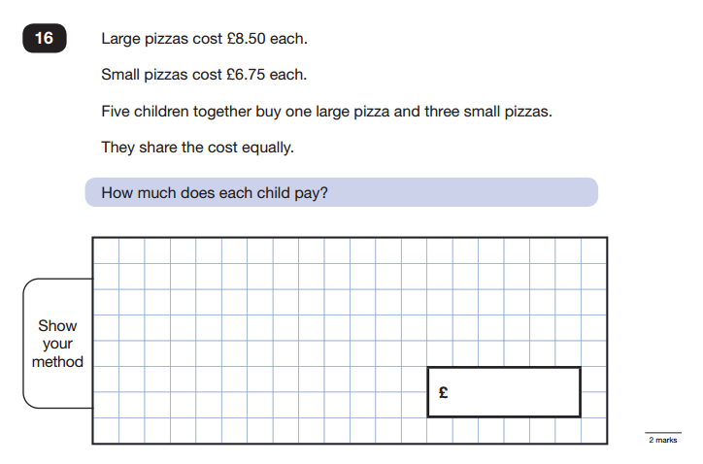
Sample Questions
Maths Paper 2 / Paper 3 : Reasoning
We do weekly maths test which helps with these types of questions.

Slide 10
How to Help Your Child
First and foremost, support and reassure your child that there is nothing to worry about and they should always just try their best. Praise and encourage!
Ensure your child has the best possible attendance at school
Support your child with any homework tasks.
Reading, spelling and arithmetic (e.g. times tables) are always good to practise.
Talk to your child about what they have learnt at school and what book(s) they are reading (the character, the plot, their opinion).
Make sure your child has a good sleep and healthy breakfast every morning!
First and foremost, support and reassure your child that there is nothing to worry about and they should always just try their best. Praise and encourage!
Ensure your child has the best possible attendance at school.
Support your child with any homework tasks.
Reading, spelling and arithmetic (e.g. times tables) are always good to practise.
Talk to your child about what they have learnt at school and what book(s) they are reading (the character, the plot, their opinion).
Make sure your child has a good sleep and healthy breakfast every morning!
After half term we will be running additional sessions before school and at lunchtime. Please encourage your child to attend if they are invited.
Any extra work at home will have massive benefit. 30 mins a day is achievable
TTRS, Spelling Shed, Reading, SPAG Boosters.
Please visit the Y6 class pages for even more resources & links.

Slide 11
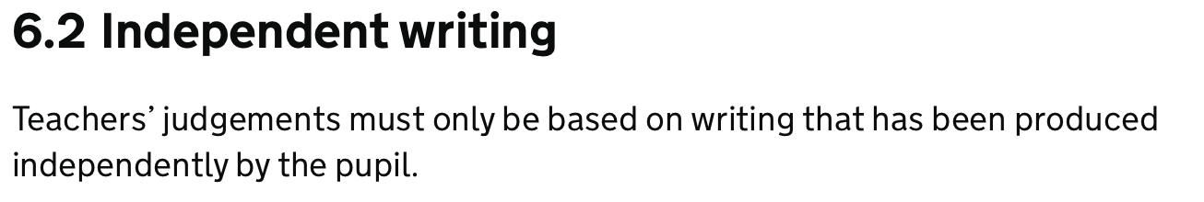
Writing Assessment.
Children’s writing is assessed within school and then moderated by Bury.
Children are assessed using TA Framework (I can statements)
A child will receive Working Towards, Expected or Greater Depth – just like the exam papers.
A child must meet all the standards at one level to be able to reach the next.
Some examples of what is expected are on your desk.
https://www.gov.uk/government/publications/2018-teacher-assessment-exemplification-ks2-english-writing
https://www.gov.uk/government/publications/key-stage-2-teacher-assessment-guidance/key-stage-2-teacher-assessment-guidance
Work assessed also has to be independent – children are support through the process but to be used as evidence it has to be with little teacher aid.

Slide 12
Thank You and Any Questions?
At Parents Evening, have a look at your child’s writing latest scores to see where they are at.
We will send home the last assessments with areas to focus.
We are three months away so do not panic the mocks are used as guidance for us.
SATs are only a snapshot of who they are, we all know the children are so much more.

